Slide 1
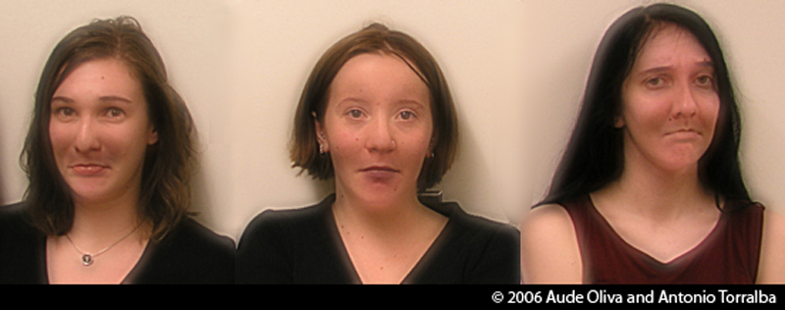
Lecture 1: Images and image filtering
CS5670: Intro to Computer Vision
Noah Snavely
Hybrid Images, Oliva et al., http://olivalab.mit.edu/hybridimage.htm
Notes:
What expression are these people wearing?

Slide 2
Lecture 1: Images and image filtering
CS5670: Intro to Computer Vision
Noah Snavely
Hybrid Images, Oliva et al., http://olivalab.mit.edu/hybridimage.htm
Notes:
Now what expression?

Slide 3
Reading
Szeliski, Chapter 3.1-3.3

Slide 4

What is an image?
Notes:
First, we should talk about what an image is.

Slide 5
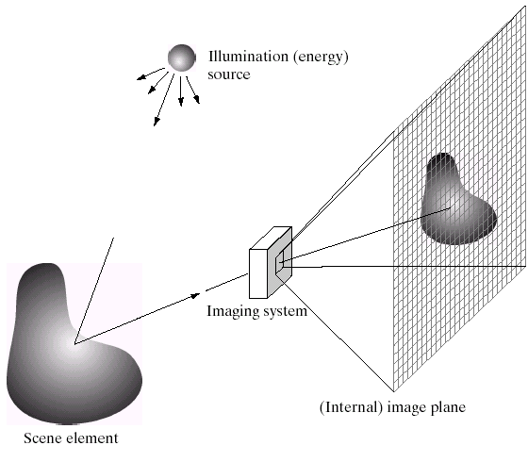
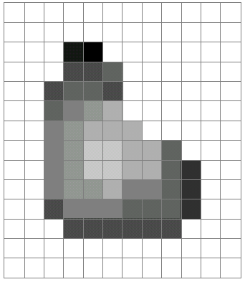
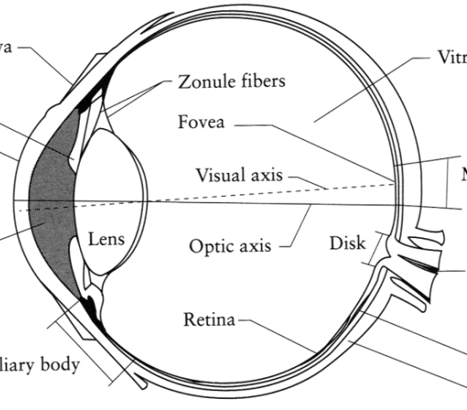
What is an image?
Digital Camera
We’ll focus on these in this class
(More on this process later)
The Eye
Source: A. Efros
Notes:
One way to think of an image is as a record of a set of light rays that bounce through space and hit a piece of light-sensitive film or a digital sensor.
Another way is to think of an image as just a grid of pixel values.
Another way is to think of an image as a response of our retinas to a light stimulus. In this class, we’ll focus on digital images. Later, we’ll come back to talk about how images are formed via the transmission of light through a scene.
هناك طريقة واحدة للتفكير في الصورة وهي تسجيل مجموعة من أشعة الضوء التي ترتد عبر الفضاء وتصطدم بقطعة من الفيلم الحساس للضوء أو مستشعر رقمي.
وهناك طريقة أخرى وهي التفكير في الصورة على أنها مجرد شبكة من قيم البكسل.
وهناك طريقة أخرى وهي التفكير في الصورة على أنها استجابة لشبكية العين لمحفز ضوئي. في هذه الدورة، سنركز على الصور الرقمية
. وسنعود لاحقًا للحديث عن كيفية تكوين الصور من خلال انتقال الضوء عبر مشهد ما.

Slide 6
What is an image?
A grid (matrix) of intensity values
(common to use one byte per value: 0 = black, 255 = white)
255 | 255 | 255 | 255 | 255 | 255 | 255 | 255 | 255 | 255 | 255 | 255
255 | 255 | 255 | 255 | 255 | 255 | 255 | 255 | 255 | 255 | 255 | 255
255 | 255 | 255 | 20 | 0 | 255 | 255 | 255 | 255 | 255 | 255 | 255
255 | 255 | 255 | 75 | 75 | 75 | 255 | 255 | 255 | 255 | 255 | 255
255 | 255 | 75 | 95 | 95 | 75 | 255 | 255 | 255 | 255 | 255 | 255
255 | 255 | 96 | 127 | 145 | 175 | 255 | 255 | 255 | 255 | 255 | 255
255 | 255 | 127 | 145 | 175 | 175 | 175 | 255 | 255 | 255 | 255 | 255
255 | 255 | 127 | 145 | 200 | 200 | 175 | 175 | 95 | 255 | 255 | 255
255 | 255 | 127 | 145 | 200 | 200 | 175 | 175 | 95 | 47 | 255 | 255
255 | 255 | 127 | 145 | 145 | 175 | 127 | 127 | 95 | 47 | 255 | 255
255 | 255 | 74 | 127 | 127 | 127 | 95 | 95 | 95 | 47 | 255 | 255
255 | 255 | 255 | 74 | 74 | 74 | 74 | 74 | 74 | 255 | 255 | 255
255 | 255 | 255 | 255 | 255 | 255 | 255 | 255 | 255 | 255 | 255 | 255
255 | 255 | 255 | 255 | 255 | 255 | 255 | 255 | 255 | 255 | 255 | 255
=

Slide 7
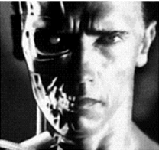
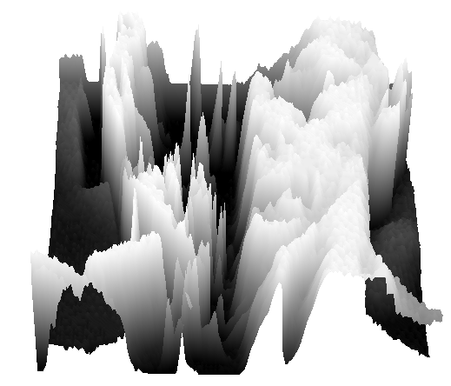
What is an image?
Can think of a (grayscale) image as a function f from R² to R:
  f (x,y) gives the intensity at position (x,y)
  A digital image is a discrete (sampled, quantized) version of this function
f (x, y)
x
y
snoop
3D view
Notes:
[Instructors note.] Here I show two demos.
One is “snoop” (https://www.csie.ntu.edu.tw/~cyy/projects/snoop/index.html), which is a Windows utility for zooming into the screen and showing the pixel values as numbers. So you can see brighter pixels have values close to 255, and darker pixels have values closer to 0. (Probably there exists some similar tool for Mac.)
The second demo is using Meshlab to open up a mesh that I’ve created to replicate an image, but where the “z” axis corresponds to intensity – really, just a visualization of the image as a function z = f(x,y). That mesh is here:
https://drive.google.com/open?id=1uJXcpQcWgRYlorrH_ctYn-yncEDvcxwV
If you look at it “head-on” it looks like the image of T100 above. If you move the viewpoint to the side, you see the image turn into hills and valleys. Bright regions are plateaus, dark regions are valleys, and “cliffs” represent edges in the image
[ملاحظة المدرب.] هنا أعرض عرضين توضيحيين.
العرض الأول هو "snoop" (https://www.csie.ntu.edu.tw/~cyy/projects/snoop/index.html)، وهو أداة مساعدة لنظام التشغيل Windows لتكبير الشاشة وإظهار قيم البكسل كأرقام. لذا يمكنك رؤية أن قيم البكسل الأكثر سطوعًا تقترب من 255، وأن قيم البكسل الأكثر قتامة تقترب من 0. (ربما توجد أداة مماثلة لنظام التشغيل Mac.)
العرض التوضيحي الثاني يستخدم Meshlab لفتح شبكة أنشأتها لتكرار صورة، ولكن حيث يتوافق المحور "z" مع الكثافة - في الحقيقة، مجرد تصور للصورة كدالة z = f(x,y). هذه الشبكة موجودة هنا:
https://drive.google.com/open?id=1uJXcpQcWgRYlorrH_ctYn-yncEDvcxwV
إذا نظرت إليها "بشكل مباشر"، فستبدو مثل صورة T100 أعلاه. إذا حركت وجهة النظر إلى الجانب، فسترى الصورة تتحول إلى تلال ووديان. المناطق المضيئة هي هضاب، والمناطق المظلمة هي وديان، و"المنحدرات" تمثل حواف الصورة..

Slide 8
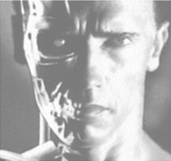
Image transformations
As with any function, we can apply operators to an image
Today we’ll talk about a special kind of operator, convolution (linear filtering)
  g (x,y) = f (x,y) + 20
  g (x,y) = f (-x,y)

Slide 9
Filters
Filtering
  Form a new image whose pixel values are a combination of the original pixel values
Why?
  To get useful information from images
    E.g., extract edges or contours (to understand shape)
  To enhance the image
    E.g., to remove noise
    E.g., to sharpen and “enhance image” a la CSI
  A key operator in Convolutional Neural Networks

Slide 10
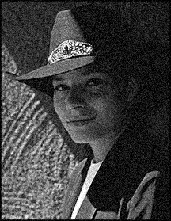
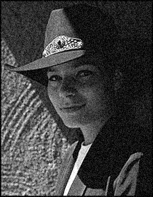

Question: Noise reduction
Given a camera and a still scene, how can you reduce noise?
Take lots of images and average them!
What’s the next best thing?
Source: S. Seitz
Notes:
Answer: take lots of images, average them

Slide 11
Image filtering
Modify the pixels in an image based on some function of a local neighborhood of each pixel
10
5
3
Some function
4
5
1
7
1
1
7
Local image data
Modified image data
Source: L. Zhang

Slide 12
Linear filtering
One simple version of filtering: linear filtering (cross-correlation, convolution)
  Replace each pixel by a linear combination (a weighted sum) of its neighbors
The prescription for the linear combination is called the “kernel” (or “mask”, “filter”)
10
5
3
0
0
0
4
6
1
0
0.5
0
8
1
1
8
0
1
0.5
Local image data
kernel
Modified image data
Source: L. Zhang

Slide 13



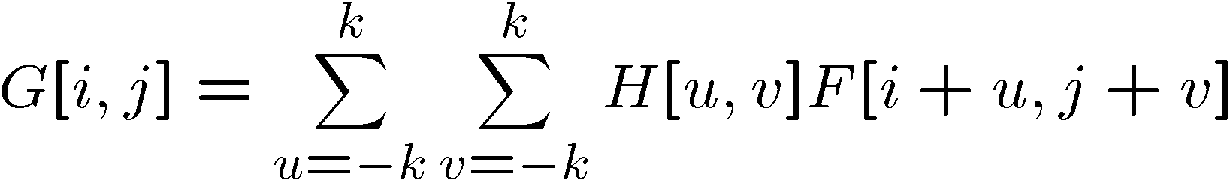

Cross-correlation
Let be the image, be the kernel (of size 2k+1 x 2k+1), and be the output image
Can think of as a “dot product” between local neighborhood and kernel for each pixel
This is called a cross-correlation operation:

Slide 14
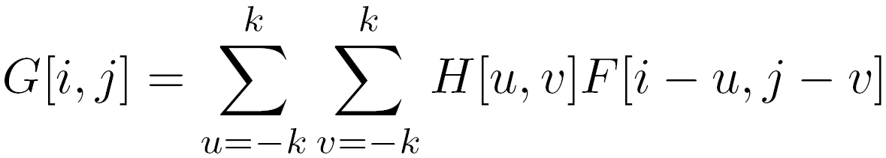

Convolution
Same as cross-correlation, except that the kernel is “flipped” (horizontally and vertically)
Convolution is commutative and associative
This is called a convolution operation:
Notes:
يُطلق على هذه العملية اسم عملية الالتفاف:
الالتفاف هو تبادلي وترابطي

Slide 15



Convolution
Adapted from F. Durand

Slide 16

Mean filtering
0 | 0 | 0 | 0 | 0 | 0 | 0 | 0 | 0 | 0
0 | 0 | 0 | 0 | 0 | 0 | 0 | 0 | 0 | 0
0 | 0 | 0 | 90 | 90 | 90 | 90 | 90 | 0 | 0
0 | 0 | 0 | 90 | 90 | 90 | 90 | 90 | 0 | 0
0 | 0 | 0 | 90 | 90 | 90 | 90 | 90 | 0 | 0
0 | 0 | 0 | 90 | 0 | 90 | 90 | 90 | 0 | 0
0 | 0 | 0 | 90 | 90 | 90 | 90 | 90 | 0 | 0
0 | 0 | 0 | 0 | 0 | 0 | 0 | 0 | 0 | 0
0 | 0 | 90 | 0 | 0 | 0 | 0 | 0 | 0 | 0
0 | 0 | 0 | 0 | 0 | 0 | 0 | 0 | 0 | 0
 | 0 | 10 | 20 | 30 | 30 | 30 | 20 | 10
 | 0 | 20 | 40 | 60 | 60 | 60 | 40 | 20
 | 0 | 30 | 60 | 90 | 90 | 90 | 60 | 30
 | 0 | 30 | 50 | 80 | 80 | 90 | 60 | 30
 | 0 | 30 | 50 | 80 | 80 | 90 | 60 | 30
 | 0 | 20 | 30 | 50 | 50 | 60 | 40 | 20
 | 10 | 20 | 30 | 30 | 30 | 30 | 20 | 10
 | 10 | 10 | 10 | 0 | 0 | 0 | 0 | 0
*
=
1 | 1 | 1
1 | 1 | 1
1 | 1 | 1

Slide 17
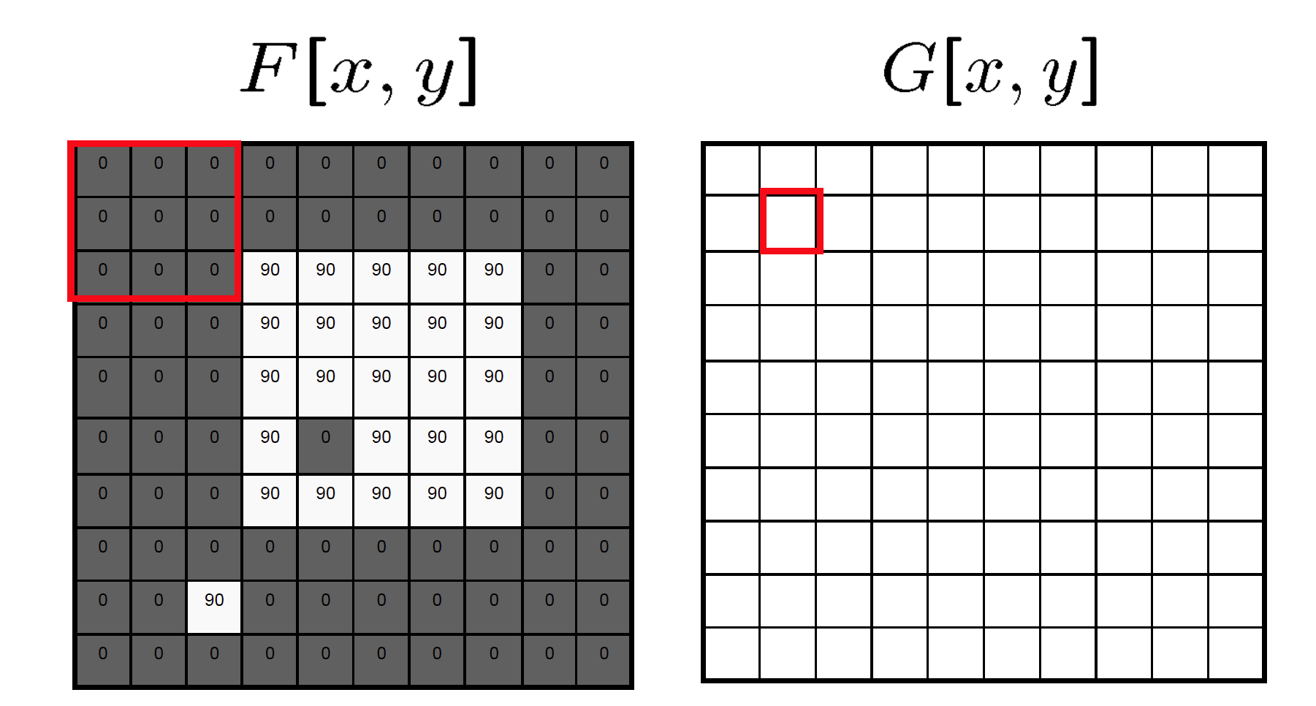
Mean filtering/Moving average

Slide 18
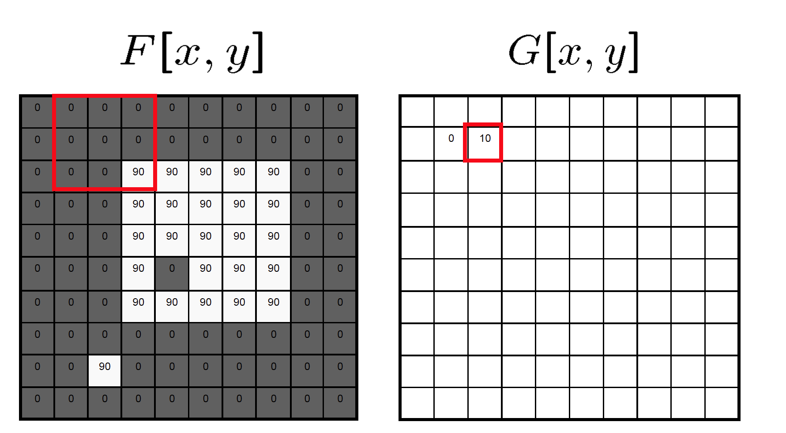
Mean filtering/Moving average

Slide 19

Mean filtering/Moving average

Slide 20
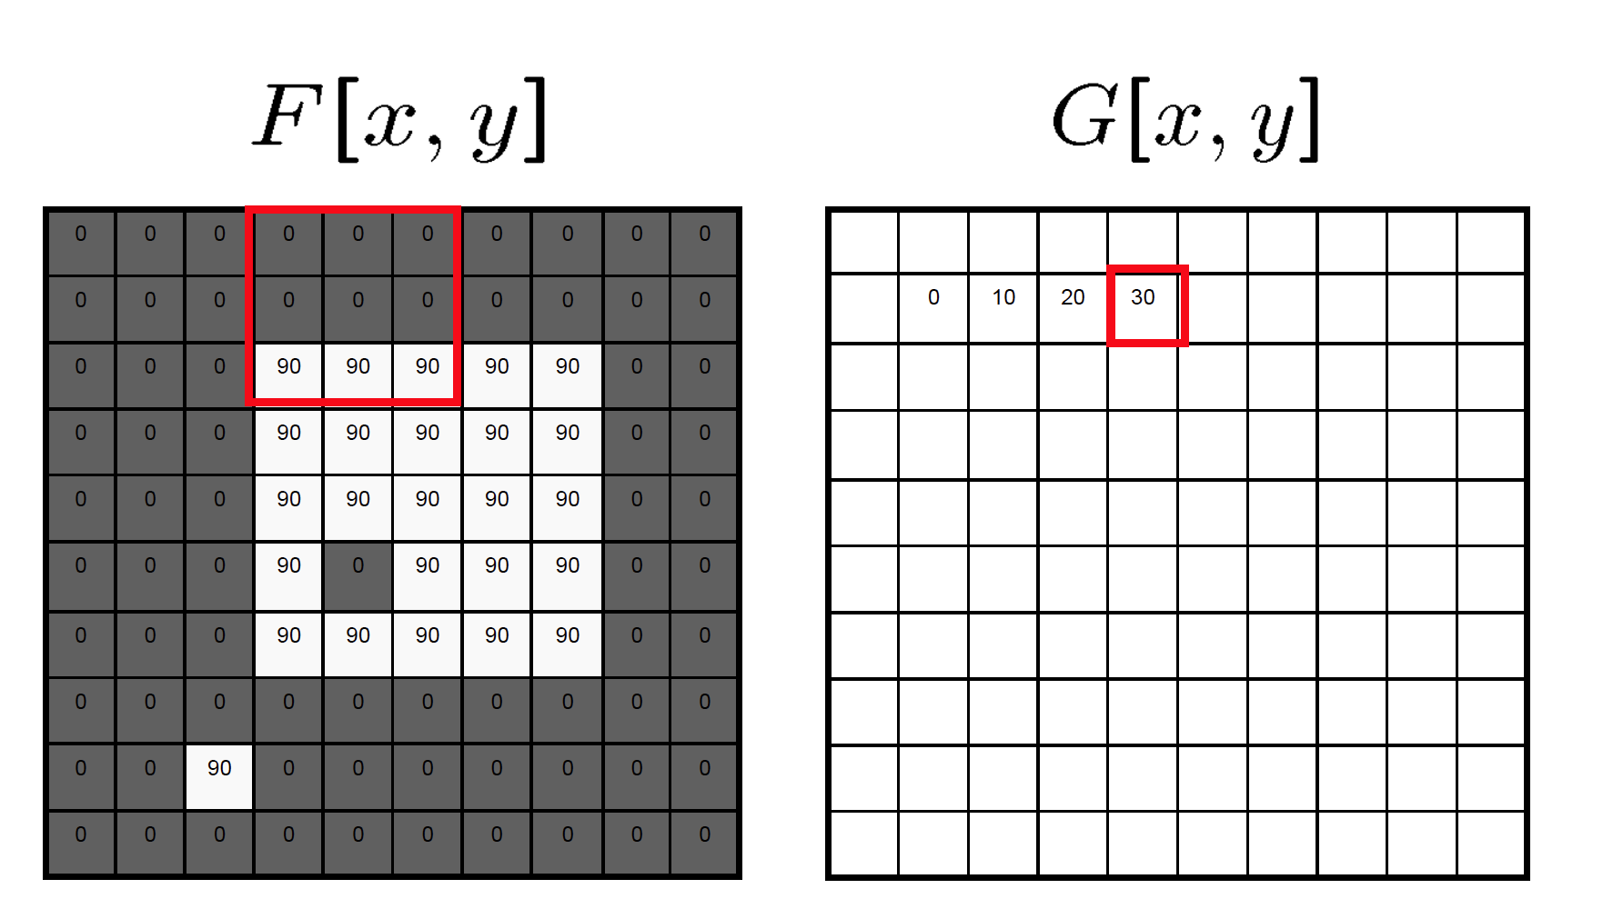
Mean filtering/Moving average

Slide 21
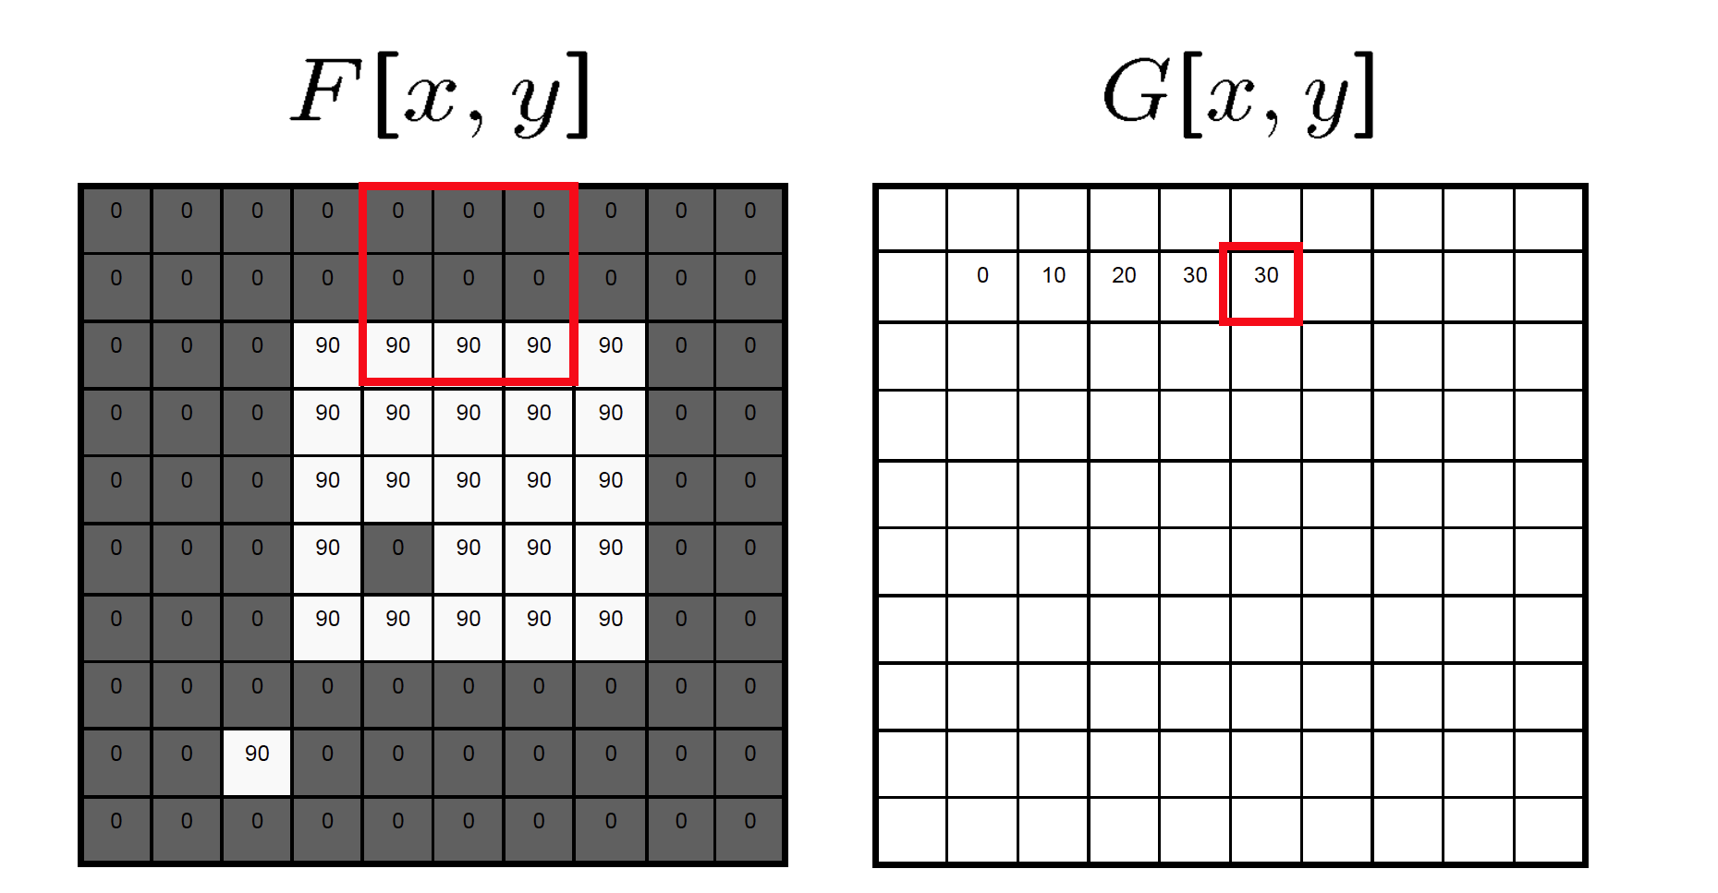
Mean filtering/Moving average

Slide 22
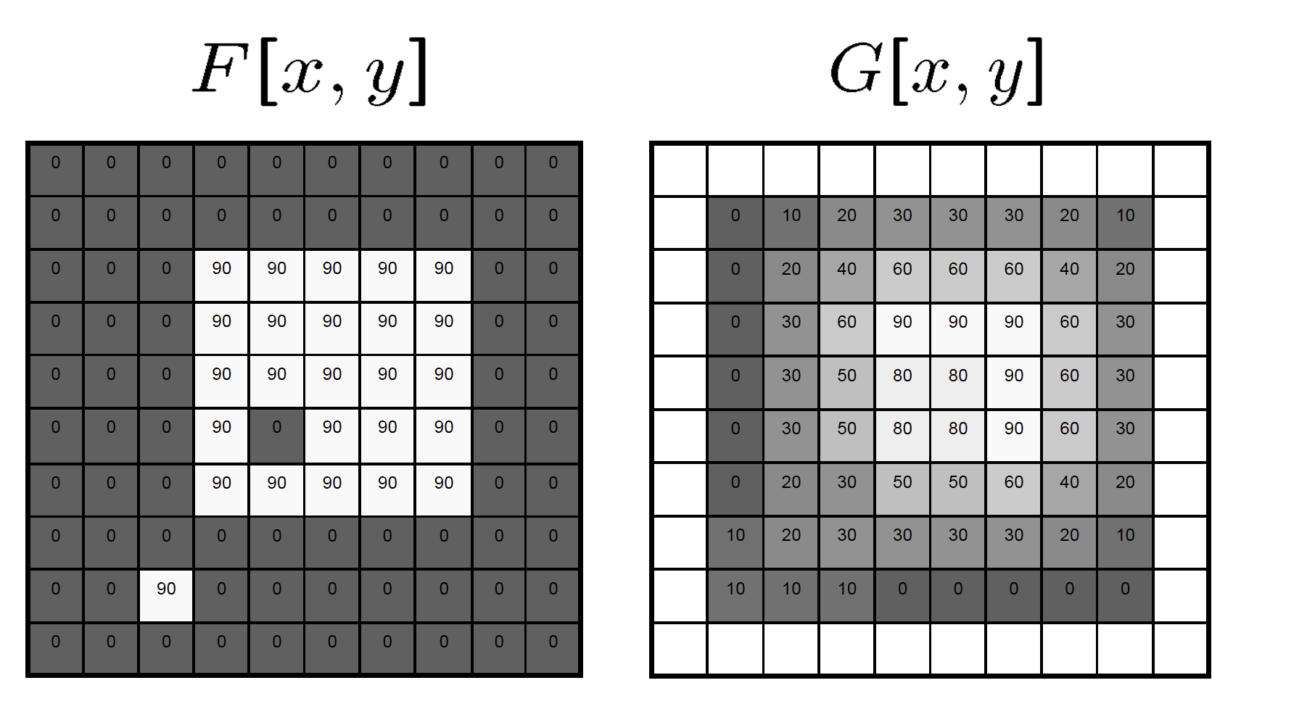
Mean filtering/Moving average

Slide 23
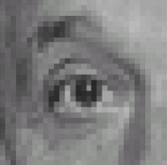
Linear filters: examples
*
0
0
0
0
1
0
0
0
0
Original
Source: D. Lowe

Slide 24


What image operation does filtering with this kernel perform?
([0 0 0; 0 1 0; 0 0 0])
ⓘ Start presenting to display the poll results on this slide.

Slide 25
Linear filters: examples
*
0
0
0
=
0
1
0
0
0
0
Original
Identical image
Source: D. Lowe

Slide 26
Linear filters: examples
*
0
0
0
1
0
0
0
0
0
Original
Source: D. Lowe

Slide 27
What image operation does filtering with this kernel perform? ([0 0 0; 1 0 0; 0 0 0])
ⓘ Start presenting to display the poll results on this slide.

Slide 28
Linear filters: examples
*
0
0
0
=
1
0
0
0
0
0
Original
Shifted left by 1 pixel
Source: D. Lowe

Slide 29
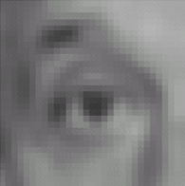

Linear filters: examples
*
1
1
1
=
1
1
1
1
1
1
Original
Blur (with a mean filter)
Source: D. Lowe

Slide 30
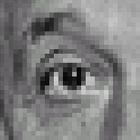



Linear filters: examples
*
0
0
0
-
1
1
1
=
0
2
0
1
1
1
0
0
0
1
1
1
Sharpening filter (accentuates edges)
Original
Source: D. Lowe

Slide 31
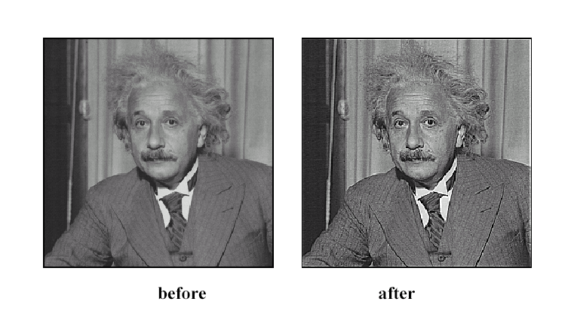
Sharpening
Source: D. Lowe

Slide 32
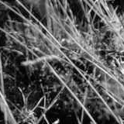
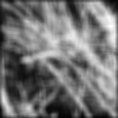
Smoothing with box filter revisited
Source: D. Forsyth
Notes:
I always walk through the argument on the left rather carefully; it gives some insight into the
significance of impulse responses or point spread functions.

Slide 33
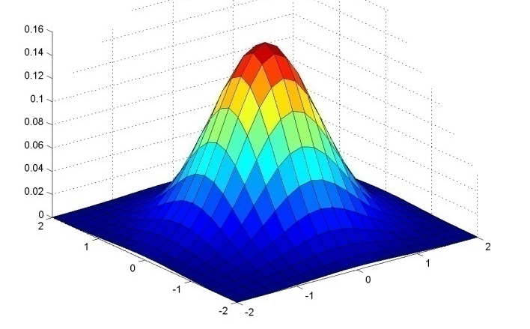
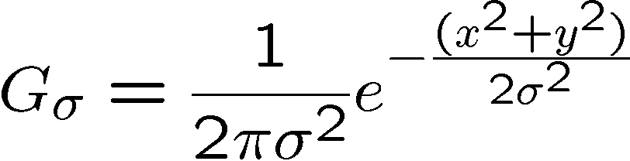
Gaussian kernel
Source: C. Rasmussen

Slide 34
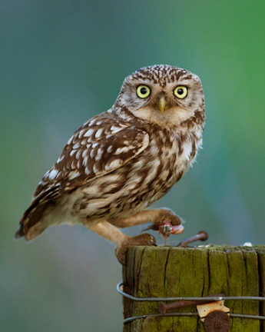
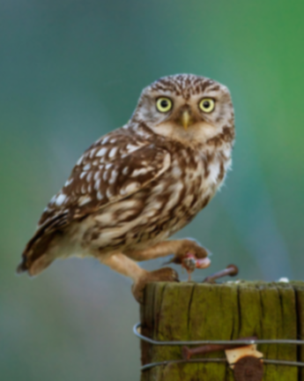

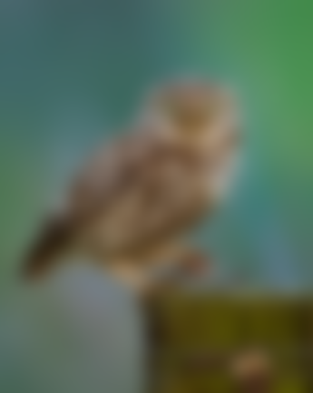






Gaussian filters
= 1 pixel
= 5 pixels
= 10 pixels
= 30 pixels

Slide 35
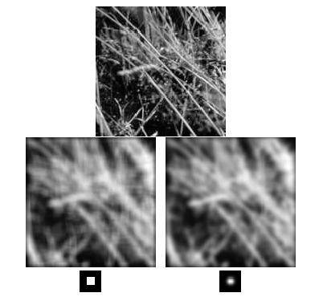
Mean vs. Gaussian filtering

Slide 36



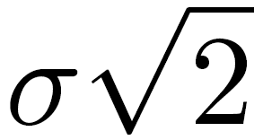
Gaussian filter
Removes “high-frequency” components from the image (low-pass filter)
Convolution with self is another Gaussian
  Convolving twice with Gaussian kernel of width = convolving once with kernel of width
*
=
Source: K. Grauman
Notes:
Linear vs. quadratic in mask size

Slide 37
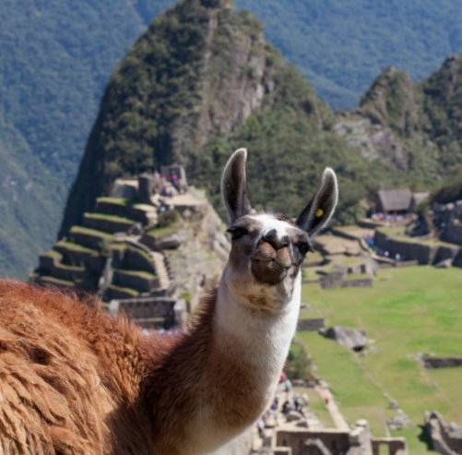

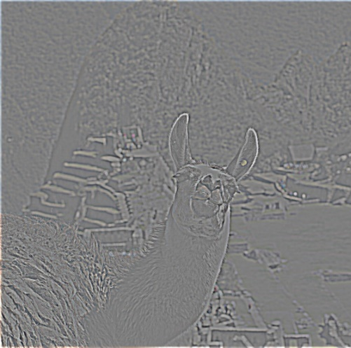
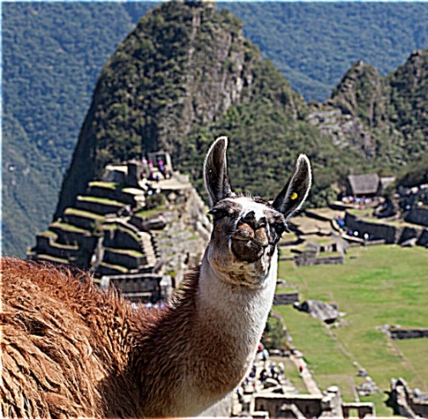
Sharpening revisited
What does blurring take away?
–
=
original
smoothed (5x5)
detail
(This “detail extraction” operation is also called a high-pass filter)
Let’s add it back:
+ α
=
original
detail
sharpened
Photo credit: https://www.flickr.com/photos/geezaweezer/16089096376/

Slide 38
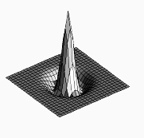

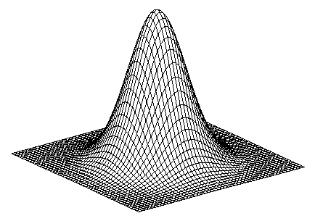
Sharpen filter
+
blurred
image
image
unit impulse
(identity kernel with single 1 in center, zeros elsewhere)
scaled impulse
Gaussian
Sharpen filter
Notes:
This slide derives a sharpen filter from the intuition in the previous slide – i.e., “sharpening is taking an image I, blurring it, subtracting the blurred image from I to get high-frequency edges, then scaling and adding those edges back to I to yield an image with emphasized edges).
f + a(f - f * g) = (1+a)f-af*g = f*((1+a)e-ag)

Slide 39

Sharpen filter
unfiltered
filtered
Notes:
Note how in sharpened region of the image (also known as “unsharp mask filtered” image), the edges are transformed so that the image gets darker on one side and brighter on the other – in this way, the edge is emphasized. The sharpened image “anticipates” the edges.

Slide 40
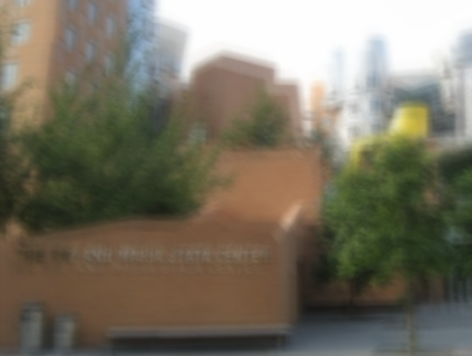
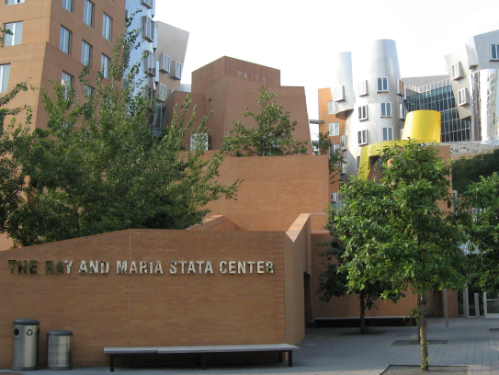
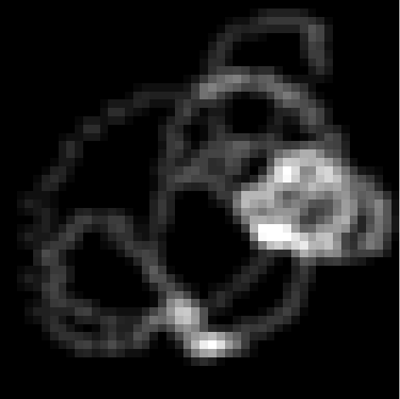
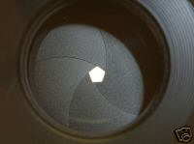


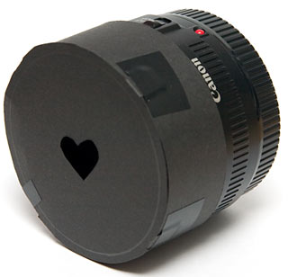
“Optical” convolution
Camera shake
=
*
Source: Fergus, et al. “Removing Camera Shake from a Single Photograph”, SIGGRAPH 2006
Bokeh: Blur in out-of-focus regions of an image.
Source: https://www.diyphotography.net/diy_create_your_own_bokeh/

Slide 41
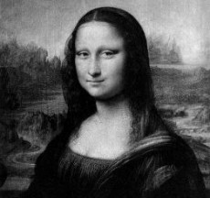
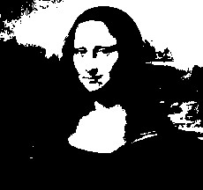

Filters: Thresholding

Slide 42
Linear filters
Can thresholding be implemented with a linear filter?
Notes:
Answer: No.

Slide 43
Can thresholding be implemented with a linear filter?
ⓘ Start presenting to display the poll results on this slide.

