Slide 1
Understanding Histograms in Image Processing
Introduction, Construction, and Applications
Assist. Prof. Dr. Abdul Hadi Mohammed

Slide 2
histogram
The histogram of a digital image is a plot that records the frequency distribution of gray levels in that image. In other words, the histogram is a plot of the gray-level values versus the number of pixels at each gray value. The shape of the histogram provides us with useful information about the nature of the image content.

Slide 3
Image Enhancement
Defined as it is usually used when an image having a distortion and noise present into it which can tend to make a loss of Information in the image to recover that key Information, Enhancement mainly use for removal of noise , sharpening and brightening of an image.
Some Mathematical and Logical Operations are used to overcome the noise and to enhance the Image

Slide 4
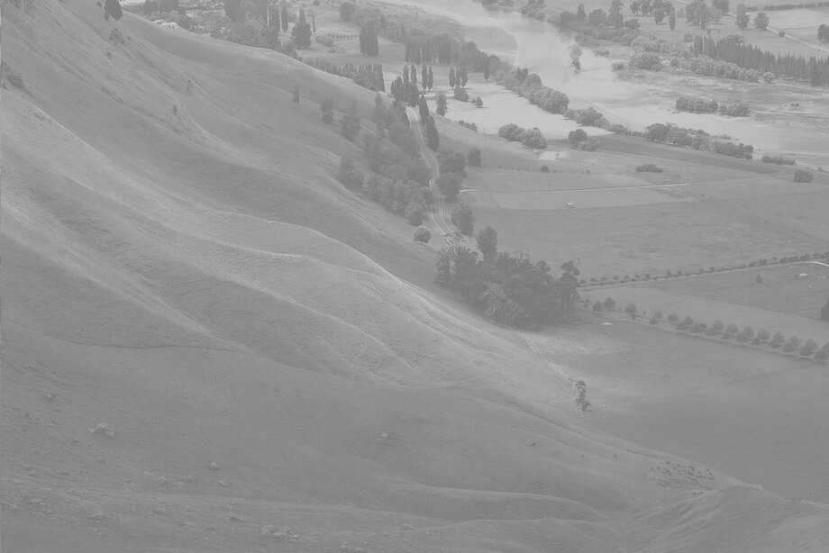
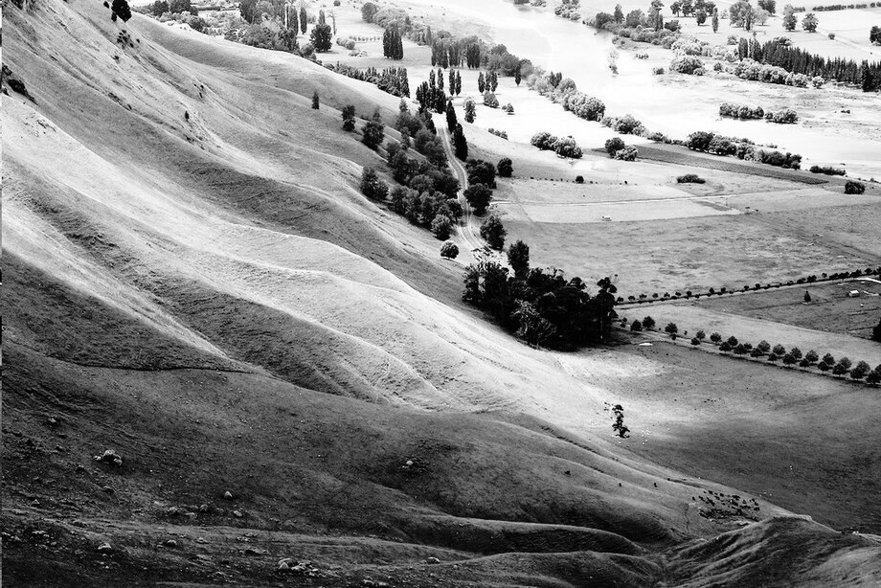
Histogram Equalization
It is used to enhance the Contrast
Contrast is the difference in color that makes an object distinguishable from other objects within the same field of view

Slide 5
Cumulative Histogram (Exp)
Now, Let us take a grayscale image in matrix form.
4*4 image matrix
3 | 2 | 4 | 5
7 | 7 | 8 | 2
3 | 1 | 2 | 3
5 | 4 | 6 | 7
Let each element be a pixel of an image and values of the elements represent intensities of the pixels.
We can see that the intensity of the pixels vary between 1-10. Suppose that we want to perform histogram equalization on this image & scale the intensity to 1-20.

Slide 6
Cumulative Histogram (Exp)
Pixel Intensities (r_{k}) | No. of pixel (n_{k})
1 | 1
2 | 3
3 | 3
4 | 2
5 | 2
6 | 1
7 | 3
8 | 1
9 | 0
10 | 0
 | Total 16
4*4 image matrix
3 | 2 | 4 | 5
7 | 7 | 8 | 2
3 | 1 | 2 | 3
5 | 4 | 6 | 7
First step is to count the total number of pixels associated with each pixel intensity.

Slide 7
Cumulative Histogram (Exp)
Pixel Intensities (r_{k}) | No. of pixel (n_{k}) | Probability (PDF)
1 | 1 | 1/16=0.0625
2 | 3 | 3/16=0.1875
3 | 3 | 3/16=0.1875
4 | 2 | 2/16=0.125
5 | 2 | 2/16=0.125
6 | 1 | 1/16=0.0625
7 | 3 | 3/16=0.1875
8 | 1 | 1/16=0.0625
9 | 0 | 0/16=0
10 | 0 | 0/16=0
 | Total 16
4*4 image matrix
3 | 2 | 4 | 5
7 | 7 | 8 | 2
3 | 1 | 2 | 3
5 | 4 | 6 | 7
Second step is to calculate probability of each pixel intensity in the image matrix.
Probability Density Function (PDF)
Total number of element is 16! Probability is no. of pixel divided by total no. of pixels(16).

Slide 8
Cumulative Histogram (Exp)
The next step is to calculate cumulative probability.
Cumulative Distribution Function(CDF)
is equal to previous (PDF) plus
current (PDF).
0.0625+0.1875=0.25 & so on....
Pixel Intensities (r_{k}) | No. of pixel (n_{k}) | Probability (PDF) | Cumulative probability(CDF)
1 | 1 | 0.0625 | 0.0625
2 | 3 | 0.1875 | 0.25
3 | 3 | 0.1875 | 0.4375
4 | 2 | 0.125 | 0.5625
5 | 2 | 0.125 | 0.6825
6 | 1 | 0.0625 | 0.75
7 | 3 | 0.1875 | 0.9375
8 | 1 | 0.0625 | 1
9 | 0 | 0 | 1
10 | 0 | 0 | 1
 | Total 16 |  | Total 1
4*4 image matrix
3 | 2 | 4 | 5
7 | 7 | 8 | 2
3 | 1 | 2 | 3
5 | 4 | 6 | 7

Slide 9
Cumulative Histogram (Exp)
Since we want to change the intensity range to 1-20, we shall multiply cumulative probability by 20.
Cumulative probability (CDF)
multiply by 20.
0.0625*20=1.25
Pixel Intensities (r_{k}) | No. of pixel (n_{k}) | Probability (PDF) | Cumulative probability(CDF) | Cumulative probability*20
1 | 1 | 0.0625 | 0.0625 | 1.25
2 | 3 | 0.1875 | 0.25 | 5
3 | 3 | 0.1875 | 0.4375 | 8.75
4 | 2 | 0.125 | 0.5625 | 11.25
5 | 2 | 0.125 | 0.6825 | 13.75
6 | 1 | 0.0625 | 0.75 | 15
7 | 3 | 0.1875 | 0.9375 | 18.75
8 | 1 | 0.0625 | 1 | 20
9 | 0 | 0 | 1 | 20
10 | 0 | 0 | 1 | 20
 | Total 16
4*4 image matrix
3 | 2 | 4 | 5
7 | 7 | 8 | 2
3 | 1 | 2 | 3
5 | 4 | 6 | 7

Slide 10
Cumulative Histogram (Exp)
Finally, we round the decimal values obtained to the lower integer values (also known as floor rounding).
Like 13.75 to 13.
Pixel Intensities (r_{k}) | No. of pixel (n_{k}) | Probability (PDF) | C.P(CDF) | C.P*20 | Floor Rounding
1 | 1 | 0.0625 | 0.0625 | 1.25 | 1
2 | 3 | 0.1875 | 0.25 | 5 | 5
3 | 3 | 0.1875 | 0.4375 | 8.75 | 8
4 | 2 | 0.125 | 0.5625 | 11.25 | 11
5 | 2 | 0.125 | 0.6825 | 13.75 | 13
6 | 1 | 0.0625 | 0.75 | 15 | 15
7 | 3 | 0.1875 | 0.9375 | 18.75 | 18
8 | 1 | 0.0625 | 1 | 20 | 20
9 | 0 | 0 | 1 | 20 | 20
10 | 0 | 0 | 1 | 20 | 20
 | Total 16
4*4 image matrix
3 | 2 | 4 | 5
7 | 7 | 8 | 2
3 | 1 | 2 | 3
5 | 4 | 6 | 7

Slide 11
Cumulative Histogram (Exp)
So the original image has been transformed to the equalized image with different intensity on each pixel.
4*4 Original image matrix
4*4 Transformed image matrix
3 | 2 | 4 | 5
7 | 7 | 8 | 2
3 | 1 | 2 | 3
5 | 4 | 6 | 7
8 | 5 | 11 | 13
18 | 18 | 20 | 5
8 | 1 | 5 | 8
13 | 11 | 15 | 18

Slide 12
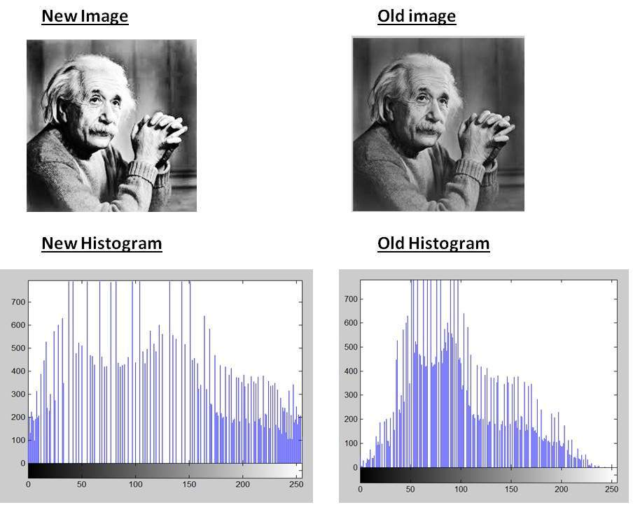
Cumulative Histogram (Exp)
We can see that the intensity range of the pixel have been increased and hence the histogram of the image will look more spread. This in turn is called Histogram Equalization.

Slide 13
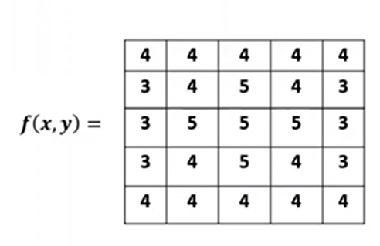
Example1:Perform Histogram Equalization of the Image

Slide 14
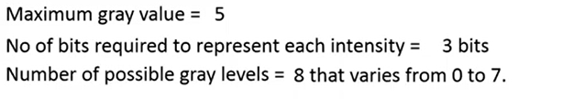
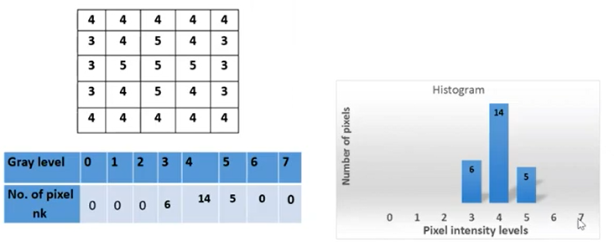
Histogram Equalization

Slide 15
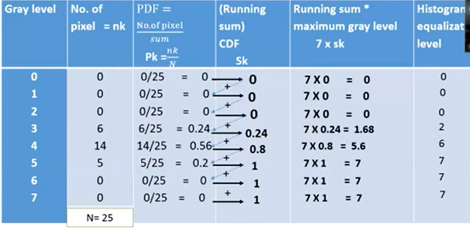
Solution

Slide 16
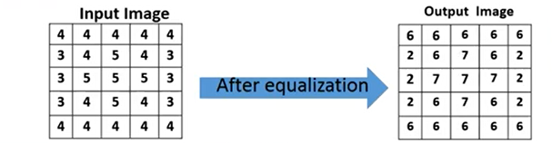

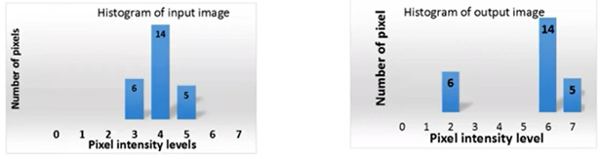
Solution

Slide 17
Arithmetic Operation Between Images
There are Array Operations which are carried out between corresponding pixels pairs. The four arithmetic operations are denoted as
A(x,y) = f(x,y)+g(x,y)
S(x,y) = f(x,y)-g(x,y)
p(x,y) = f(x,y)*g(x,y)
D(x,y) = f(x,y)/g(x,y)
These all arithmetic operations are performed between corresponding pixels pairs.

Slide 18
Important Points
If the result is a floating point number, round off its value
If the result is above the pixel range, select the max range value
If the result is below the pixel range, select the min range value
If the result is infinity, write it as zero

Slide 19
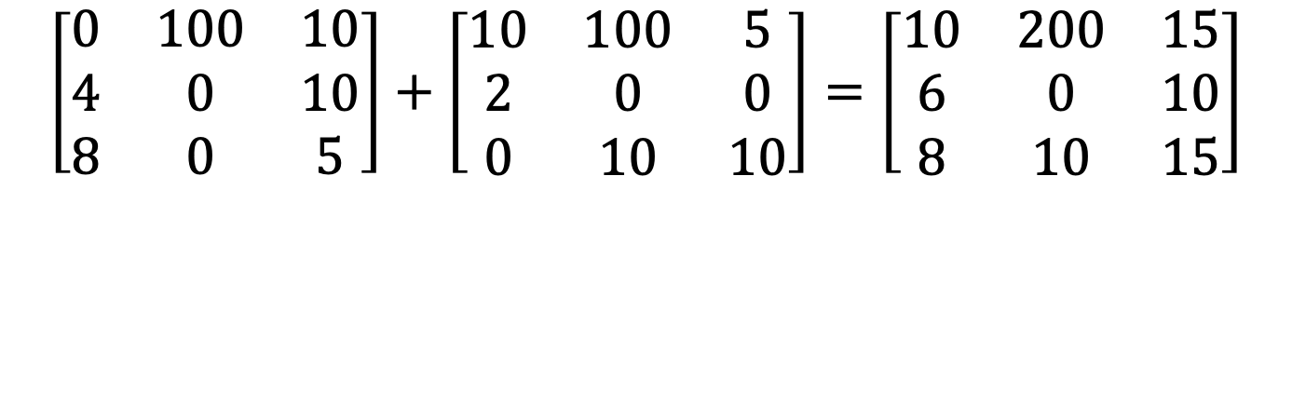
Addition
$$\left[\begin{matrix}0 & 100 & 10 \\ 4 & 0 & 10 \\ 8 & 0 & 5\end{matrix}\right]+\left[\begin{matrix}10 & 100 & 5 \\ 2 & 0 & 0 \\ 0 & 10 & 10\end{matrix}\right]=\left[\begin{matrix}10 & 200 & 15 \\ 6 & 0 & 10 \\ 8 & 10 & 15\end{matrix}\right]$$
Addition is used to combine the information in two images.
Applications include development of image restoration algorithms for modeling additive noise and special effects such as image morphing in motion pictures as shown in the figures below.
Uses:
Changing Image Background
Watermark Images

Slide 20
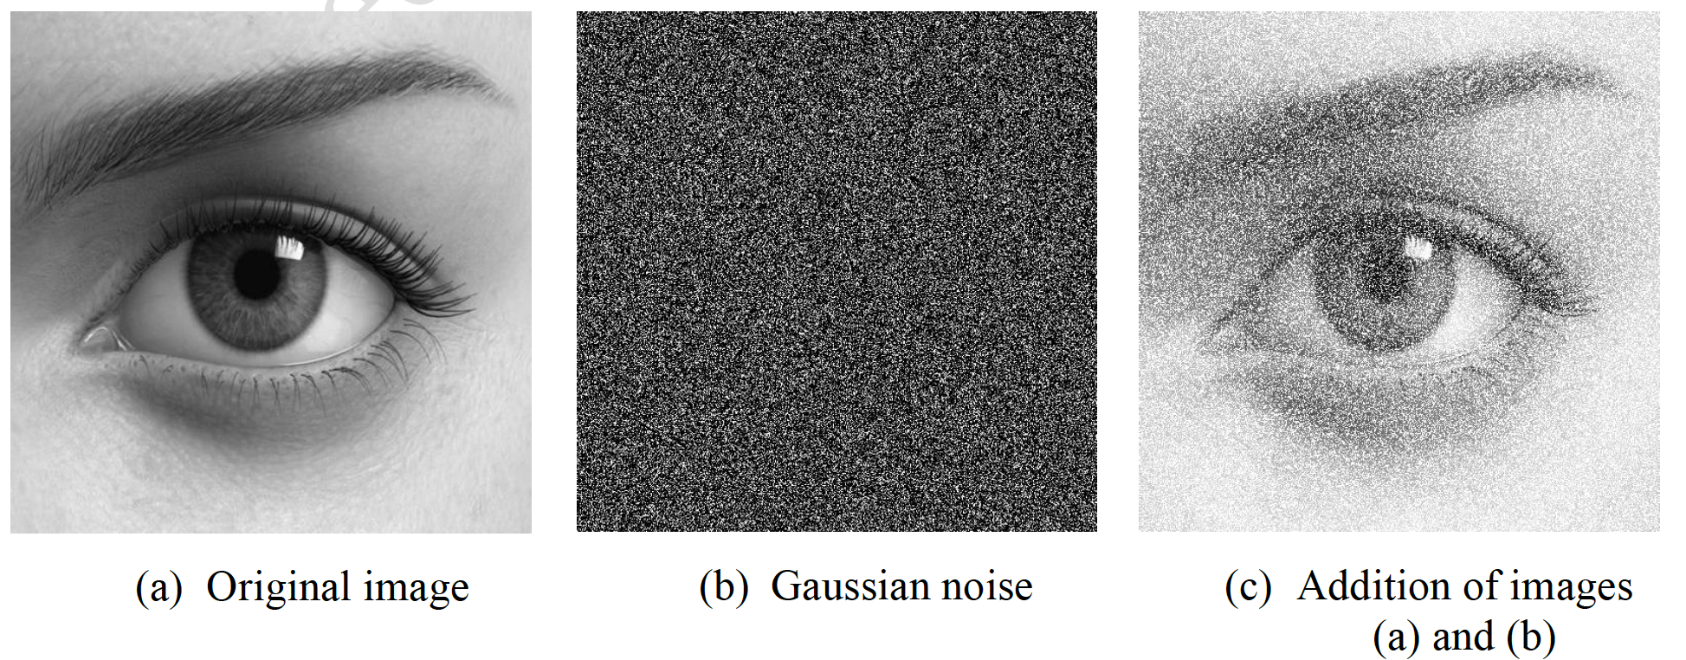
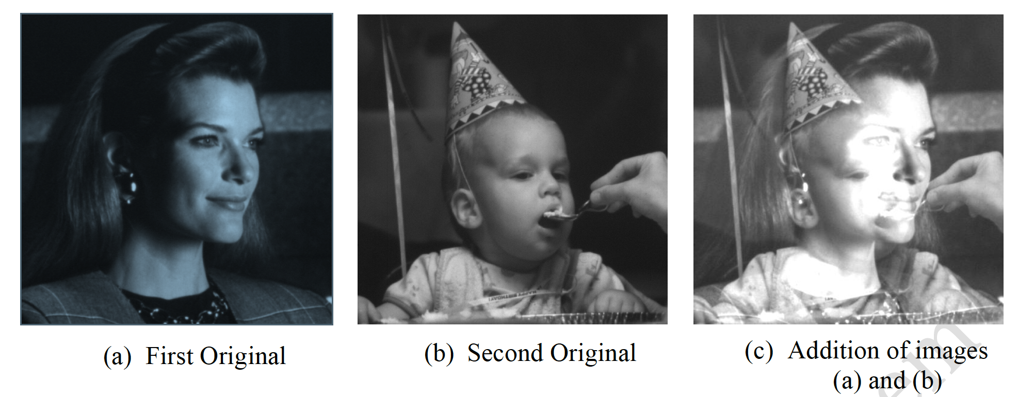

Slide 21
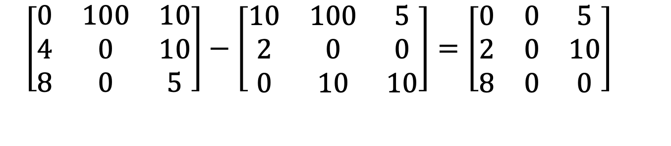
Subtraction
$\left[\begin{matrix}0 & 100 & 10 \\ 4 & 0 & 10 \\ 8 & 0 & 5\end{matrix}\right]−\left[\begin{matrix}10 & 100 & 5 \\ 2 & 0 & 0 \\ 0 & 10 & 10\end{matrix}\right]=\left[\begin{matrix}0 & 0 & 5 \\ 2 & 0 & 10 \\ 8 & 0 & 0\end{matrix}\right]$
Subtraction of two images is often used to detect motion. For
example, in a scene when nothing has changed, the image resulting from the subtraction is filled with zeros(black image). If something has changed in the scene, subtraction produces a nonzero result at the location of movement as shown in the figure below.
Uses:
Enhancement of differences between images.
Mask mode radiography in medical imaging.

Slide 22
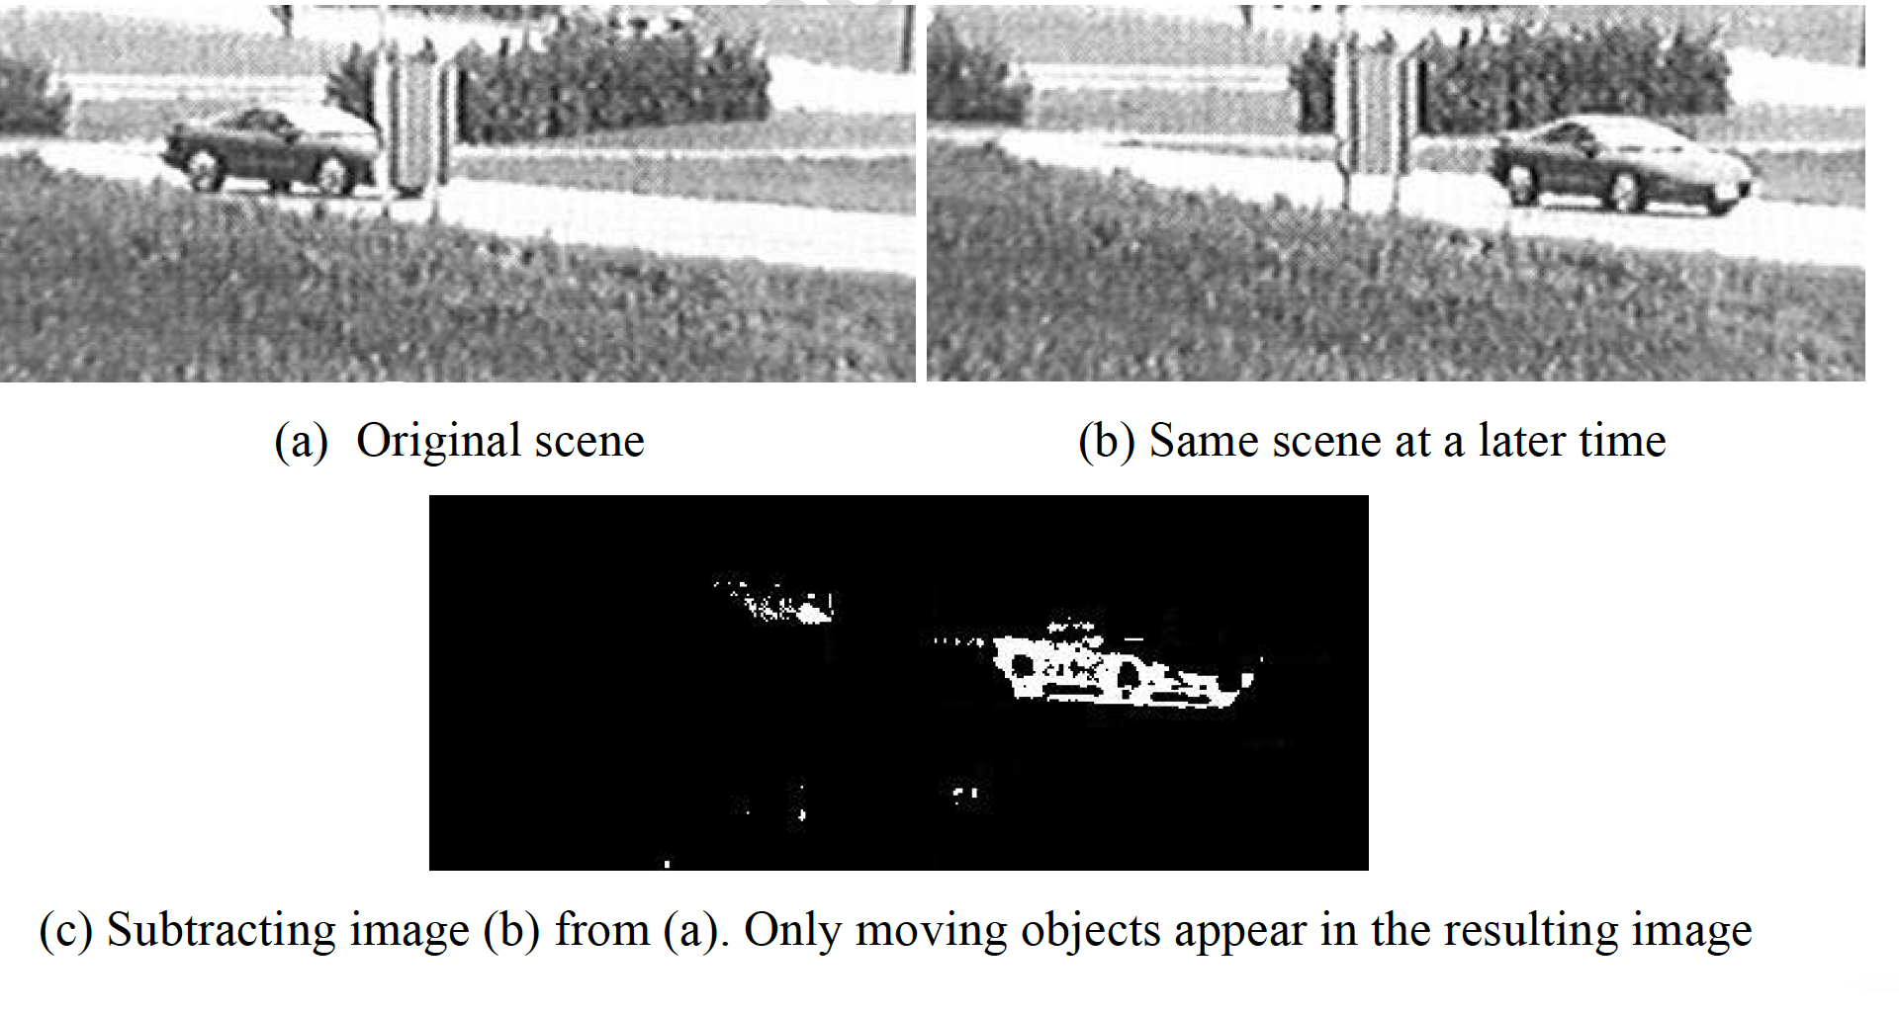

Slide 23
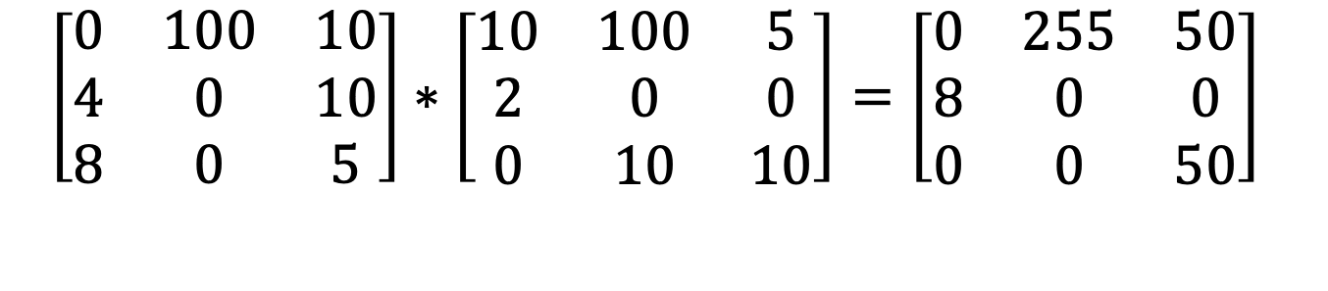
Multiplication
$\left[\begin{matrix}0 & 100 & 10 \\ 4 & 0 & 10 \\ 8 & 0 & 5\end{matrix}\right]∗\left[\begin{matrix}10 & 100 & 5 \\ 2 & 0 & 0 \\ 0 & 10 & 10\end{matrix}\right]=\left[\begin{matrix}0 & 255 & 50 \\ 8 & 0 & 0 \\ 0 & 0 & 50\end{matrix}\right]$
Multiplication and division are used to adjust the brightness of an image. Multiplying the pixel values by a number greater than one will brighten the image, and dividing the pixel values by a factor greater than one will darken the image.
Uses:
Shading correction

Slide 24

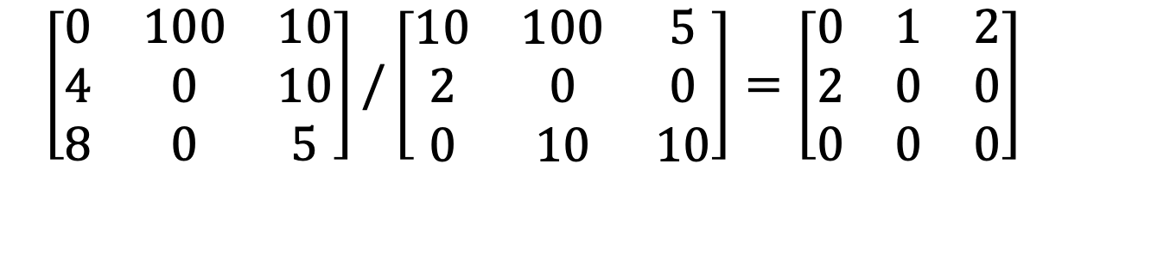
Division
$\left[\begin{matrix}0 & 100 & 10 \\ 4 & 0 & 10 \\ 8 & 0 & 5\end{matrix}\right]/\left[\begin{matrix}10 & 100 & 5 \\ 2 & 0 & 0 \\ 0 & 10 & 10\end{matrix}\right]=\left[\begin{matrix}0 & 1 & 2 \\ 2 & 0 & 0 \\ 0 & 0 & 0\end{matrix}\right]$
Note: $0.5 → 1$
Uses:
Shading correction

Slide 25
