Slide 1
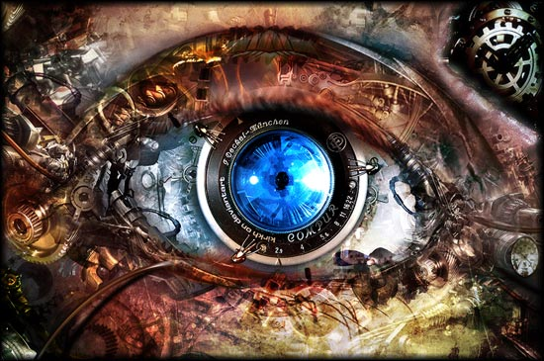
ECE 5554/ ECE 4554
Computer Vision
Jia-Bin Huang
Electrical and Computer Engineering
Virginia Tech

Slide 2
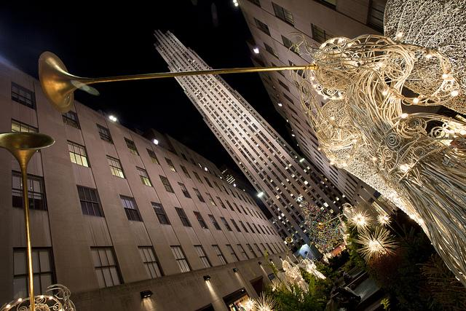
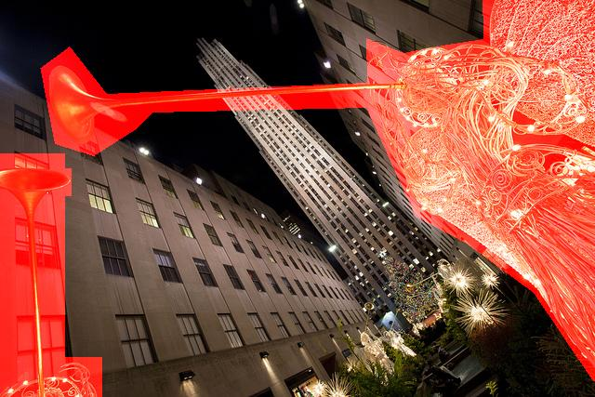
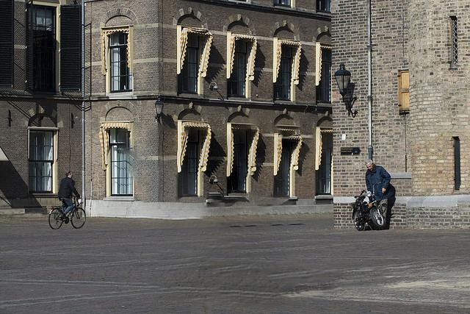
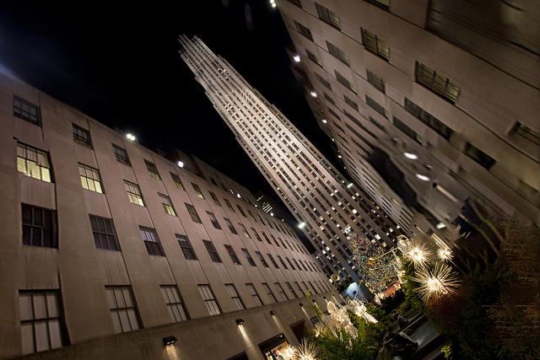

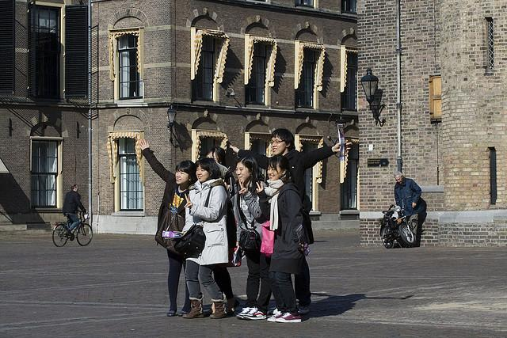
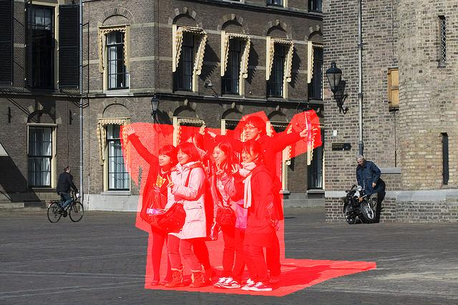
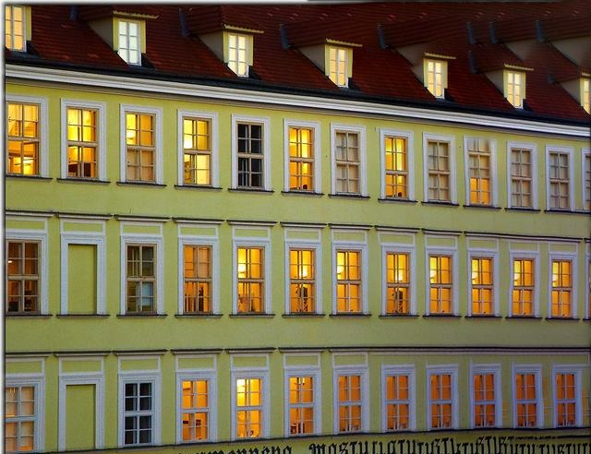
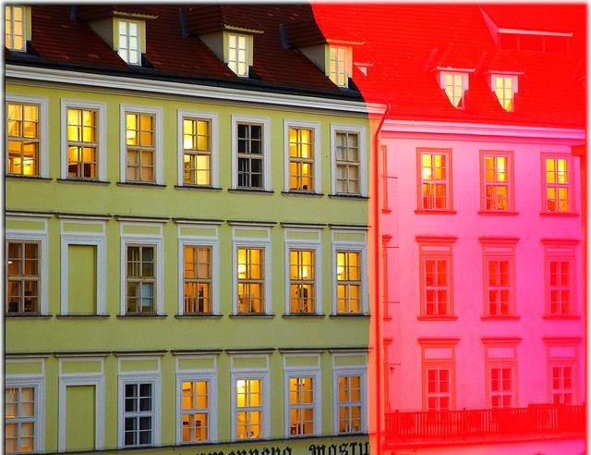
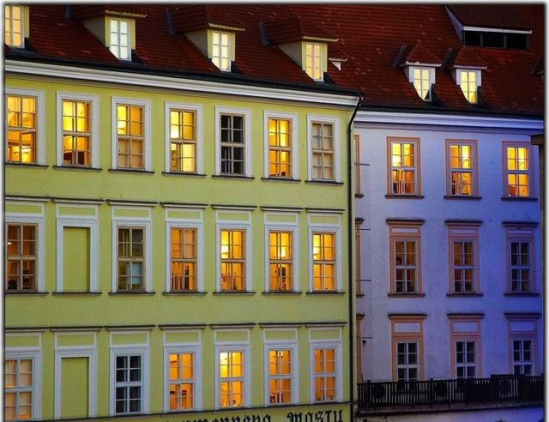

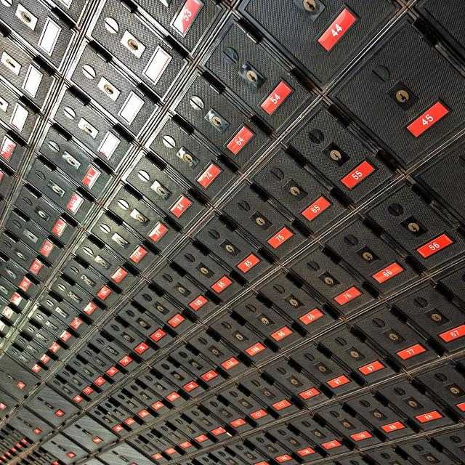
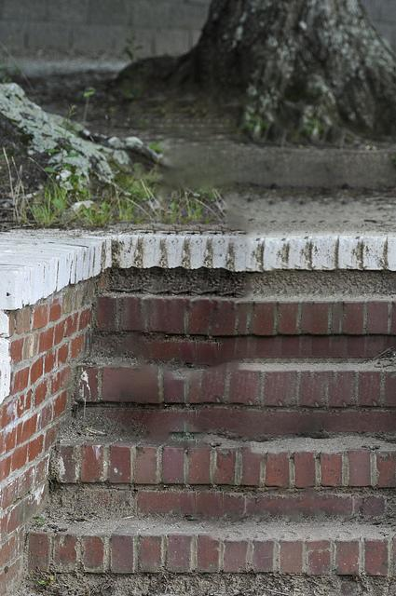
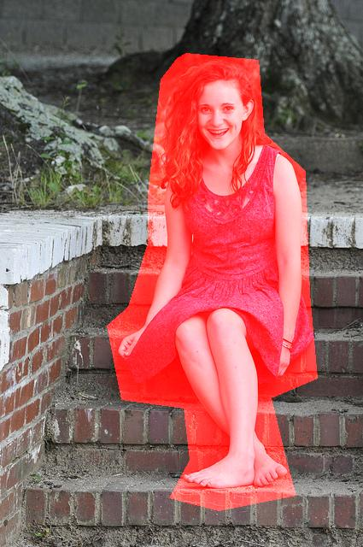
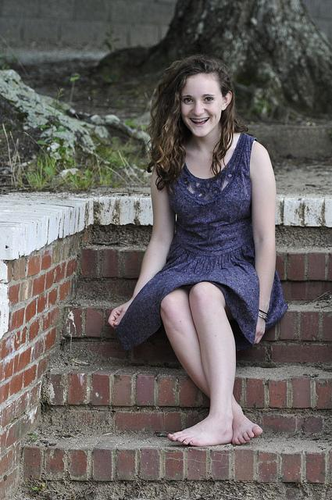
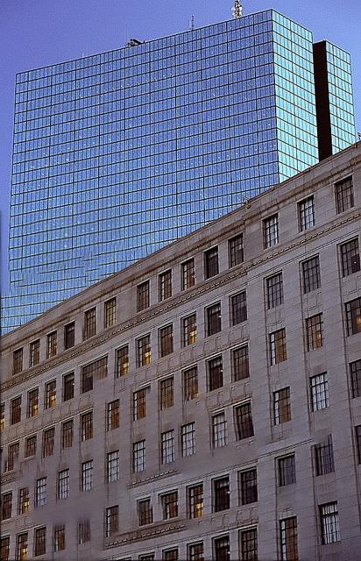
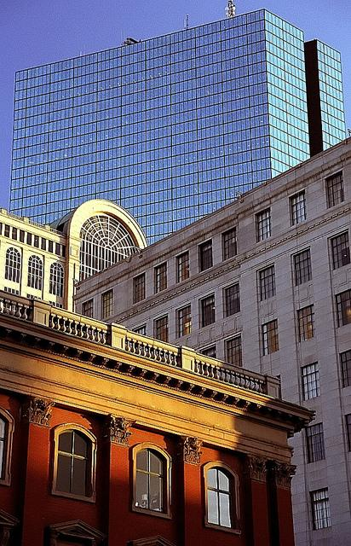
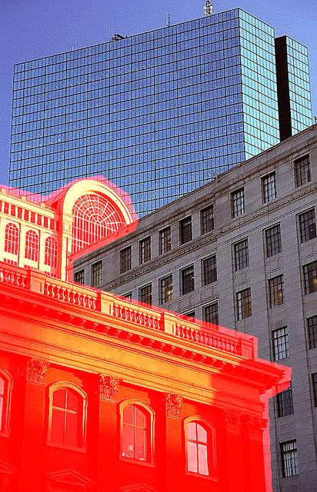
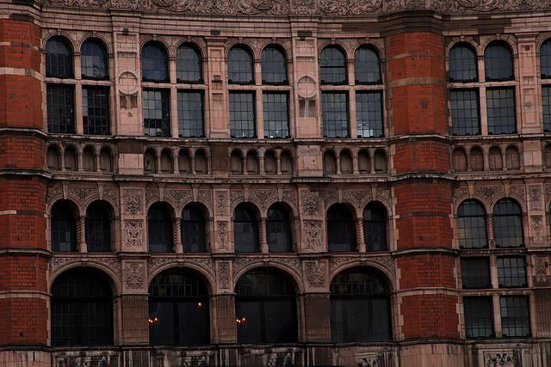
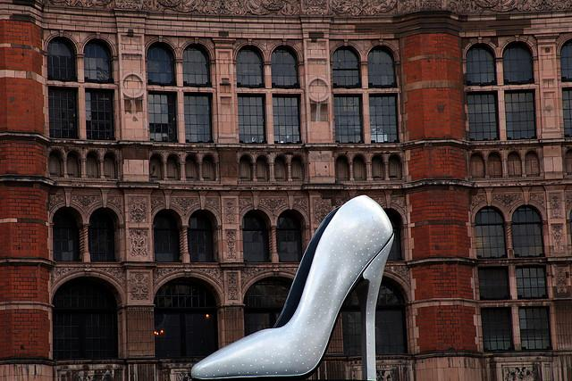
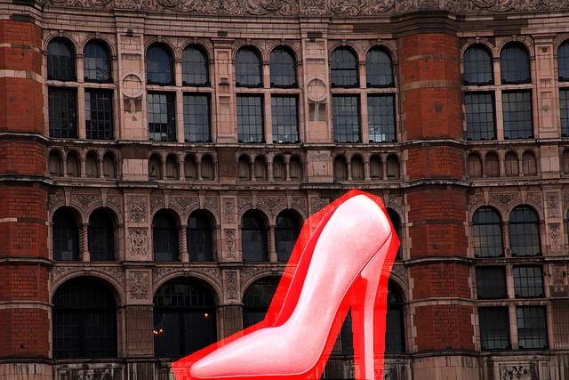
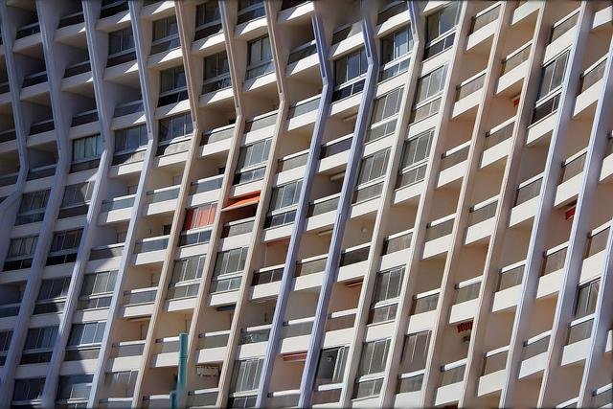
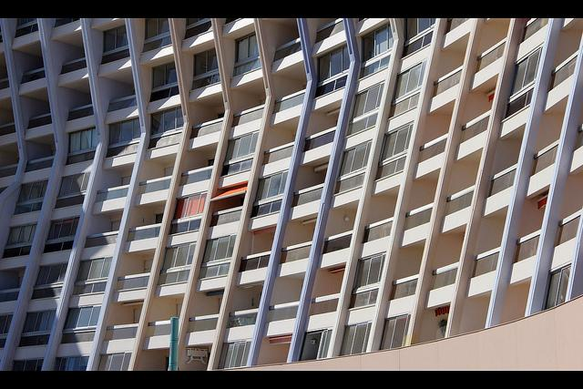
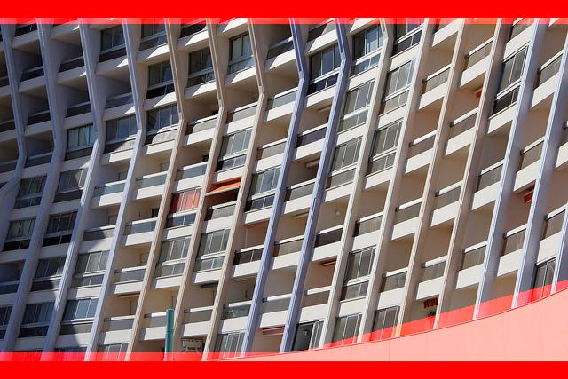
Image Completion [SIGGRAPH14]
- Revealing unseen pixels
Notes:
Thanks for your attention!

Slide 3
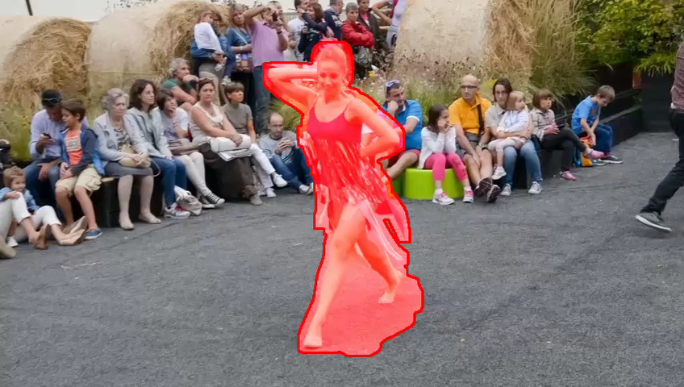
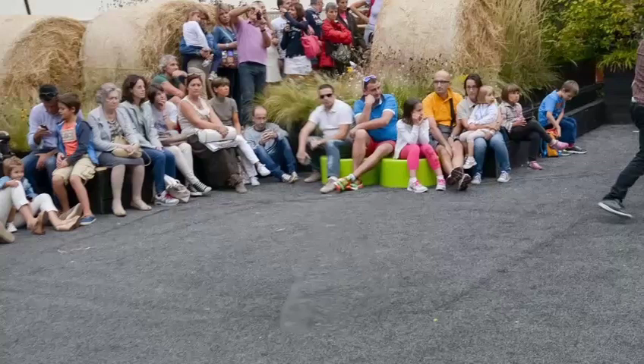
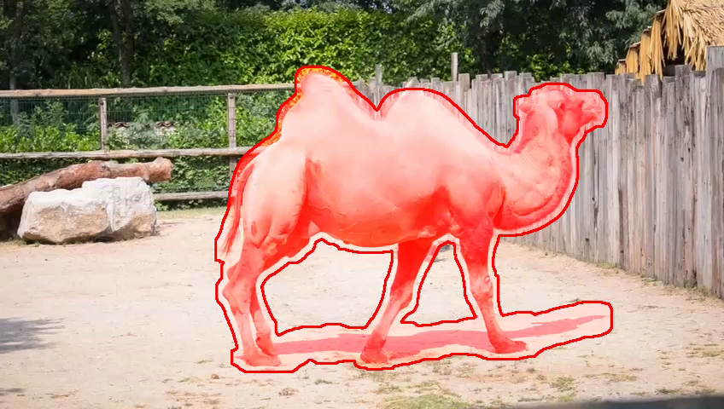
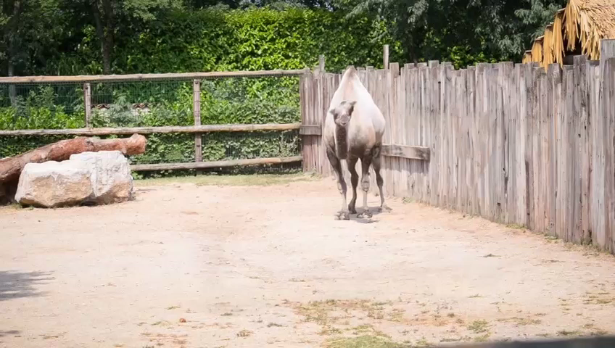
Video Completion [SIGGRAPH Asia16]
- Revealing temporally coherent pixels

Slide 4


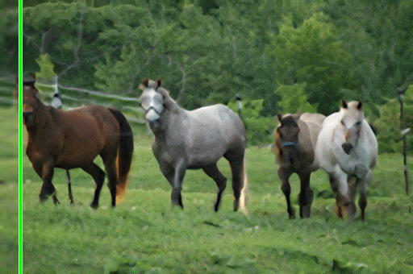


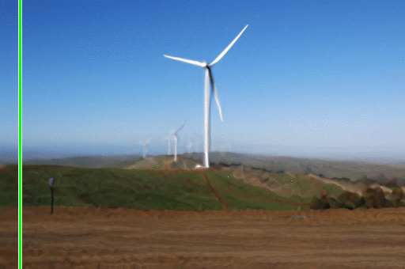
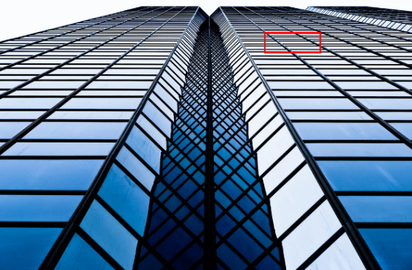


Image super-resolution [CVPR15]
  - Revealing unseen high frequency details

Slide 5
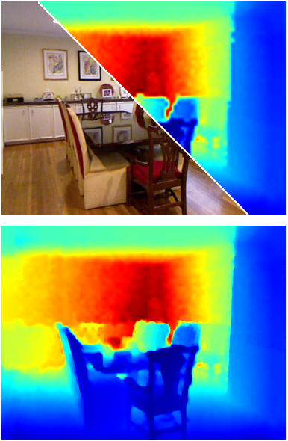
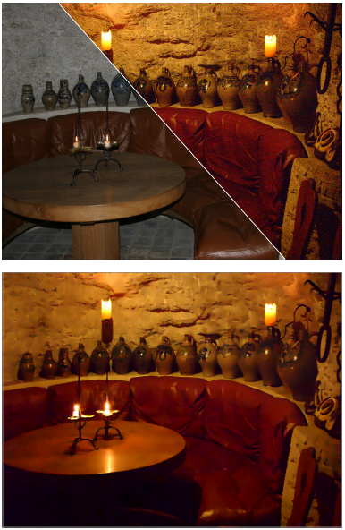
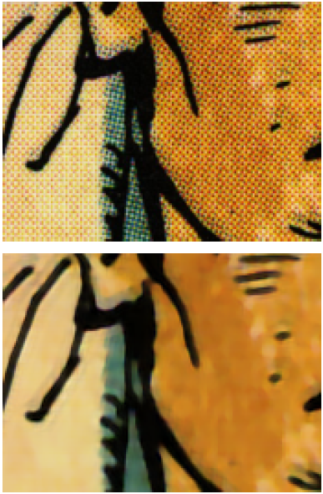
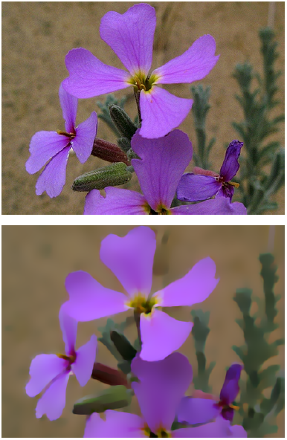
Depth upsampling
Noise reduction
Inverse halftoning
Texture removal
Deep Joint Image Filtering [ECCV16]
  - Transferring structural details

Slide 6
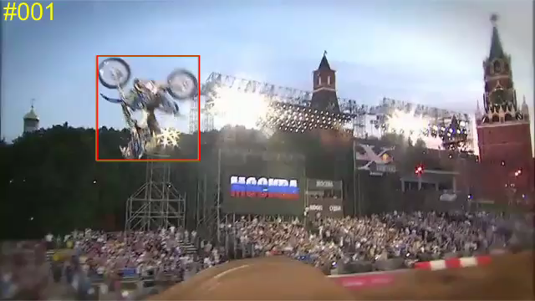
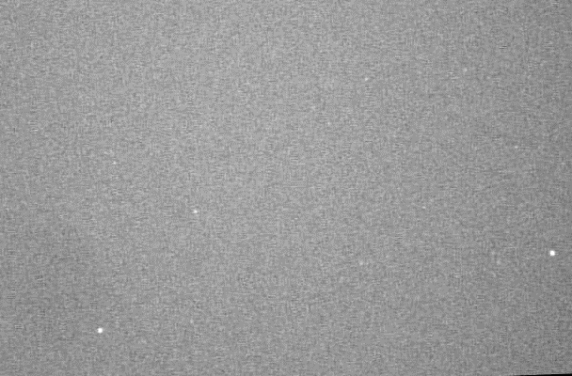
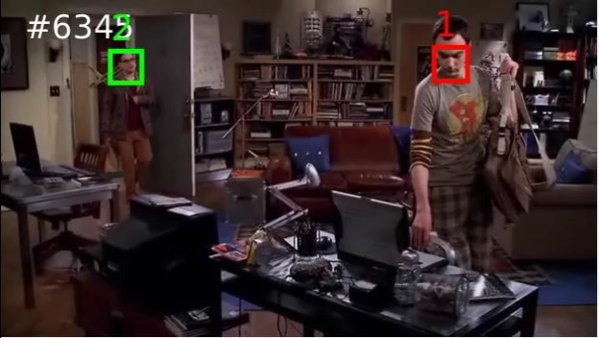
Object tracking [ICCV15]
Detecting migrating birds [CVPR16]
Visual Tracking
- Locating moving objects across video frames
Multi-face tracking [ECCV16]

Slide 7
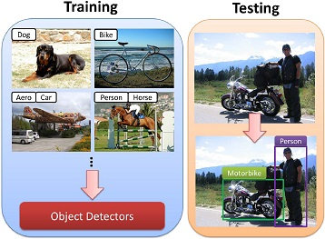
Unlabeled images
k-NN Graph
Positive mining
Negative mining
Weakly supervised localization [CVPR16]
Learning with weak labels
Unsupervised feature learning [ECCV16]

Slide 8
What is Computer Vision?
Make computers understand images and videos.
What kind of scene?
Where are the cars?
How far is the building?

Slide 9
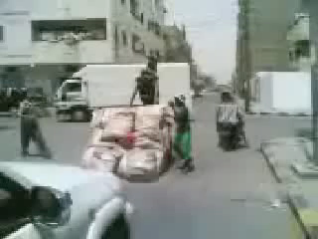
What is Computer Vision?
Make computers understand images and videos.
What are they doing?
Why is this happening?
What is important?
What will I see?

Slide 10

Computer Vision and Nearby Fields
Digital Image Processing
Computational Photography
Geometry (3D)
Shape
Computer Vision
Images (2D)
Photometry
Appearance
Computer Graphics
Machine learning:
Vision = Machine learning applied to visual data

Slide 11


Visual data on the Internet
90% of net traffic will be visual!
Flickr
  10+ billion photographs
  60 million images uploaded a month
Facebook
  250 billion+
  300 million a day
Instagram
  55 million a day
YouTube
  100 hours uploaded every minute
Mostly about cats

Slide 12


Too big for humans
Need automatic tools to access and analyze visual data!
http://www.petittube.com/

Slide 13
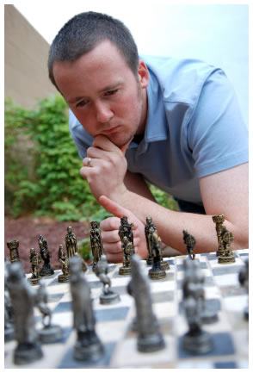
Vision is Really Hard
Vision is an amazing feature of natural intelligence
  Visual cortex occupies about 50% of Macaque brain
  More human brain devoted to vision than anything else
Is that a queen or a bishop?

Slide 14
Why is Computer Vision Hard?

Slide 15
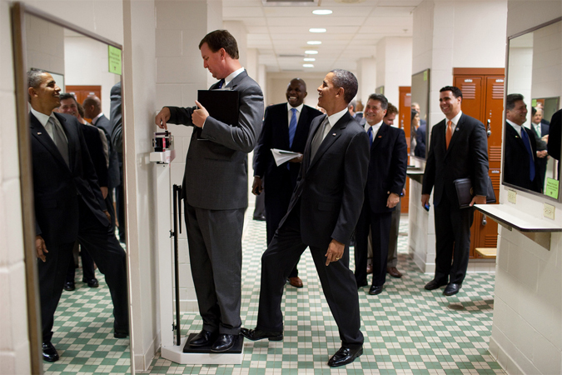
Why is Computer Vision Hard?

Slide 16
What did you see?
Where this picture was taken?
How many people are there?
What are they doing?
What object the person on the left standing on?
Why this is a funny picture?

Slide 17
Why is Computer Vision Hard?

Slide 18
Why is Computer Vision Hard?

Slide 19
Why is Computer Vision Hard?

Slide 20
Why is Computer Vision Hard?

Slide 21
Why is Computer Vision Hard?

Slide 22
Why is Computer Vision Hard?

Slide 23

Computer: okay, it’s a funny picture

Slide 24
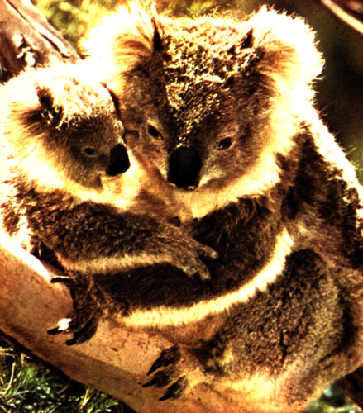
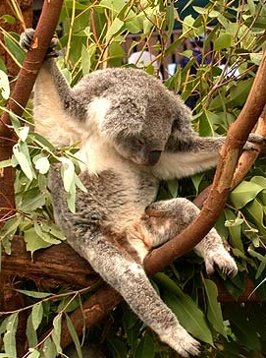





Challenges: Many nuisance parameters
Illumination
Object pose
Clutter
Occlusions
Intra-class appearance
Viewpoint
Slide credit: Kristen Grauman

Slide 25
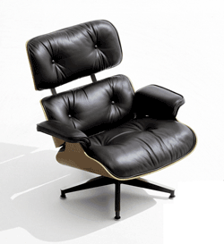
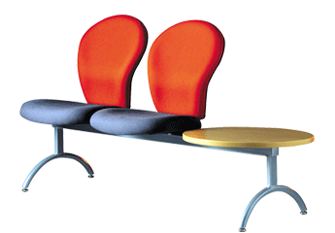
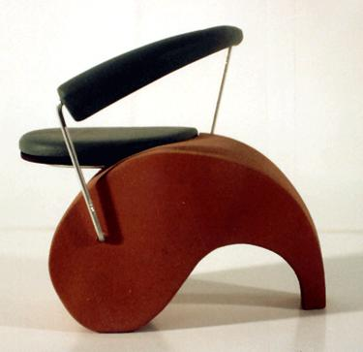
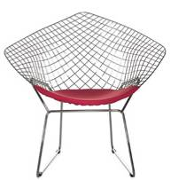
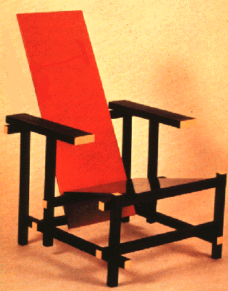
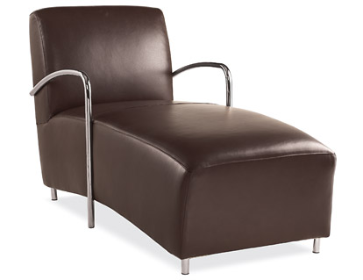
Challenges: Intra-class variation
Slide credit: Fei-Fei, Fergus & Torralba

Slide 26


Challenges: Importance of context
Slide credit: Fei-Fei, Fergus & Torralba

Slide 27
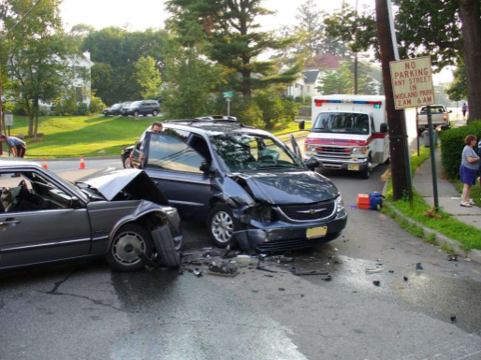





Computer Vision
Technology
Can Better Our Lives
Safety
Health
Security
Comfort
Fun
Access

Slide 28

History of Computer Vision
“In 1966, Minsky hired a first-year undergraduate student and assigned him a problem to solve over the summer:
connect a camera to a computer and get the machine to describe what it sees.”
Crevier 1993, pg. 88
Marvin Minsky, MIT
Turing award, 1969

Slide 29

Half a century later,
we're still working on it.

Slide 30

History of Computer Vision
Marvin Minsky, MIT
Turing award, 1969
Gerald Sussman, MIT
“You’ll notice that Sussman never worked in vision again!” – Berthold Horn

Slide 31

1960’s: interpretation of synthetic worlds
Larry Roberts
“Father of Computer Vision”
Input image
2x2 gradient operator
computed 3D model
rendered from new viewpoint
Larry Roberts PhD Thesis, MIT, 1963,
Machine Perception of Three-Dimensional Solids
Slide credit: Steve Seitz

Slide 32



1970’s: some progress on interpreting selected images
The representation and matching of pictorial structures
Fischler and Elschlager, 1973

Slide 33



1970’s: some progress on interpreting selected images
The representation and matching of pictorial structures
Fischler and Elschlager, 1973

Slide 34

1980’s: ANNs come and go; shift toward geometry and increased mathematical rigor
Image credit: Rick Szeliski

Slide 35

Goodbye
science

Slide 36

1990’s: face recognition; statistical analysis in vogue
Image credit: Rick Szeliski

Slide 37

2000’s: broader recognition; large annotated datasets available; video processing starts
Image credit: Rick Szeliski

Slide 38




2010’s: resurgence of deep learning
[AlexNet NIPS 2012]
[DeepFace CVPR 2014]
[DeepPose CVPR 2014]
[Show, Attend and Tell ICML 2015]

Slide 39

2020’s: autonomous vehicles

Slide 40

2030’s: robot uprising?

Slide 41
Examples of Computer Vision Applications
How is computer vision used today?

Slide 42

Face detection
Most digital cameras and smart phones detect faces (and more)
  Canon, Sony, Fuji, …
For smart focus, exposure compensation, and cropping
Slide credit: Steve Seitz

Slide 43

Face recognition
Facebook face auto-tagging

Slide 44

Face Landmark Alignment – 3D Persona
What Makes Tom Hanks Look Like Tom Hanks ICCV 2015

Slide 45
Smile Detection
Sony Cyber-shot® T70 Digital Still Camera
Slide credit: Steve Seitz

Slide 46



Vision-based Biometrics
“How the Afghan Girl was Identified by Her Iris Patterns” Read the story wikipedia
Slide credit: Steve Seitz

Slide 47

Vision-based Biometrics

Slide 48


Optical Character Recognition (OCR)
Technology to convert scanned docs to text
  If you have a scanner, it probably came with OCR software
Digit recognition, AT&T labs
http://www.research.att.com/~yann/
License plate readers
http://en.wikipedia.org/wiki/Automatic_number_plate_recognition
Slide credit: Steve Seitz

Slide 49

Computer vision in sports
Hawk-Eye: helping/improving referee decisions

Slide 50

Computer vision in sports
SportVision: improving viewer experiences

Slide 51

Computer vision in sports
Replay Technologies: improving viewer experiences

Slide 52

Computer vision in sports
Play tracking

Slide 53


Visual recognition for photo organization
Google photo

Slide 54

Earth viewers (3D modeling)
Image from Microsoft’s Virtual Earth
(see also: Google Earth)
Slide credit: Steve Seitz

Slide 55

3D from thousands of images
[Furukawa et al. CVPR 2010]

Slide 56

Microsoft PhotoSynth: Photo Tourism

Slide 57

First-person Hyperlapse Videos
[Kopf et al. SIGGRAPH 2014]

Slide 58

3D Time-lapse from Internet Photos
3D Time-lapse from Internet Photos, ICCV 2015

Slide 59



Style transfer
Source image (Style)
Target image (Content)
Output (deepart)
A Neural Algorithm of Artistic Style [Gatys et al. 2015]

Slide 60

Special effects: Matting and composition
Kylie Minogue - Come Into My World

Slide 61


Special effects: Shape capture
The Matrix movies, ESC Entertainment, XYZRGB, NRC
Slide credit: Steve Seitz

Slide 62


Special effects: Motion capture
Pirates of the Carribean, Industrial Light and Magic
Slide credit: Steve Seitz

Slide 63

Google cars
Google in talks with Ford, Toyota and Volkswagen to realise driverless cars
http://www.theatlantic.com/technology/archive/2014/05/all-the-world-a-track-the-trick-that-makes-googles-self-driving-cars-work/370871/

Slide 64


Interactive Games: Kinect
Object Recognition: http://www.youtube.com/watch?feature=iv&v=fQ59dXOo63o
Mario: http://www.youtube.com/watch?v=8CTJL5lUjHg
3D: http://www.youtube.com/watch?v=7QrnwoO1-8A
Robot: http://www.youtube.com/watch?v=w8BmgtMKFbY

Slide 65

Vision in space
NASA'S Mars Exploration Rover Spirit captured this westward view from atop
a low plateau where Spirit spent the closing months of 2007.
Vision systems (JPL) used for several tasks
  Panorama stitching
  3D terrain modeling
  Obstacle detection, position tracking
  For more, read “Computer Vision on Mars” by Matthies et al.

Slide 66


Industrial robots
Vision-guided robots position nut runners on wheels
http://www.automationworld.com/computer-vision-opportunity-or-threat

Slide 67




Mobile robots
NASA’s Mars Spirit Rover
http://www.robocup.org/
Saxena et al. 2008
STAIR at Stanford
http://www.youtube.com/watch?v=DF39Ygp53mQ

Slide 68


Medical imaging
Image guided surgery
Grimson et al., MIT
3D imaging
MRI, CT

Slide 69


Computer vision for the mass
Counting cells
Predicting poverty

Slide 70

Current state of the art
Many of these are less than 5 years old
Very active and exciting research area!
To learn more about vision applications and companies
  David Lowe maintains an excellent overview of vision companies
    http://www.cs.ubc.ca/spider/lowe/vision.html

Slide 71


Getting help outside of class
Readings/Textbook:
http://szeliski.org/Book/
Lecture notes: will be posted online

Slide 72
What to expect from this course
Broad coverage
  geometry, image processing, recognition, multiview, video
  Focus is on algorithms, rather than specific systems.
Background to delve deeper into any computer vision-related topic
Practical experience
Lots of work, tough material, fast pace, but hopefully lots of learning too!

Slide 73






Course Topics
Interpreting Intensities
  What determines the brightness and color of a pixel?
  How can we use image filters to extract meaningful information from the image?
Correspondence and Alignment
  How can we find corresponding points in objects or scenes?
  How can we estimate the transformation between them?
Perspective and 3D Geometry
  How can we map between the 3D world and the 2D image?
  How can we recover 3D coordinates from images or video?
Grouping and Segmentation
  How can we group pixels into meaningful regions?
Categorization and Object Recognition
  How can we represent images and categorize them?
  How can we recognize categories of objects?
Advanced Topics
  Action recognition, 3D scenes and context, CNNs, …

