Slide 1
Linear Least Squares Optimization: A Computer Vision Application by Rigel Mahmood

Slide 2
Outline
Introduction
Linear Least Squares Optimization
Development of Linear Least Squares for Computer Vision
Computer Vision Application for Face Registration
Results
Conclusion
Future Work

Slide 3
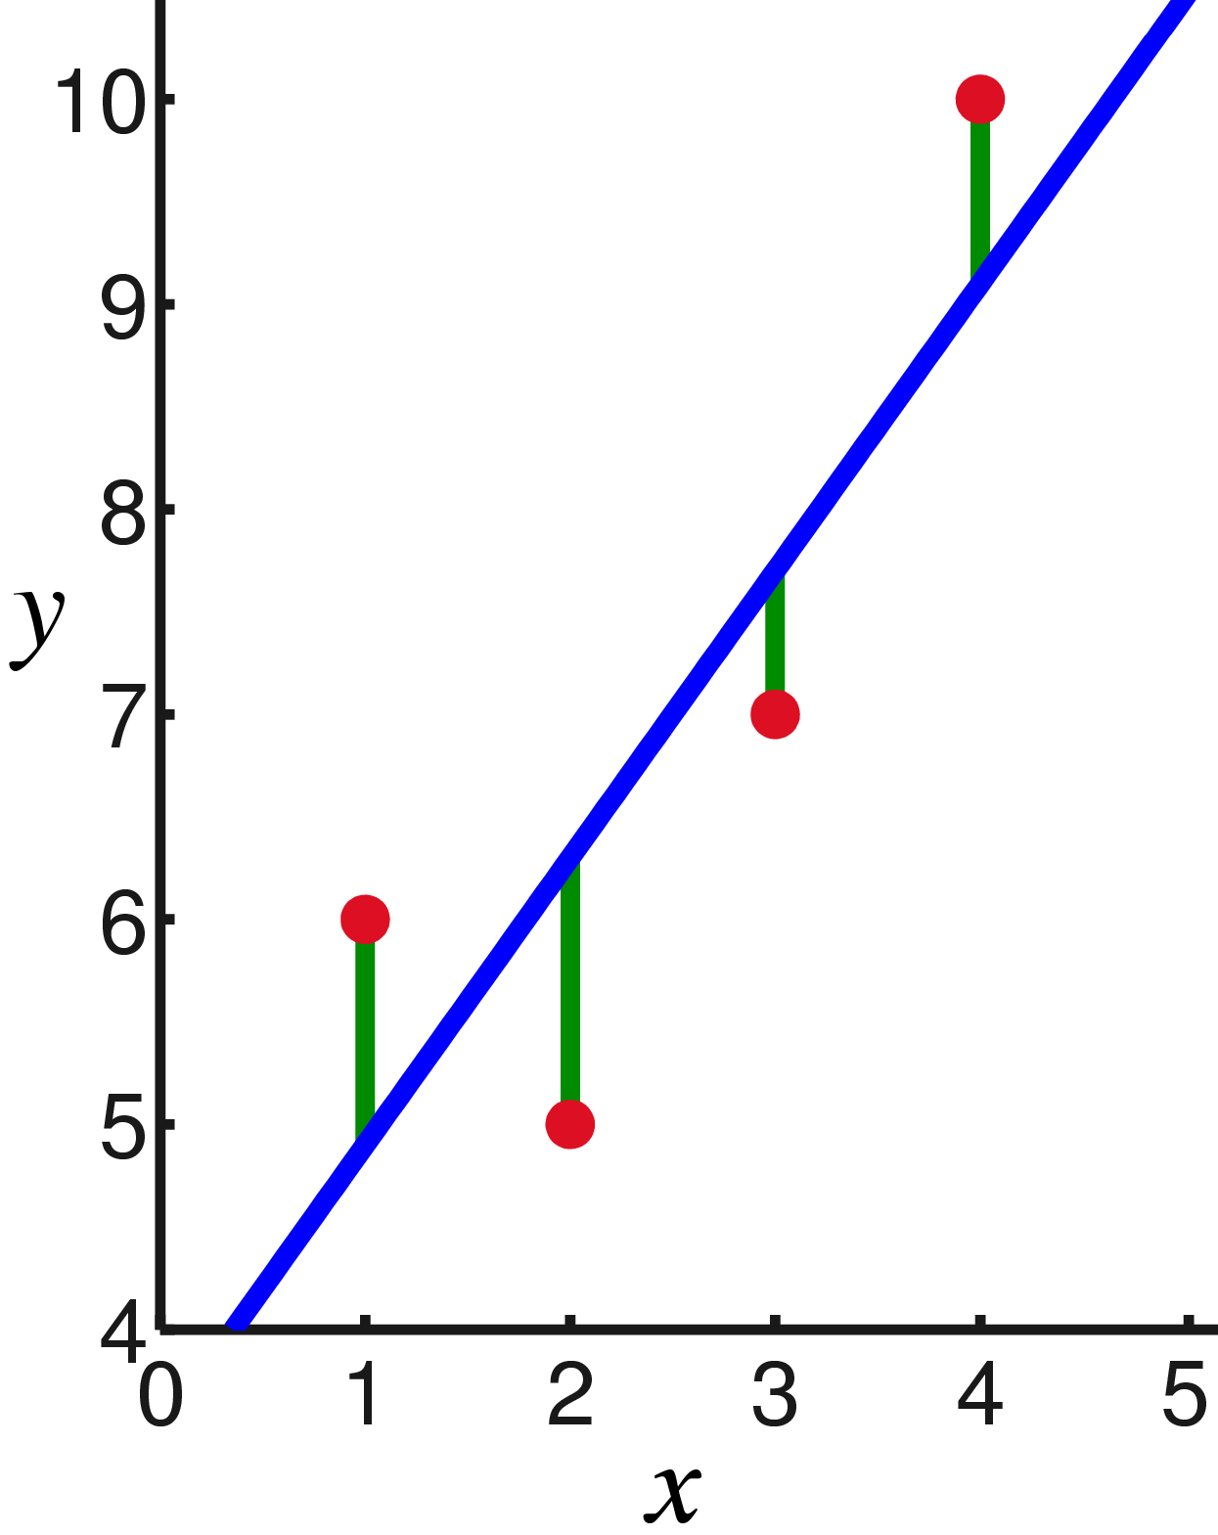
Introduction
Main idea: approximating the parameters of a model to given data
Definition: minimizes the sum of squared differences between the given data and the function value obtained from the modeled parameters
Applications: regression problems (curve fitting), computer vision (image alignment)
https://www.google.com/search?q=linear+least+squares&source=lnms&tbm=isch&sa=X&ved=0ahUKEwic0qCO7fneAhViRN8KHZHbAOMQ_AUIDygC&biw=1229&bih=578#imgrc=iQpcdjZwUluwVM:

Slide 4
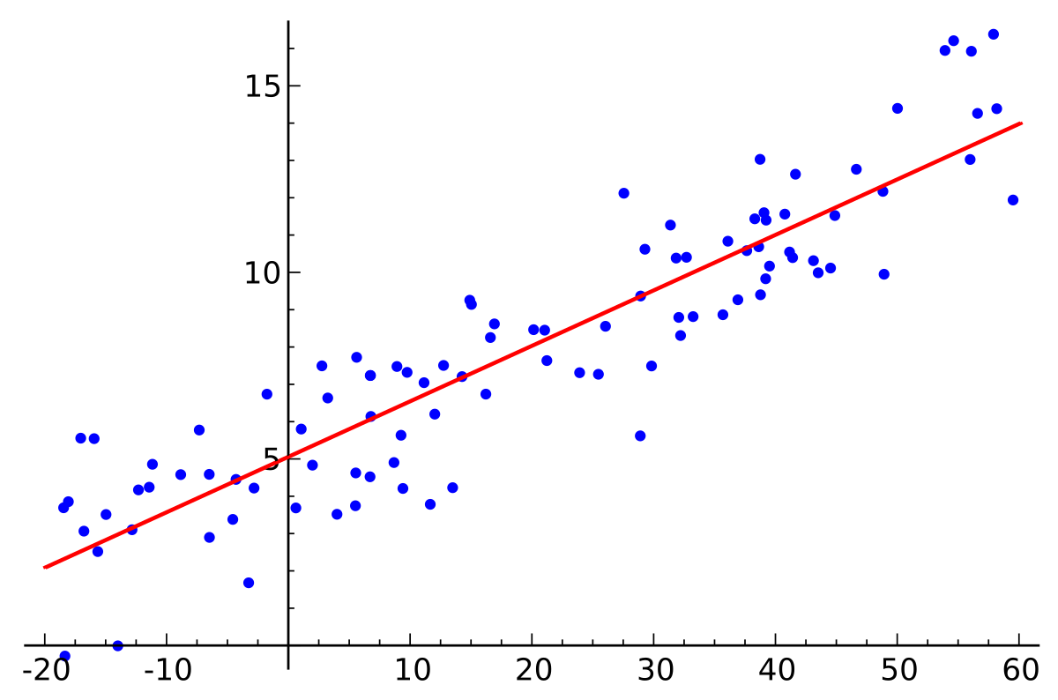
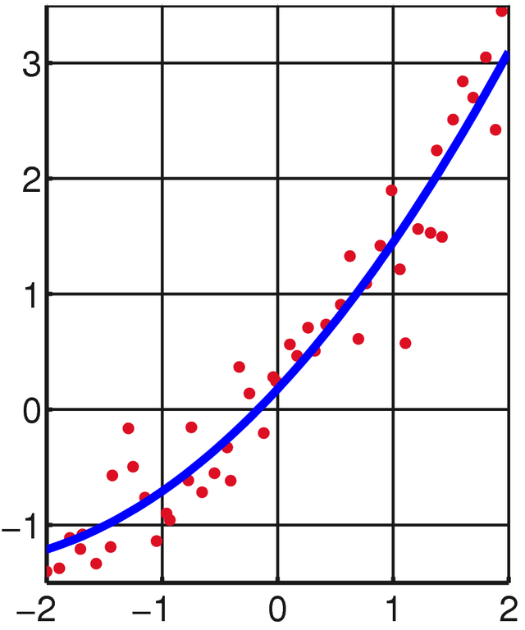

Linear Least Squares Optimization (LLSO)
Linear refers to the parameters, not the line fitting the data
LLSO for regression fits data using a function of the form:
$$f\left(\vec{x;} \vec{β}\right)= β_{0}+β_{1}x+β_{2}x^{2}+…$$
https://en.wikipedia.org/wiki/Linear_least_squares

Slide 5
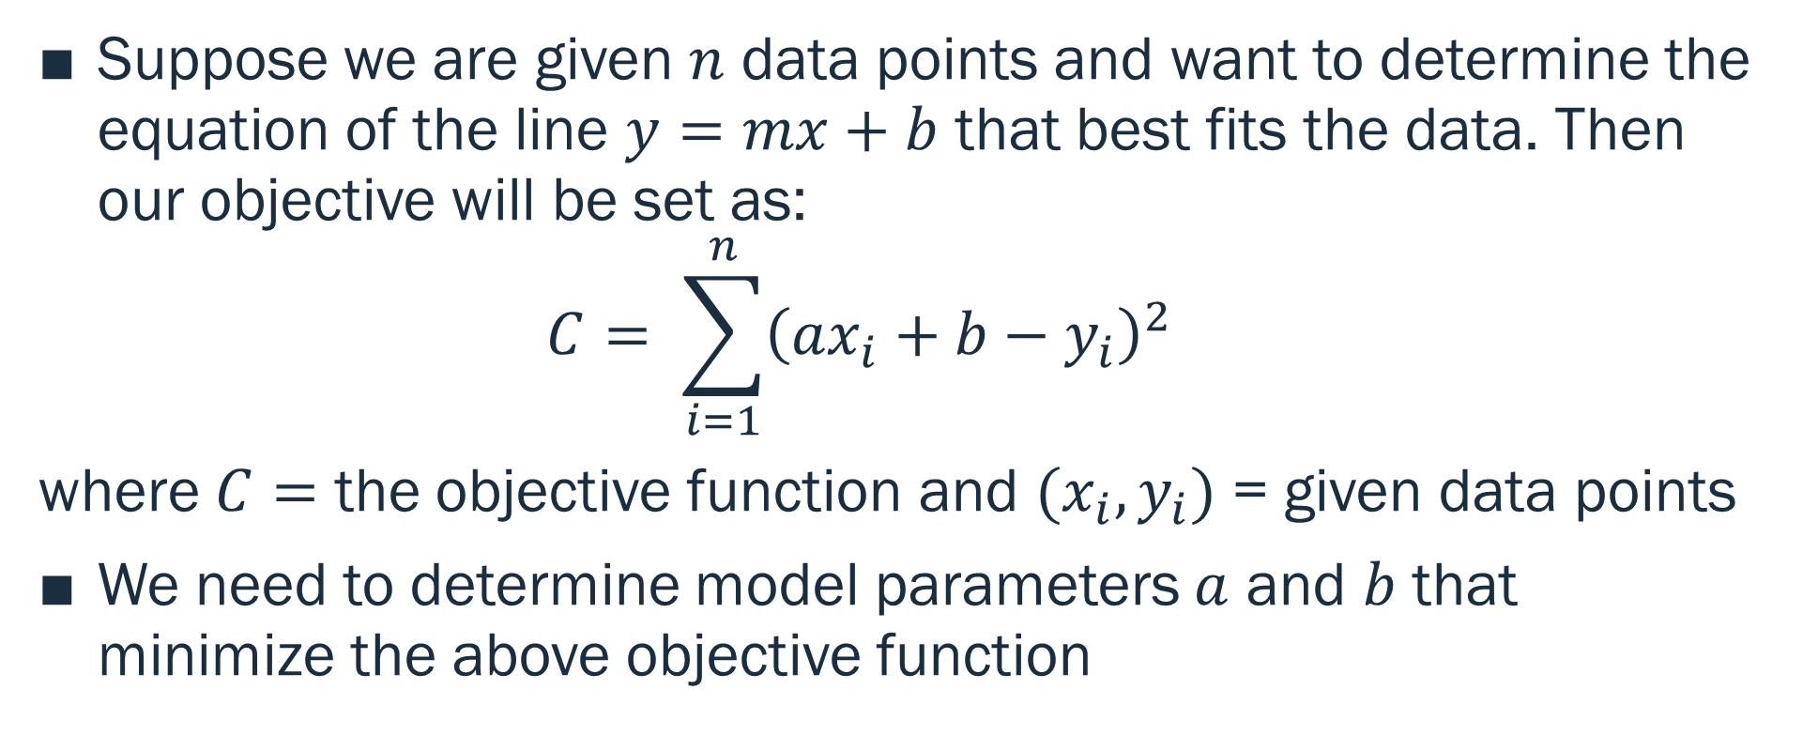
Linear Least Squares Optimization Algorithm
Suppose we are given $n$ data points and want to determine the equation of the line $y=mx+b$ that best fits the data. Then our objective will be set as:
$$C= \sum_{i=1}^{n}{{\left(ax_{i}+b−y_{i}\right)}^{2}}$$
where $C=$ the objective function and ${(x}_{i},y_{i})$ = given data points
We need to determine model parameters $a$ and $b$ that minimize the above objective function

Slide 6
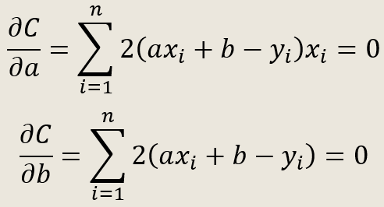



Linear Least Squares Optimization Cont.
$$C= \sum_{i=1}^{n}{{\left(ax_{i}+b−y_{i}\right)}^{2}}$$
To determine $a$ and $b$ that minimizes $C$, we take the partial derivatives with respect to each parameter and equate to 0:
$$1$$
$$2$$

Slide 7
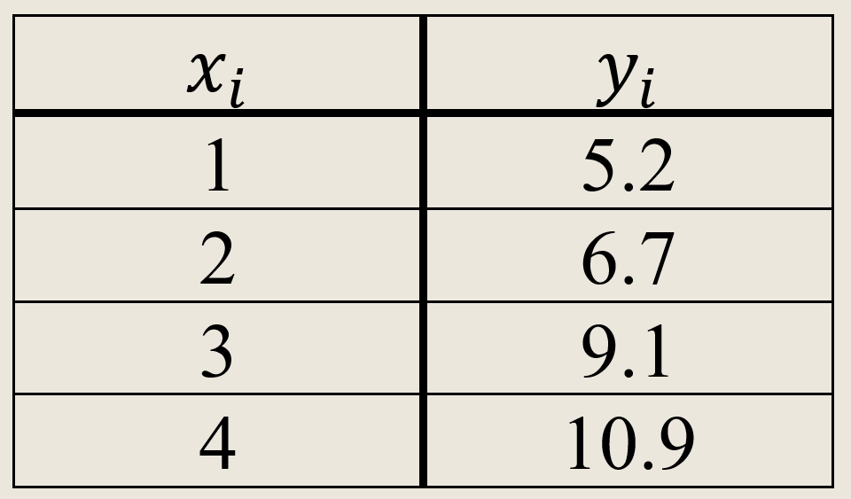
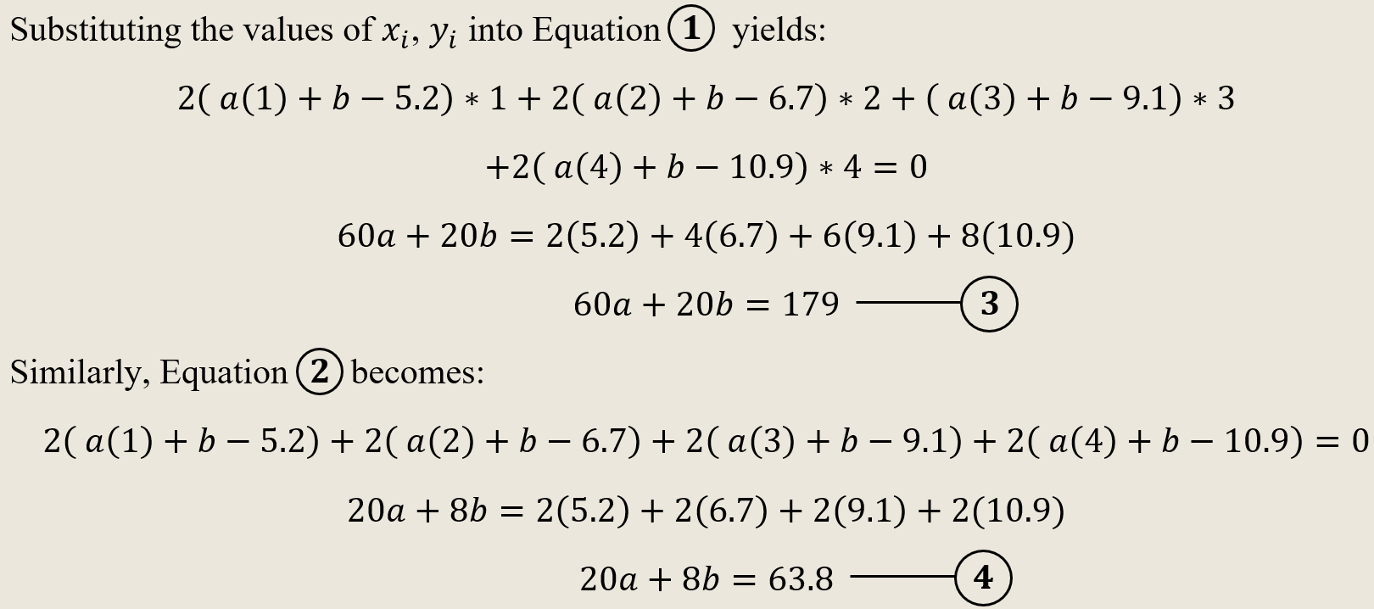
Example

Slide 8
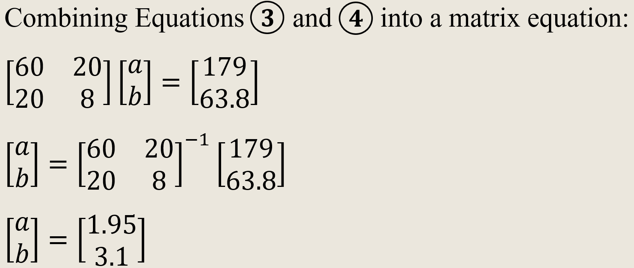
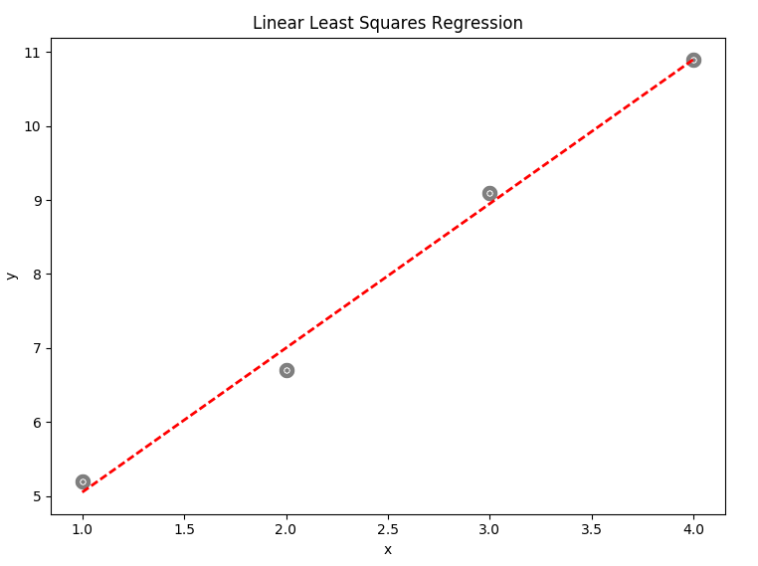
Example Cont.

Slide 9


Application of LLSO to Computer Vision
Image Alignment:
Let Image 1 be our reference image
Let Image 2 be the image we wish to transform to resemble the reference image
Image 1
Image 2

Slide 10

Image Alignment Cont.
Consider a rotation transformation on Image 2 as follows:

Slide 11
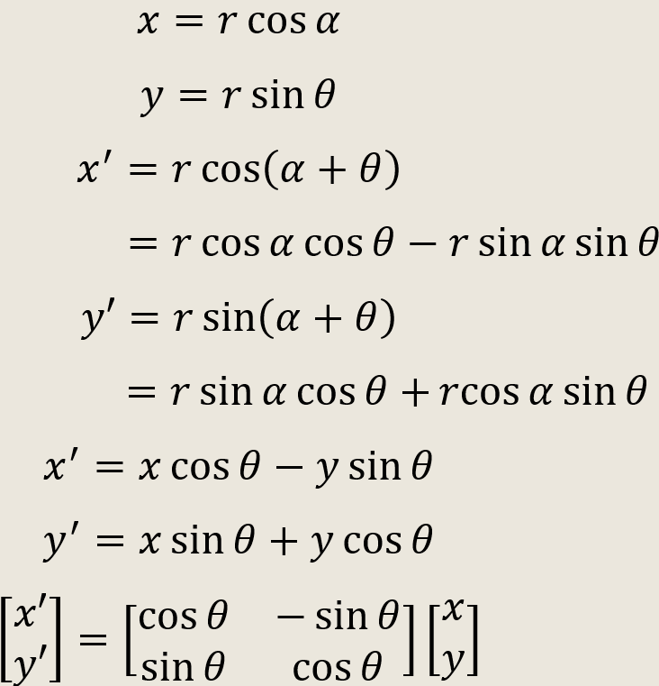
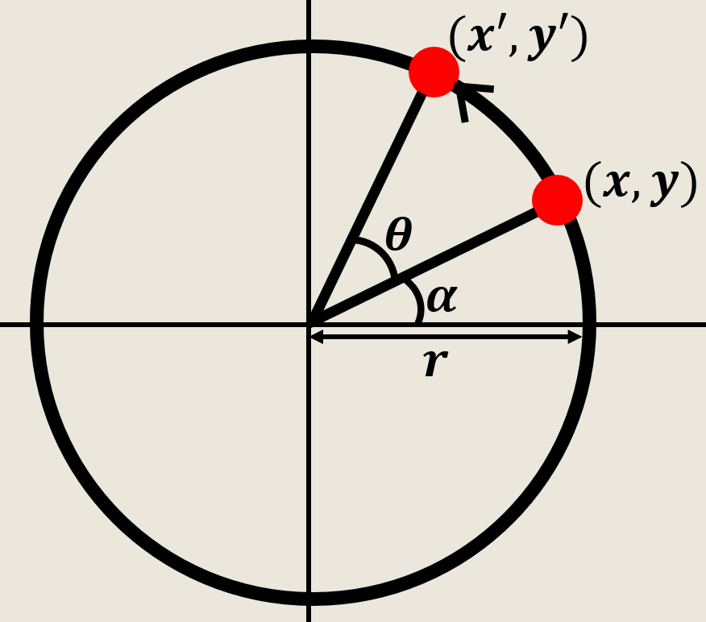
Rotation Derivation

Slide 12
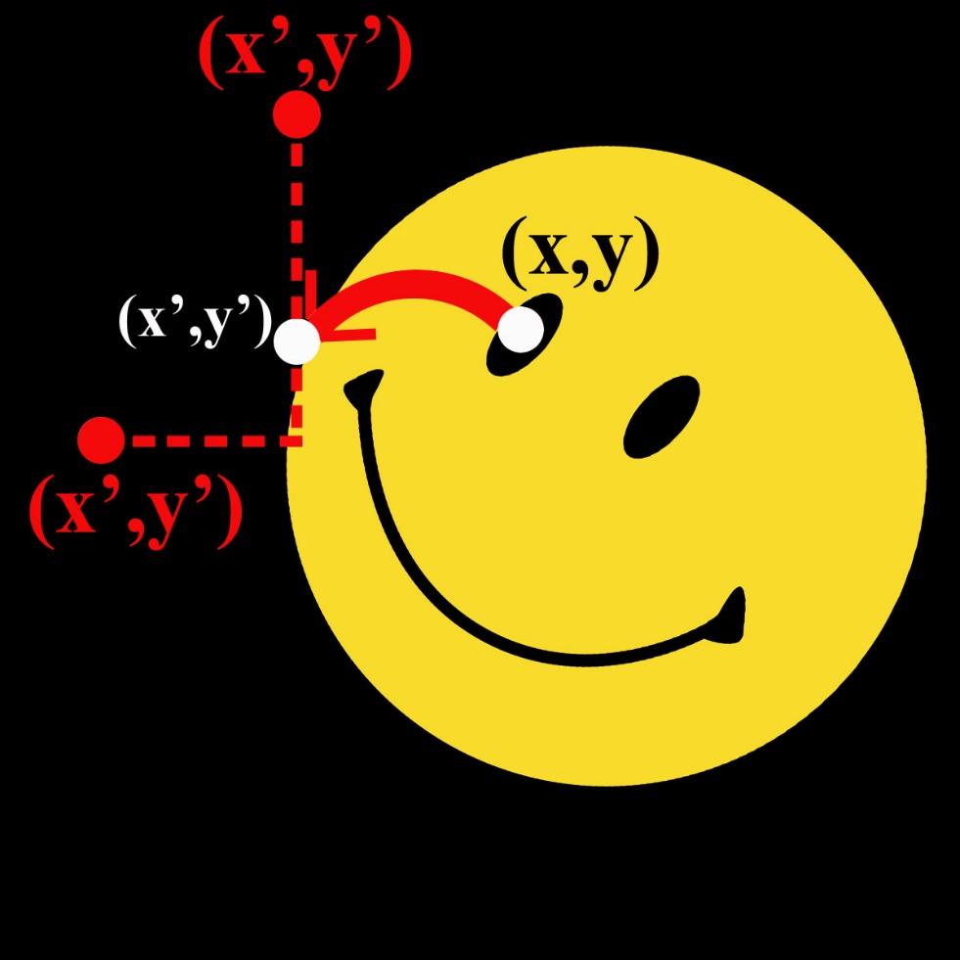
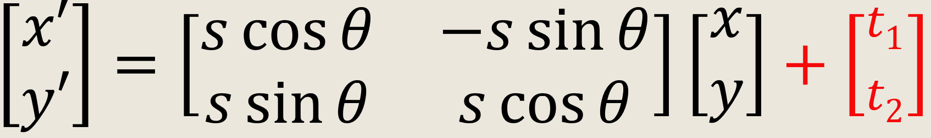
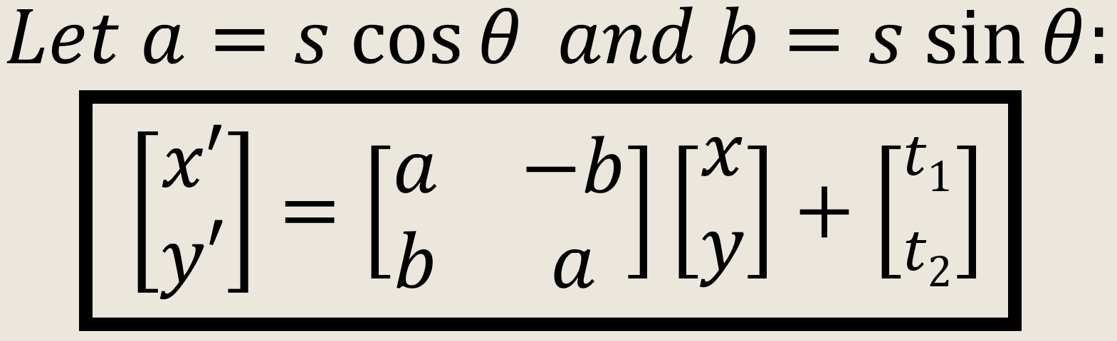
Image Alignment: Final Result
Suppose there is a horizontal or vertical shift in addition to the point rotation:

Slide 13
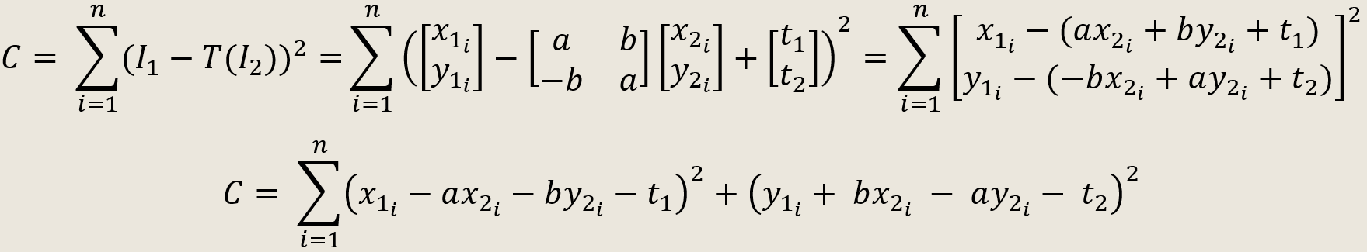

Development of Linear Least Squares for Computer Vision
A set of points corresponds to the locations of eyes, a nose, and a chin for the images of two persons. Let the first image be $I_{1}$ and the second be $I_{2}$

Slide 14
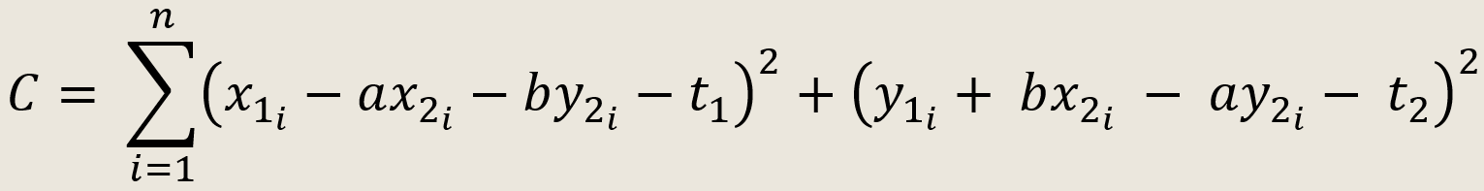
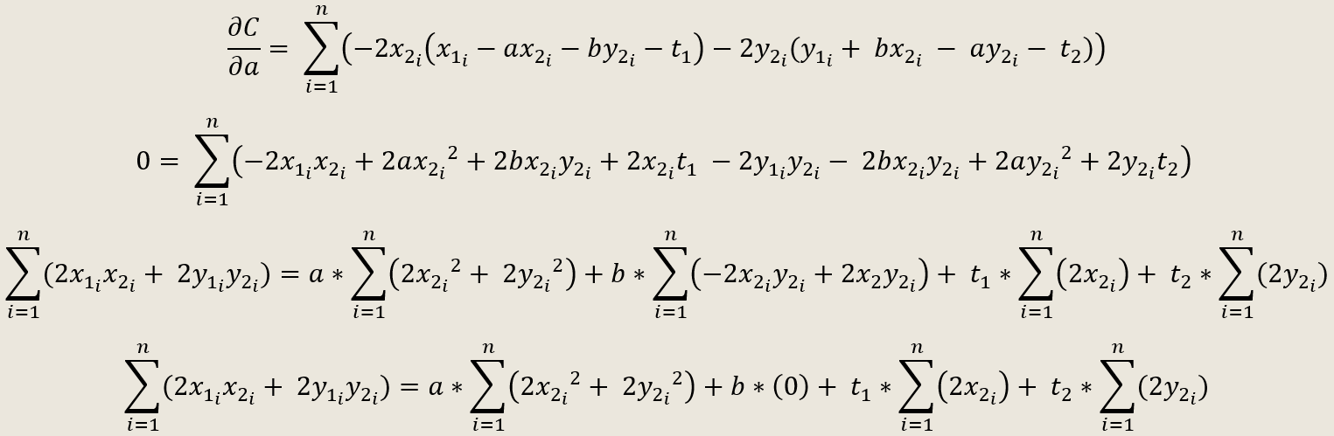
Development of Linear Least Squares for Computer Vision Cont.

Slide 15
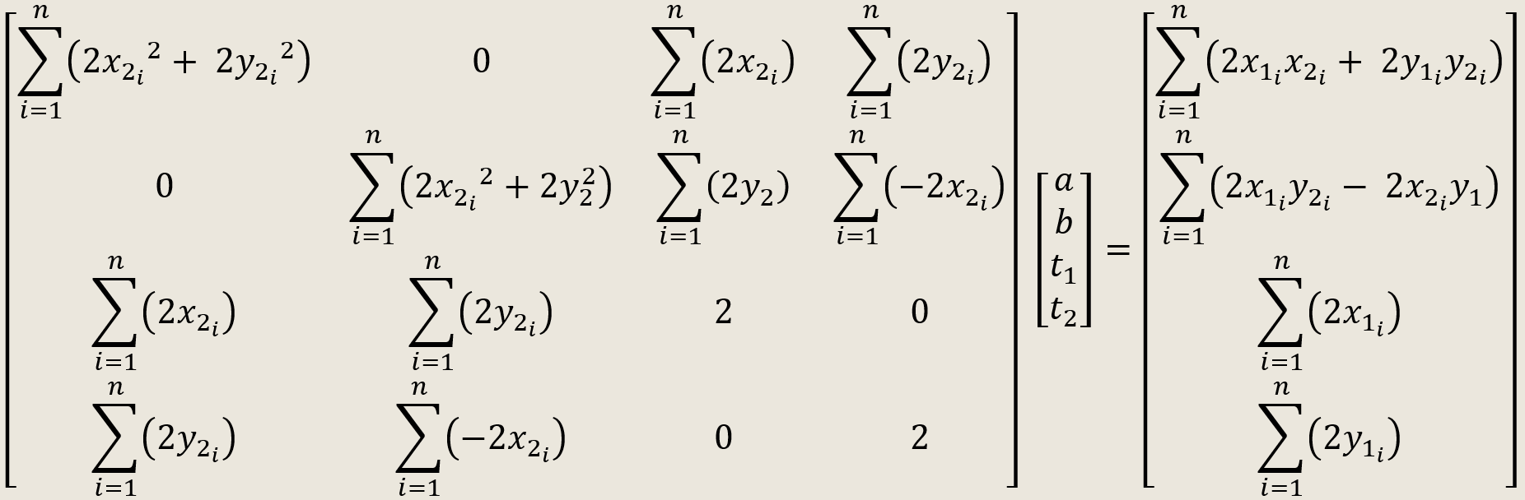
Development of Linear Least Squares for Computer Vision Cont.
Assembling the four partial derivatives into a matrix equation:

Slide 16
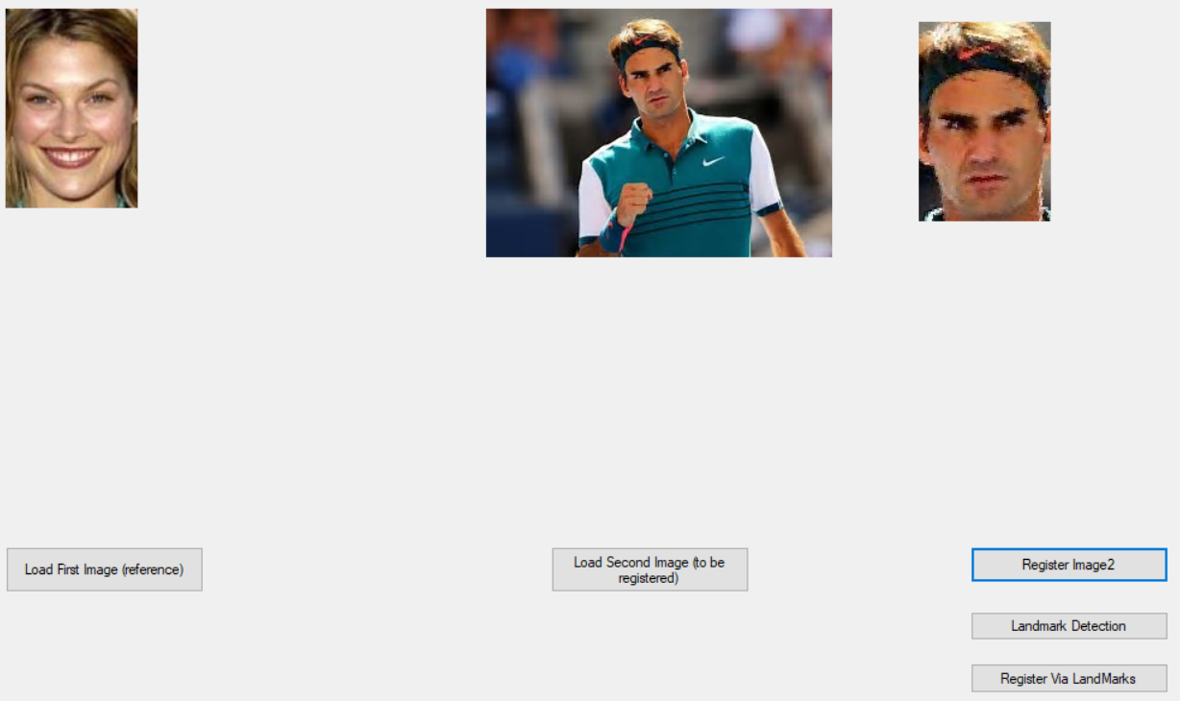
Manual Registration

Slide 17
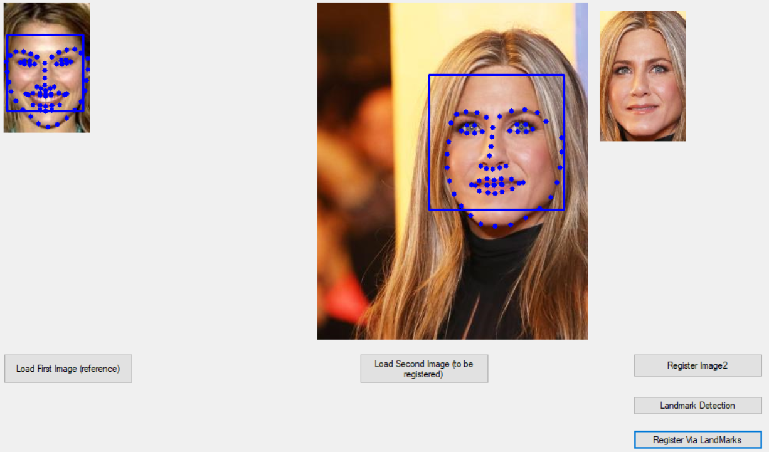
Automated Registration
Correspondence points between two images are obtained using Landmark Detection in Intel OpenCV library

Slide 18
References
https://www.itl.nist.gov/div898/handbook/pmd/section1/pmd141.htm

