Slide 1
Algorithms
Assist. Prof. Dr Abdul Hadi Mohammed Alaidi
Greedy Algorithms

Slide 2
Greedy Algorithms
Greedy algorithm repeatedly makes locally best choice/decision ignoring what its effect will be in future
They are often intuitive, easy to understand and easy to implement
However the problem is that in many situations we can not solve a problem using a greedy approach
Greedy solution is not necessarily best
Sometimes greedy may also be good enough
  When you can prove it

Slide 3
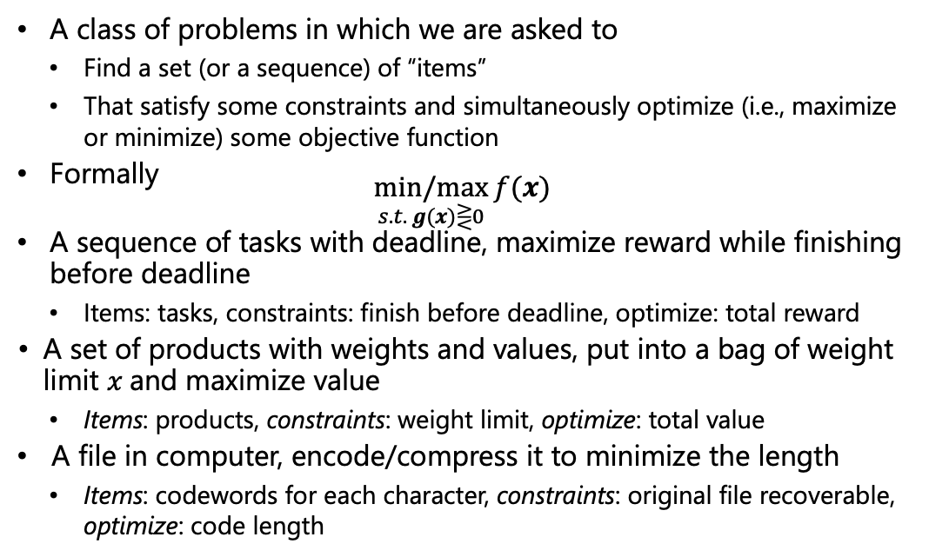
Optimization Problems
A class of problems in which we are asked to
  Find a set (or a sequence) of “items”
  That satisfy some constraints and simultaneously optimize (i.e., maximize or minimize) some objective function
Formally
$\underset{s.t. g(x)⋛0}{min/max}{f(x)}$
A sequence of tasks with deadline, maximize reward while finishing before deadline
  Items: tasks, constraints: finish before deadline, optimize: total reward
A set of products with weights and values, put into a bag of weight limit $x$and maximize value
  Items: products, constraints: weight limit, optimize: total value
A file in computer, encode/compress it to minimize the length
  Items: codewords for each character, constraints: original file recoverable, optimize: code length

Slide 4
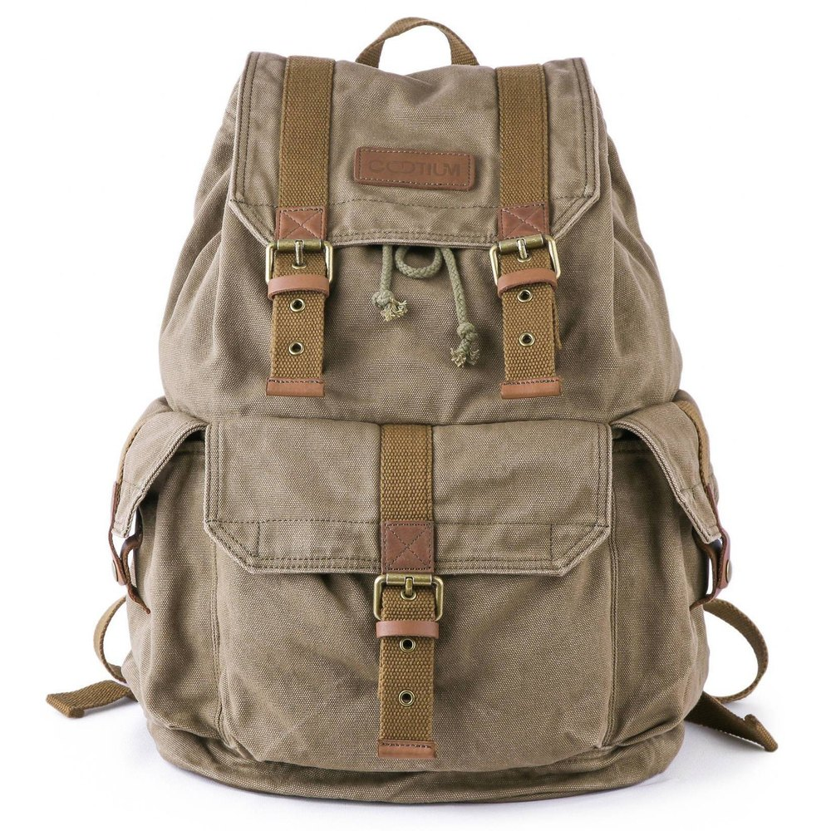
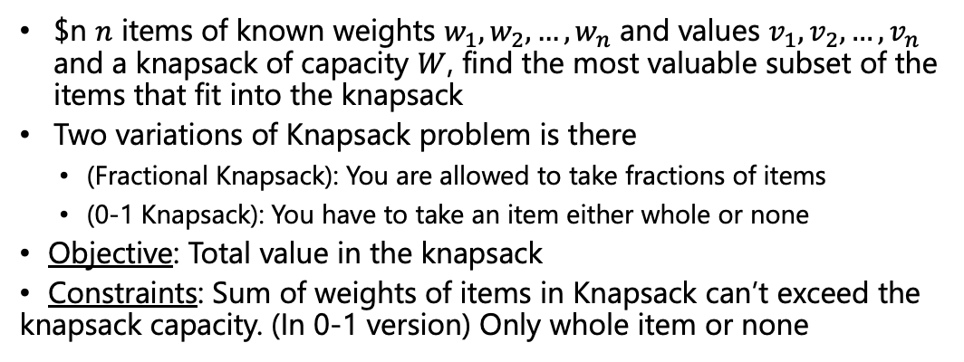
Knapsack Problem
$n $n$ items of known weights $w_{1},w_{2},…, w_{n}$ and values $v_{1},v_{2},…, v_{n}$ and a knapsack of capacity $W$, find the most valuable subset of the items that fit into the knapsack
Two variations of Knapsack problem is there
  (Fractional Knapsack): You are allowed to take fractions of items
  (0-1 Knapsack): You have to take an item either whole or none
Objective: Total value in the knapsack
Constraints: Sum of weights of items in Knapsack can’t exceed the knapsack capacity. (In 0-1 version) Only whole item or none
Item 3
Item 2
Item 1
30 Kg
50 Kg
20 Kg
10 Kg
$60
$100
$120

Slide 5
Knapsack Problem
Which variation of the Knapsack problem should be easy to solve?
Any simple approach to solve the fractional Knapsack problem?
Get the per unit value of the items and fill out the knapsack starting with the item highest per unit value and go on in a descending order
The total value is coming to be $240
The strategy here is literally “greedy”
It is also optimal in this case
Total value =
60+100+4*20 =
$240
4 $/kg
Item 3
5 $/kg
Item 2
6 $/kg
20 kg
Item 1
30 kg
50 Kg
20 kg
20 kg
10 kg
$60
$100
$120
10 kg

Slide 6
Knapsack Problem
What may come challenging sometimes is proving a greedy technique indeed gives optimal solution
For fractional knapsack its relatively easy
Intuitively: For the first 10 kg space of the knapsack we are putting the best possible option (item 1).
For the next 20 kg space we going for the best possible option available and so on
Total value =
60+100+4*20 =
$240
4 $/kg
Item 3
5 $/kg
Item 2
6 $/kg
20 kg
Item 1
30 kg
50 Kg
20 kg
20 kg
10 kg
$60
$100
$120
10 kg

Slide 7
Knapsack Problem
Lets see how this strategy works for 0-1 Knapsack problem
But this is not the optimal solution. We can do better
What is the optimal solution?
Total value =
60+100 =
$160
4 $/kg
Item 3
5 $/kg
Item 2
6 $/kg
0 kg
Item 1
30 kg
50 Kg
20 kg
20 kg
10 kg
$60
$100
$120
10 kg

Slide 8
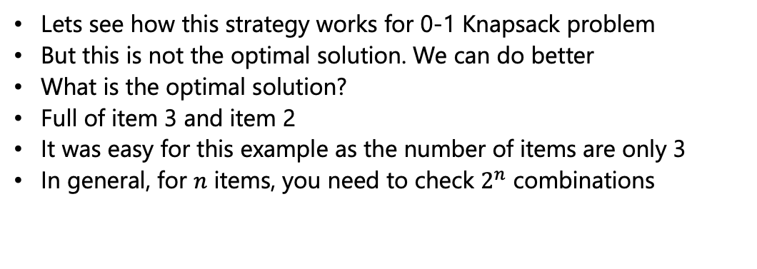
Knapsack Problem
Lets see how this strategy works for 0-1 Knapsack problem
But this is not the optimal solution. We can do better
What is the optimal solution?
Full of item 3 and item 2
It was easy for this example as the number of items are only 3
In general, for $n$ items, you need to check $2^{n}$ combinations
Total value =
120+100 =
$220
4 $/kg
Item 3
5 $/kg
Item 2
6 $/kg
20 kg
Item 1
30 kg
50 Kg
20 kg
10 kg
30 kg
$60
$100
$120

Slide 9
Knapsack Problem
The greedy strategy that worked for the fractional Knapsack problem, did not work for the 0-1 Knapsack problem
Lets try another greedy strategy
Starting with the item highest total value and go on in a descending order
For this instance, it gives the optimal solution
Any instance/example where this strategy fails?
Total value =
120+100 =
$220
4 $/kg
Item 3
5 $/kg
Item 2
6 $/kg
20 kg
Item 1
30 kg
50 Kg
20 kg
10 kg
30 kg
$60
$100
$120

Slide 10
Knapsack Problem
Add a 4th item with more weight but with slightly high value
Say a 4th item weighs 40 kg with value $130
The greedy strategy gives the solution as 40 kg of item 4 and 10 kg of item 1. The total value is $190
However, the optimal solution is 30 kg of item 1 and 20 kg of item 2. The total value is $220
Item 4
Item 3
Item 2
40 kg
Item 1
30 kg
50 Kg
20 kg
10 kg
$60
$100
$120
$130

Slide 11
Knapsack Problem
We have tried two different greedy strategies to solve 0-1 Knapsack problem. But none of them worked
Do we have any greedy strategy that works for 0-1 Knapsack problem?
To the best of our knowledge there is no known greedy strategy that works for 0-1 Knapsack problem
Later we will see other approaches to solve a 0-1 Knapsack problem
Item 4
Item 3
Item 2
40 kg
Item 1
30 kg
50 Kg
20 kg
10 kg
$60
$100
$120
$130

Slide 12
Fractional Knapsack Problem - Pseudocode
FractionalKnapsack(w, V, C, n)
Find V[i]/w[i] for all item i
Sort the items in both V[i] and w[i] by V[i]/w[i] in descending order
load = 0
for i=1 to n
if w[i] < C – load
Take whole of item i
load += w[i]
else
Take (C-load) amount of item i
Load = C
break

Slide 13
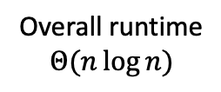
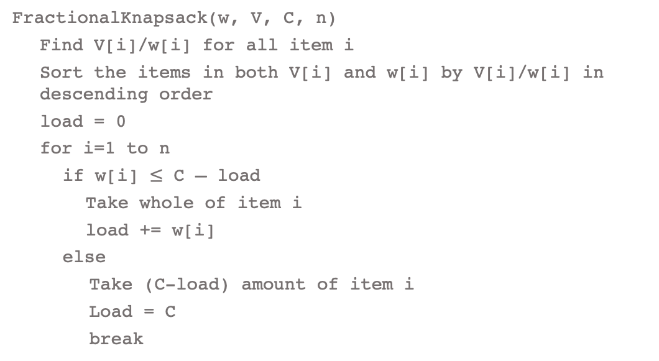




Fractional Knapsack Problem - Analysis
FractionalKnapsack(w, V, C, n)
Find V[i]/w[i] for all item i
Sort the items in both V[i] and w[i] by V[i]/w[i] in descending order
load = 0
for i=1 to n
if w[i] $≤$ C – load
Take whole of item i
load += w[i]
else
Take (C-load) amount of item i
Load = C
break
$$Θ(n)$$
$$Θ(n\log{n})$$
$$Θ(1)$$
Overall runtime
$$Θ(n\log{n})$$
$$Θ(n)$$

Slide 14
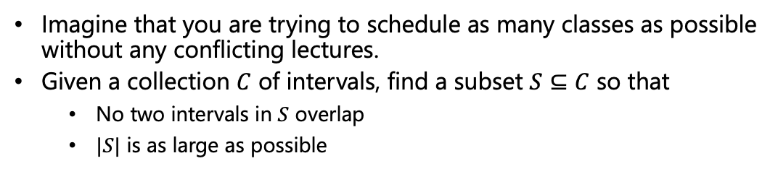
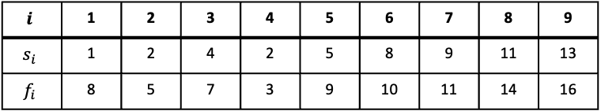
Activity Selection/Interval Scheduling Problem
Imagine that you are trying to schedule as many classes as possible without any conflicting lectures.
Given a collection $C$ of intervals, find a subset $S⊆C$ so that
  No two intervals in $S$ overlap
  $|S|$ is as large as possible
$$i$$ | 1 | 2 | 3 | 4 | 5 | 6 | 7 | 8 | 9
$$s_{i}$$ | 1 | 2 | 4 | 2 | 5 | 8 | 9 | 11 | 13
$$f_{i}$$ | 8 | 5 | 7 | 3 | 9 | 10 | 11 | 14 | 16
1
2
3
4
5
6
7
8
9

Slide 15
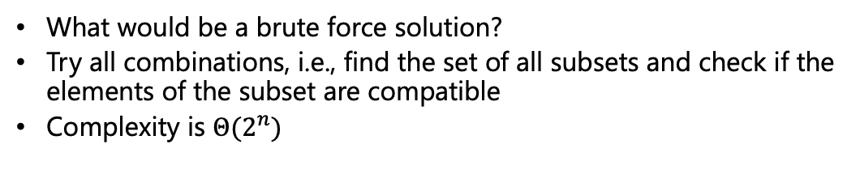
Activity Selection/Interval Scheduling Problem
What would be a brute force solution?
Try all combinations, i.e., find the set of all subsets and check if the elements of the subset are compatible
Complexity is $Θ(2^{n})$
$$i$$ | 1 | 2 | 3 | 4 | 5 | 6 | 7 | 8 | 9
$$s_{i}$$ | 1 | 2 | 4 | 2 | 5 | 8 | 9 | 11 | 13
$$f_{i}$$ | 8 | 5 | 7 | 3 | 9 | 10 | 11 | 14 | 16
1
2
3
4
5
6
7
8
9

Slide 16
Activity Selection/Interval Scheduling Problem
What can be a greedy strategy?
Remember greedy implies choosing a criterion and according to the criterion, take a decision that seems best at the moment and repeat this
What about picking the shortest duration first, then the next shortest duration and so on?
$$i$$ | 1 | 2 | 3 | 4 | 5 | 6 | 7 | 8 | 9
$$s_{i}$$ | 1 | 2 | 4 | 2 | 5 | 8 | 9 | 11 | 13
$$f_{i}$$ | 8 | 5 | 7 | 3 | 9 | 10 | 11 | 14 | 16
1
2
3
4
5
6
7
8
9

Slide 17
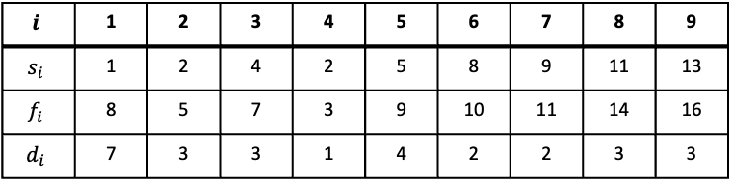
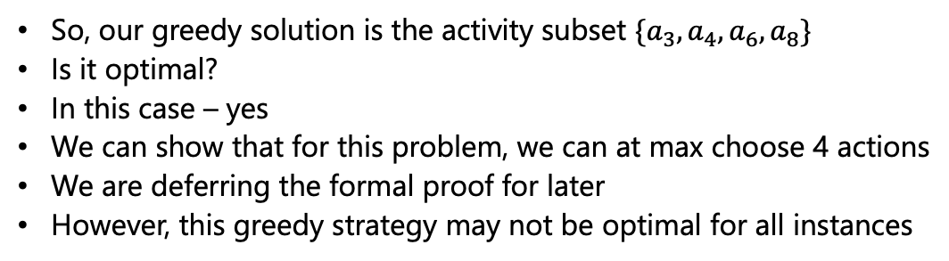
Shortest Duration
$$i$$ | 1 | 2 | 3 | 4 | 5 | 6 | 7 | 8 | 9
$$s_{i}$$ | 1 | 2 | 4 | 2 | 5 | 8 | 9 | 11 | 13
$$f_{i}$$ | 8 | 5 | 7 | 3 | 9 | 10 | 11 | 14 | 16
$$d_{i}$$ | 7 | 3 | 3 | 1 | 4 | 2 | 2 | 3 | 3
❌
❌
✅
✅
❌
✅
❌
✅
❌
So, our greedy solution is the activity subset $\{a_{3},a_{4},a_{6},a_{8}\}$
Is it optimal?
In this case – yes
We can show that for this problem, we can at max choose 4 actions
We are deferring the formal proof for later
However, this greedy strategy may not be optimal for all instances

Slide 18
Earliest Start
What about choosing by early start?
Is it optimal?
No – in general

Slide 19
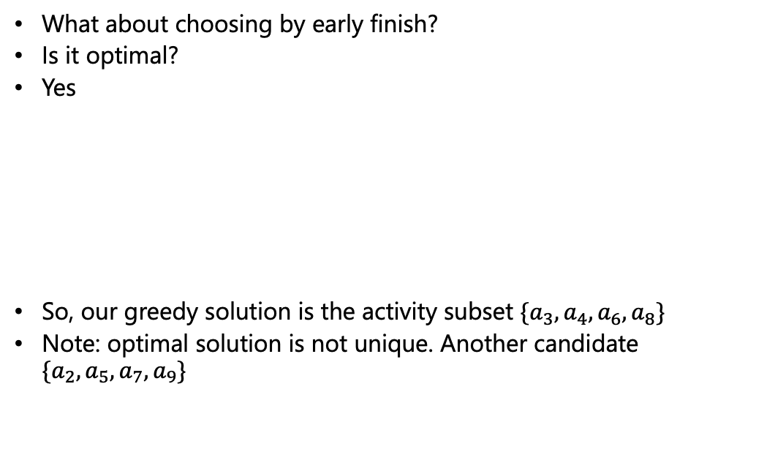
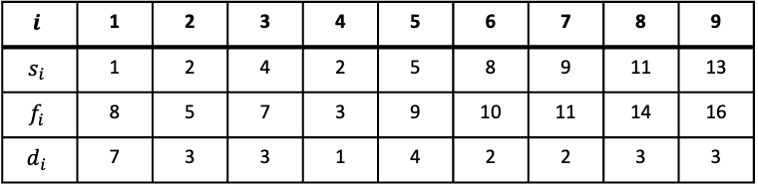
Earliest Finish
What about choosing by early finish?
Is it optimal?
Yes
So, our greedy solution is the activity subset $\{a_{3},a_{4},a_{6},a_{8}\}$
Note: optimal solution is not unique. Another candidate $\{a_{2},a_{5},a_{7},a_{9}\}$
$$i$$ | 1 | 2 | 3 | 4 | 5 | 6 | 7 | 8 | 9
$$s_{i}$$ | 1 | 2 | 4 | 2 | 5 | 8 | 9 | 11 | 13
$$f_{i}$$ | 8 | 5 | 7 | 3 | 9 | 10 | 11 | 14 | 16
$$d_{i}$$ | 7 | 3 | 3 | 1 | 4 | 2 | 2 | 3 | 3
❌
❌
✅
✅
❌
✅
❌
✅
❌

Slide 20
Alternate Strategy
Given that ‘earliest finish’ strategy works, using symmetry what can be an alternate strategy that will also work?
Hint: Think why ‘earliest finish’ strategy works
Choosing earliest finish leaves maximum room for other activities to fill in
So, by symmetry, ‘latest start’ [looking from the other end] will also give optimal solution

Slide 21
Activity Selection Problem - Pseudocode
s: Array of start times, f: Array of finish times
R: Set of all requests, A: Set of accepted requests
n: Number of activities, k: Index of last accepted activity
ActivitySel(s, f, A, n)
Sort the items in s, f and R by f[i] in ascending order
Remove R[1] from R and add to A
k = 1; i = 2
while R is not empty:
if s[i] > f[k]:
Remove R[i] from R and add to A
k = i
else:
Remove R[i] from R
i++
The runtime is $Θ(n\log{n})$ [Sorting dominates]

Slide 22
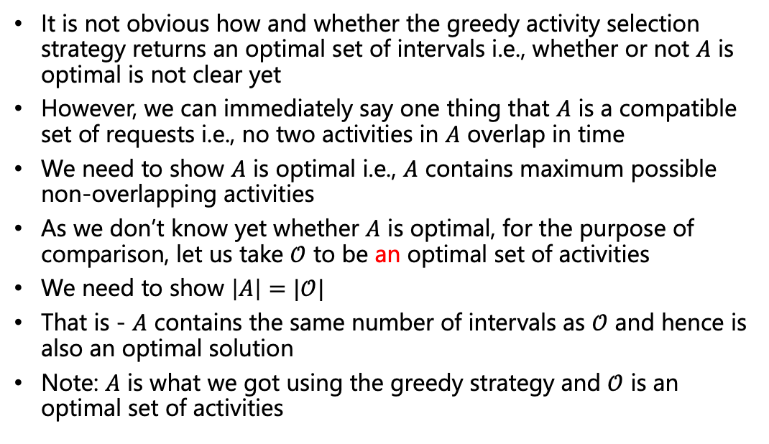
Optimality of Greedy Activity Selection
It is not obvious how and whether the greedy activity selection strategy returns an optimal set of intervals i.e., whether or not $A$ is optimal is not clear yet
However, we can immediately say one thing that $A$ is a compatible set of requests i.e., no two activities in $A$ overlap in time
We need to show $A$ is optimal i.e., $A$ contains maximum possible non-overlapping activities
As we don’t know yet whether $A$ is optimal, for the purpose of comparison, let us take $𝒪$ to be an optimal set of activities
We need to show $\left|A\right|=|𝒪|$
That is - $A$ contains the same number of intervals as $𝒪$ and hence is also an optimal solution
Note: $A$ is what we got using the greedy strategy and $𝒪$ is an optimal set of activities

Slide 23
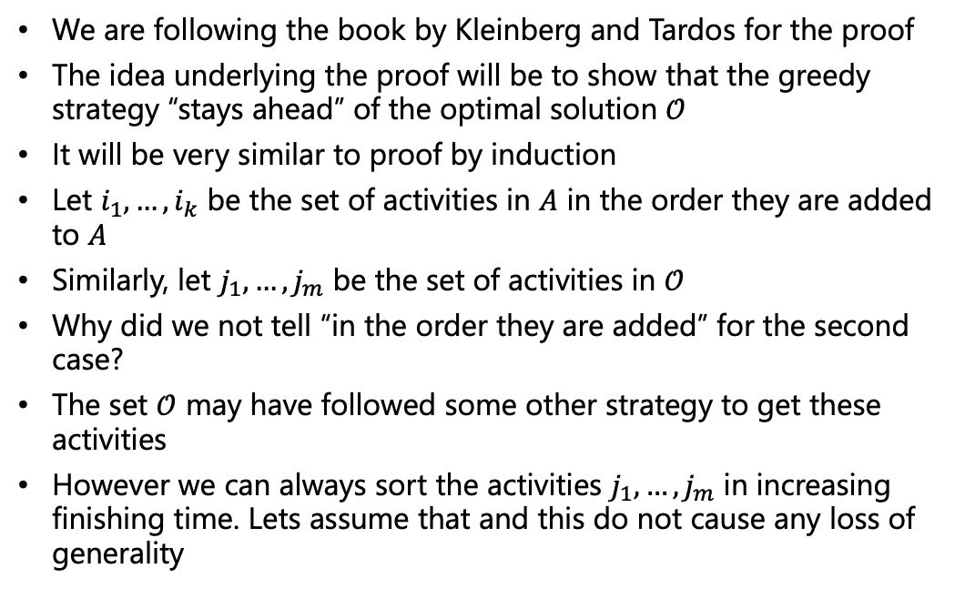
Optimality of Greedy Activity Selection
We are following the book by Kleinberg and Tardos for the proof
The idea underlying the proof will be to show that the greedy strategy “stays ahead” of the optimal solution $𝒪$
It will be very similar to proof by induction
Let $i_{1},…,i_{k}$ be the set of activities in $A$ in the order they are added to $A$
Similarly, let $j_{1},…,j_{m}$ be the set of activities in $𝒪$
Why did we not tell “in the order they are added” for the second case?
The set $𝒪$ may have followed some other strategy to get these activities
However we can always sort the activities $j_{1},…,j_{m}$ in increasing finishing time. Lets assume that and this do not cause any loss of generality
Notes:
Answer to the question: Well this set is described to be optimal i.e., this set contains maximum number of non-overlapping activities, but it is not necessary that they have been obtained by some order. Its just one set with maximum number of compatible activities

Slide 24
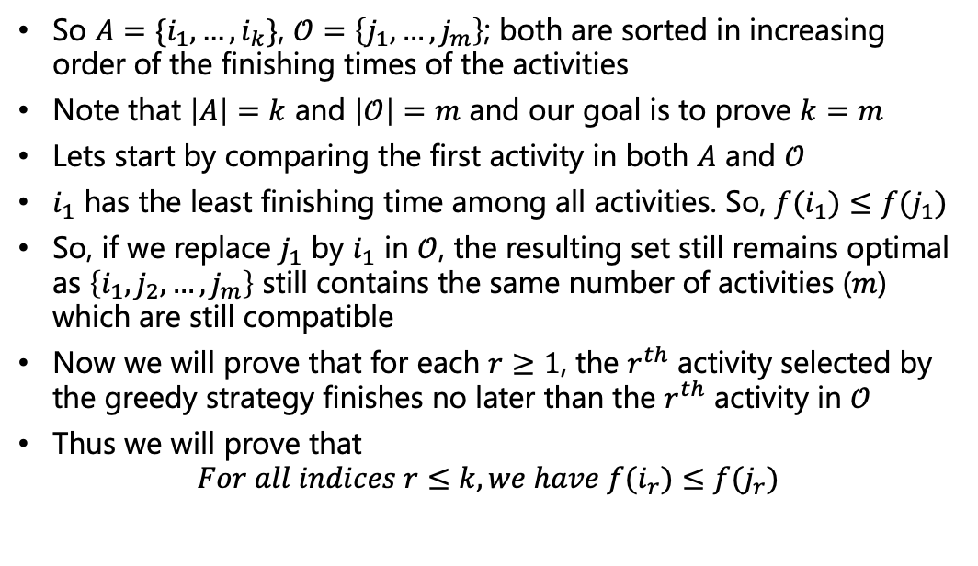
Optimality of Greedy Activity Selection
So $A=\{i_{1},…,i_{k}\}$, $𝒪=\left\{j_{1},…,j_{m}\right\}$; both are sorted in increasing order of the finishing times of the activities
Note that $\left|A\right|=k$ and $\left|𝒪\right|=m$ and our goal is to prove $k=m$
Lets start by comparing the first activity in both $A$ and $𝒪$
$i_{1}$ has the least finishing time among all activities. So, $f(i_{1})≤f(j_{1})$
So, if we replace $j_{1}$ by $i_{1}$ in $𝒪$, the resulting set still remains optimal as $\left\{i_{1},j_{2},…,j_{m}\right\}$ still contains the same number of activities ($m$) which are still compatible
Now we will prove that for each $r≥1$, the $r^{th}$ activity selected by the greedy strategy finishes no later than the $r^{th}$ activity in $𝒪$
Thus we will prove that
$For all indices r≤k, we have f(i_{r})≤f(j_{r})$

Slide 25
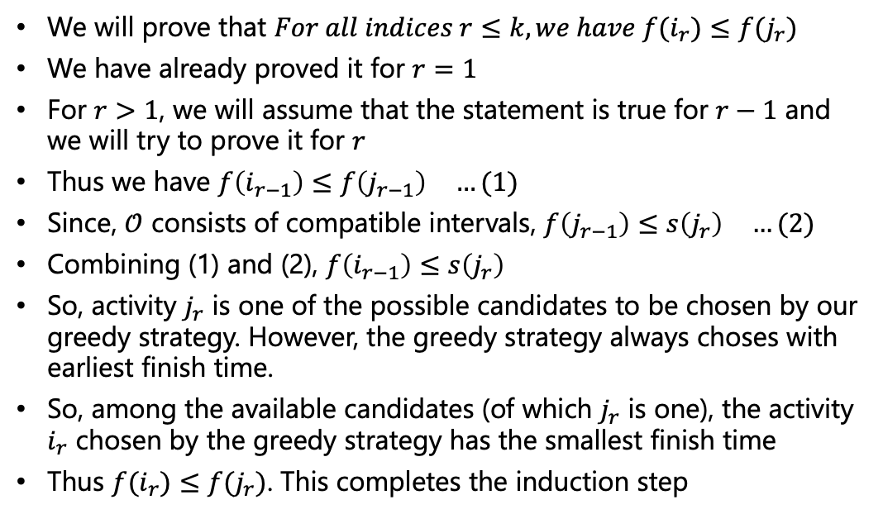
Optimality of Greedy Activity Selection
We will prove that $For all indices r≤k, we have f(i_{r})≤f(j_{r})$
We have already proved it for $r=1$
For $r>1$, we will assume that the statement is true for $r−1$ and we will try to prove it for $r$
Thus we have $f\left(i_{r−1}\right)≤f\left(j_{r−1}\right) …(1)$
Since, $𝒪$ consists of compatible intervals, $f\left(j_{r−1}\right)≤s\left(j_{r}\right) …(2)$
Combining (1) and (2), $f\left(i_{r−1}\right)≤s\left(j_{r}\right)$
So, activity $j_{r}$ is one of the possible candidates to be chosen by our greedy strategy. However, the greedy strategy always choses with earliest finish time.
So, among the available candidates (of which $j_{r}$ is one), the activity $i_{r}$ chosen by the greedy strategy has the smallest finish time
Thus $f(i_{r})≤f(j_{r})$. This completes the induction step

Slide 26
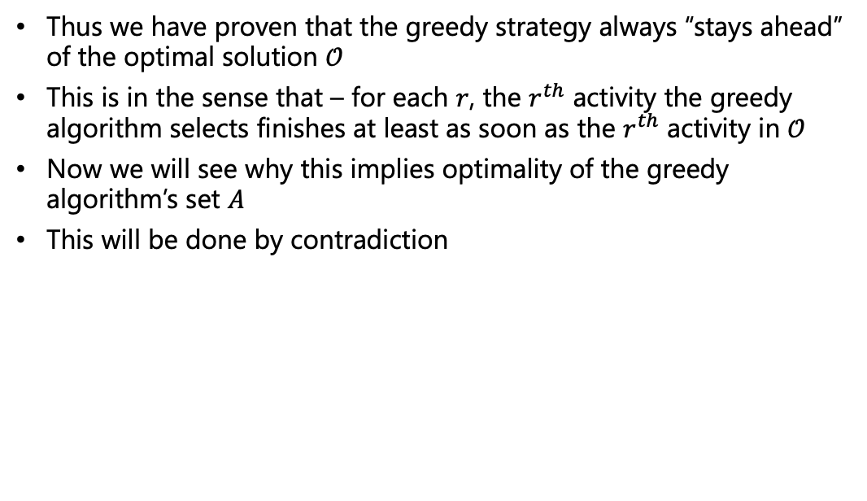
Optimality of Greedy Activity Selection
Thus we have proven that the greedy strategy always “stays ahead” of the optimal solution $𝒪$
This is in the sense that – for each $r$, the $r^{th}$ activity the greedy algorithm selects finishes at least as soon as the $r^{th}$ activity in $𝒪$
Now we will see why this implies optimality of the greedy algorithm’s set $A$
This will be done by contradiction

Slide 27
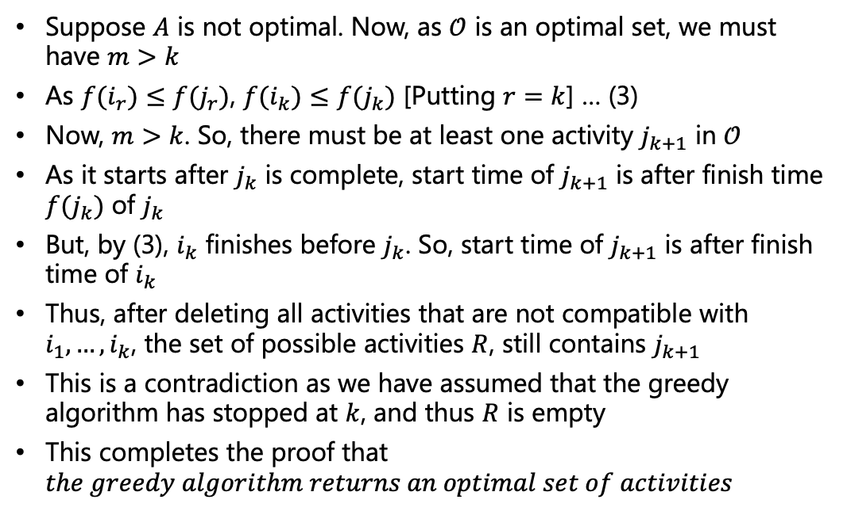
Optimality of Greedy Activity Selection
Suppose $A$ is not optimal. Now, as $𝒪$ is an optimal set, we must have $m>k$
As $f(i_{r})≤f(j_{r})$, $f(i_{k})≤f(j_{k})$ [Putting $r=k$] … (3)
Now, $m>k$. So, there must be at least one activity $j_{k+1}$ in $𝒪$
As it starts after $j_{k}$ is complete, start time of $j_{k+1}$ is after finish time $f(j_{k})$ of $j_{k}$
But, by (3), $i_{k}$ finishes before $j_{k}$. So, start time of $j_{k+1}$ is after finish time of $i_{k}$
Thus, after deleting all activities that are not compatible with $i_{1},…, i_{k}$, the set of possible activities $R$, still contains $j_{k+1}$
This is a contradiction as we have assumed that the greedy algorithm has stopped at $k$, and thus $R$ is empty
This completes the proof that $the greedy algorithm returns an optimal set of activities$

Slide 28
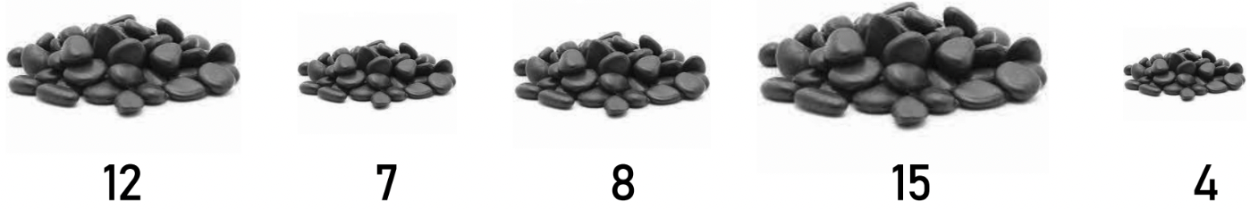
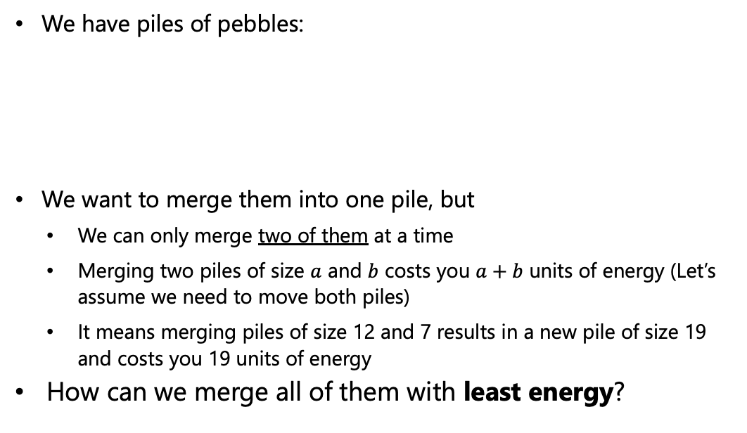
Merge Pebbles
We have piles of pebbles:
We want to merge them into one pile, but
  We can only merge two of them at a time
  Merging two piles of size $a$ and $b$ costs you $a+b$ units of energy (Let’s assume we need to move both piles)
  It means merging piles of size 12 and 7 results in a new pile of size 19 and costs you 19 units of energy
How can we merge all of them with least energy?
: UC Riverside, CS141 course, Fall 2021Source

Slide 29
Merge Pebbles
Lets try to merge the piles in the order they are given
We will use a tree to represent the trace of merging
12
7
8
15
4
46
42
4
27
15
19
8
Energy cost: 19
+ 27
+ 42
+ 46 = 134
12
7
Source: UC Riverside, CS141 course, Fall 2021

Slide 30
Merge Pebbles – Another Solution
Lets try to merge the piles two at a time from original piles
We will use a tree to represent the trace of merging
12
7
8
15
4
46
42
4
19
23
Energy cost: 19
+ 23
+ 42
+ 46 = 130
12
7
8
15
Source: UC Riverside, CS141 course, Fall 2021

Slide 31
Merge Pebbles – Any Greedy Idea?
Always merge two smallest piles
We will use a tree to represent the trace of merging
12
7
8
15
4
46
One thing to notice: The total cost sums all the internal nodes
19
27
11
8
12
15
Energy cost: 11
+ 19
+ 27
+ 46 = 103
4
7
Source: UC Riverside, CS141 course, Fall 2021

Slide 32
Merge Pebbles – Why Greedy is Good
You may need to move a pile multiple times (Cost for moving the same pile is incurred multiple times)
The pile will be charged at all of its ancestors!
Lets consider moving the pile of size 8
Paying thrice
46
Paying twice
Paying twice
46
42
4
Paying once
Paying once
27
15
19
27
19
8
11
8
12
15
12
7
Cost: 134
4
7
Cost: 103
Source: UC Riverside, CS141 course, Fall 2021

Slide 33
Merge Pebbles – Why Greedy is Good
You may need to move a pile multiple times (Cost for moving the same pile is incurred multiple times)
The pile will be charged at all of its ancestors!
How many times do we move the pile of size 8?
  The height of it (number of ancestors)
46
Total cost: 12x4 + 7x4 + 8x3 + 15x2 + 4x1 = 134
Total cost: 4x3 + 7x3 + 8x2 + 12x2 + 15x2 = 103
46
42
4
27
15
19
27
19
8
11
8
12
15
12
7
Cost: 134
4
7
Cost: 103
Source: UC Riverside, CS141 course, Fall 2021
Notes:
Bigger piles if moved closed to the root then saving is done. Note that if we have n piles, n-1 merging needs to be done always

Slide 34
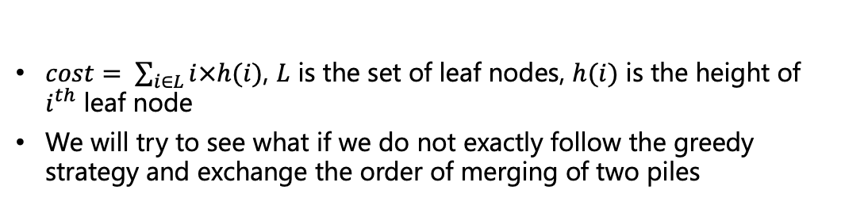
Merge Pebbles – Why Greedy is Good
$cost= \sum_{i∈L}{i×h(i)}$, $L$ is the set of leaf nodes, $h(i)$ is the height of $i^{th}$ leaf node
We will try to see what if we do not exactly follow the greedy strategy and exchange the order of merging of two piles
46
+12 -7
46
19
27
24
22
11
8
12
15
16
8
7
15
4
7
4
12
Total cost: 4x3 + 7x2 + 8x2 + 12x3 + 15x2 = 108
Total cost: 4x3 + 7x3 + 8x2 + 12x2 + 15x2 = 103
Source: UC Riverside, CS141 course, Fall 2021
Notes:
Exchanging piles at the same level does not matter

Slide 35
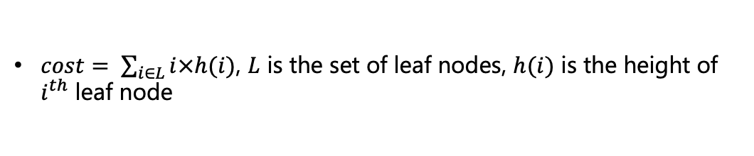
Merge Pebbles – Some Observations
$cost= \sum_{i∈L}{i×h(i)}$, $L$ is the set of leaf nodes, $h(i)$ is the height of $i^{th}$ leaf node
46
It makes sense to put the smallest piles the deepest
Since everytime we merge two piles, there are always two leaves in the deepest level
Once we merge two smallest piles we have the same problem decreased in size by 1 (optimal substructure)
Why do we care about moving pebble piles?
19
27
11
8
12
15
4
7
Total cost: 4x3 + 7x3 + 8x2 + 12x2 + 15x2 = 103
Source: UC Riverside, CS141 course, Fall 2021

Slide 36
Huffman Codes
How data is represented in computers?
Using binary (0’s and 1’s) codes
Fixed-size codes, e.g., ASCII
  A: 1000001 (65)
  B: 1000010 (66)
Fixed size codes may not necessarily be the best way to store/communicate data
Any other ways?

Slide 37

Huffman Codes
Variable size codes like Morse codes
  A:
  B:
  E:
  T:
Invented in 1800s.
Not used for storing in computers, rather for communication
Get more information in www.youtube.com/watch?v=iy8BaMs_JuI
Note: The length of each code is not same.
Why? Any advantage?
Image source: https://tinyurl.com/4mncb26k

Slide 38


Fixed Length vs Variable Length Code
Suppose we have a 100,000-character data file that we wish to store compactly
The file contains only 6 characters, appearing with the following frequencies
We would like to find a binary code that encodes the file using as few bits as possible, i.e., the compression is maximum
Fixed length code requires 300,000 bits to encode the file
The variable length code requires (45*1 + 13*3 + 12*3 + 16*3 + 9*4 + 5*4)*1000 = 224,000 bits
A savings of approximately 25%

Slide 39
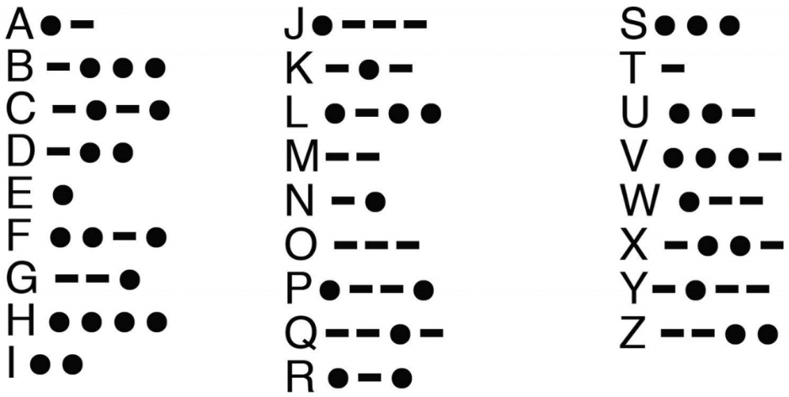

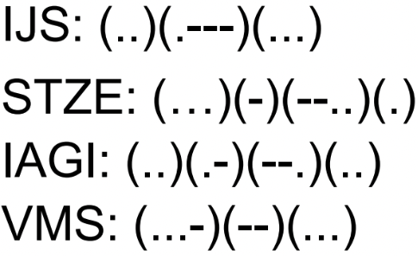
Lets Go Back to Morse Codes
Anything you can notice?
All the coded words are same
Actually ‘pause’ plays a role in Morse code
Source: UC Riverside, CS141 course, Fall 2021

Slide 40
Prefix Codes
No code should sit in front of any other code
Termed as “Prefix code” [Though the book rightly says “Perhaps prefix-free codes would be a better name”]
Morse code is not “Prefix code” [Or called as Non-prefix code]
Encoding means simply concatenate all the codes
abd -> 0101111
Character | Prefix code | Non-prefix code
a | 0 | 00
b | 101 | 001
c | 100 | 11
d | 111 | 111
e | 1101 | 01
f | 1100 | 010

Slide 41
Prefix Codes
Decoding is unambiguous
Example:
  Message: ‘DABA’
  Encoded message: 11101010
  Decoding “11101010” – greedily decode it!
Character | Prefix code | Non-prefix code
a | 0 | 00
b | 101 | 001
c | 100 | 11
d | 111 | 111
e | 1101 | 01
f | 1100 | 010

Slide 42
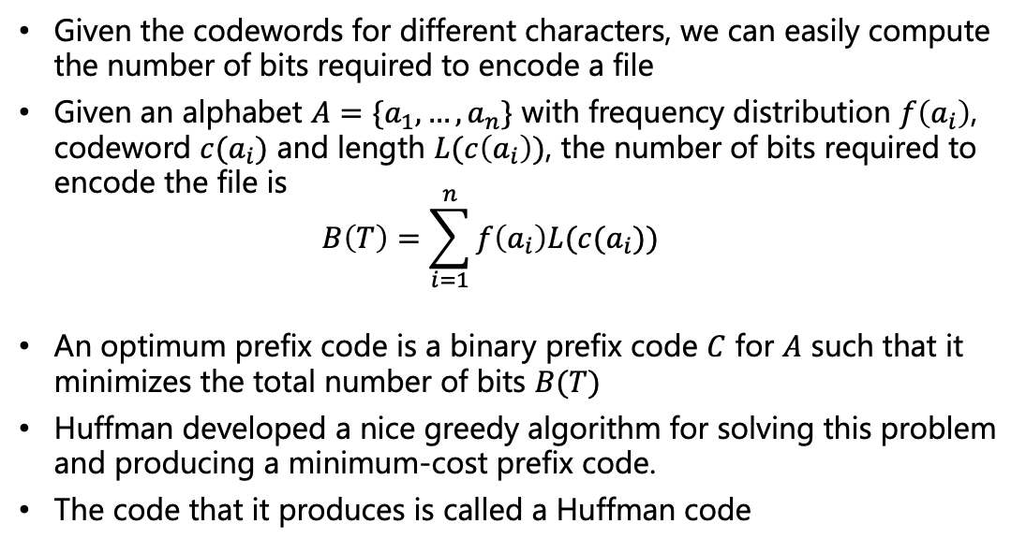
Optimum Prefix Codes
Given the codewords for different characters, we can easily compute the number of bits required to encode a file
Given an alphabet $A=\{a_{1},…,a_{n}\}$ with frequency distribution $f\left(a_{i}\right)$, codeword $c(a_{i})$ and length $L(c\left(a_{i}\right))$, the number of bits required to encode the file is
$B\left(T\right)=\sum_{i=1}^{n}{f\left(a_{i}\right)L(c(a_{i}))}$
An optimum prefix code is a binary prefix code $C$ for $A$ such that it minimizes the total number of bits $B(T)$
Huffman developed a nice greedy algorithm for solving this problem and producing a minimum-cost prefix code.
The code that it produces is called a Huffman code

Slide 43
Relation between Prefix Codes and Tree
Prefix codes can be represented by the leaves of a binary tree
An optimal code for a file is always represented by a full binary tree, in which every nonleaf node has two children
100
A left edge means 0
A right edge means 1
Each leaf is a character with its code found by traversing to the leaf from the root
Each leaf is labeled with the frequency of occurrence of the corresponding character
Each internal node contains the sum of the frequencies of the leaves of its subtrees
Any similarity to something we have seen earlier?
0
1
45
55
0
1
0: a
25
30
0
1
0
1
12
13
14
16
0
1
111: d
100: c
101: b
1100: f
5
9
1101: e

Slide 44
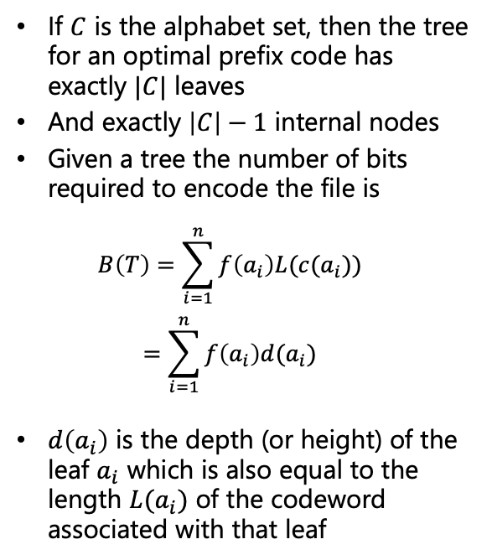
Relation between Prefix Codes and Tree
If $C$ is the alphabet set, then the tree for an optimal prefix code has exactly $|C|$ leaves
And exactly $\left|C\right|−1$ internal nodes
Given a tree the number of bits required to encode the file is
$B\left(T\right)=\sum_{i=1}^{n}{f\left(a_{i}\right)L(c(a_{i}))}$
$=\sum_{i=1}^{n}{f\left(a_{i}\right)d(a_{i})}$
$d\left(a_{i}\right)$ is the depth (or height) of the leaf $a_{i}$ which is also equal to the length $L(a_{i})$ of the codeword associated with that leaf
100
0
1
45
55
0
1
0: a
25
30
0
1
0
1
12
13
14
16
0
1
111: d
100: c
101: b
1100: f
5
9
1101: e

Slide 45
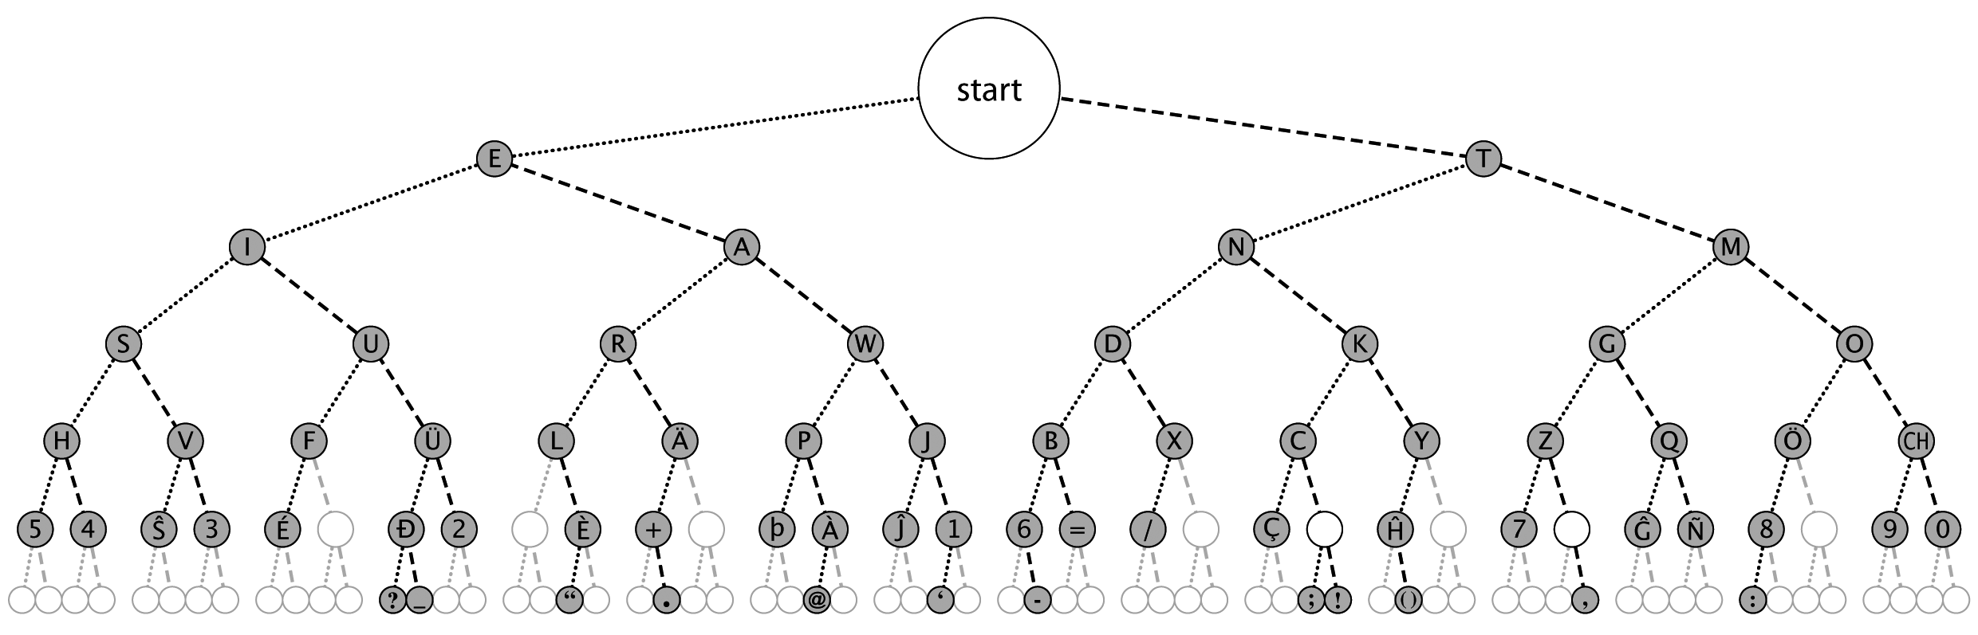
Morse Code is Non-prefix
Taken from wikipedia. Attribution to author: By The original uploader was Aris00 at English Wikipedia. - Transferred from en.wikipedia to Commons. Transfer was stated to be made by User:Ddxc., CC BY-SA 3.0, https://commons.wikimedia.org/w/index.php?curid=3177632

Slide 46
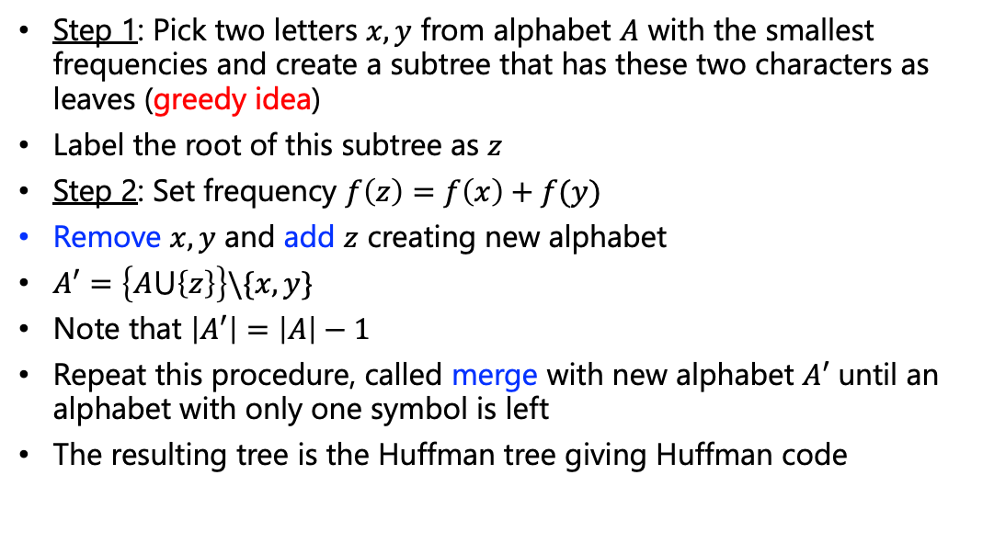
Finding Huffman Code
Step 1: Pick two letters $x,y$ from alphabet $A$ with the smallest frequencies and create a subtree that has these two characters as leaves (greedy idea)
Label the root of this subtree as $z$
Step 2: Set frequency $f\left(z\right)=f\left(x\right)+f(y)$
Remove $x,y$ and add $z$ creating new alphabet
$A^{′}=\left\{A⋃\left\{z\right\}\right\}\backslash \{x,y\}$
Note that $\left|A^{′}\right|=\left|A\right|−1$
Repeat this procedure, called merge with new alphabet $A′$ until an alphabet with only one symbol is left
The resulting tree is the Huffman tree giving Huffman code

Slide 47
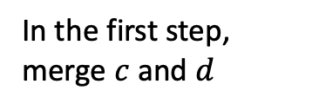
Example of Huffman Coding
Let the alphabet $A$ along with its frequency distribution is
New alphabet $A′$ is
18
15
5
20
15
45
In the first step, merge $c$ and $d$
0
1
a
b
c
d
e
5
15
c
d
20
0
1
5
15
c
d

Slide 48

Example of Huffman Coding
New alphabet $A′$ is
18
33
15
20
45
Next, merge $a$ and $b$
0
1
0
1
a
b
e
15
18
5
15
b
a
c
d
20
33
0
1
0
1
5
15
15
18
c
d
b
a

Slide 49
Example of Huffman Coding
New alphabet $A′$ is
33
53
20
45
Next, merge nodes with freq 20 and 33
0
0
1
1
0
1
e
15
20
18
5
33
15
0
1
0
1
b
a
c
d
5
15
15
18
c
d
b
a
0
53
1
20
33
0
1
0
1
5
15
15
18
c
d
b
a

Slide 50
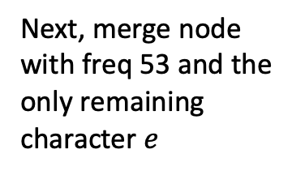

Example of Huffman Coding
New alphabet $A′$ is
empty
53
45
Next, merge node with freq 53 and the only remaining character $e$
0
1
e
20
33
0
1
0
1
5
15
15
18
c
d
b
a
98
0
1
0
53
1
45
e
20
33
0
1
0
1
5
15
15
18
c
d
b
a

Slide 51
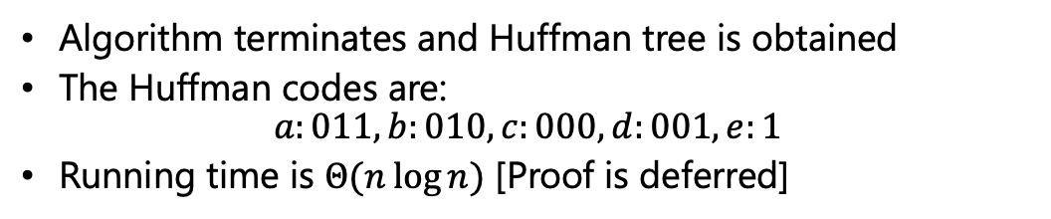
Example of Huffman Coding
Algorithm terminates and Huffman tree is obtained
The Huffman codes are:
$a:011, b:010, c:000,d:001, e:1$
Running time is $Θ(n\log{n})$ [Proof is deferred]
0
98
1
0
53
1
45
e
20
33
0
1
0
1
5
15
15
18
c
d
b
a

Slide 52
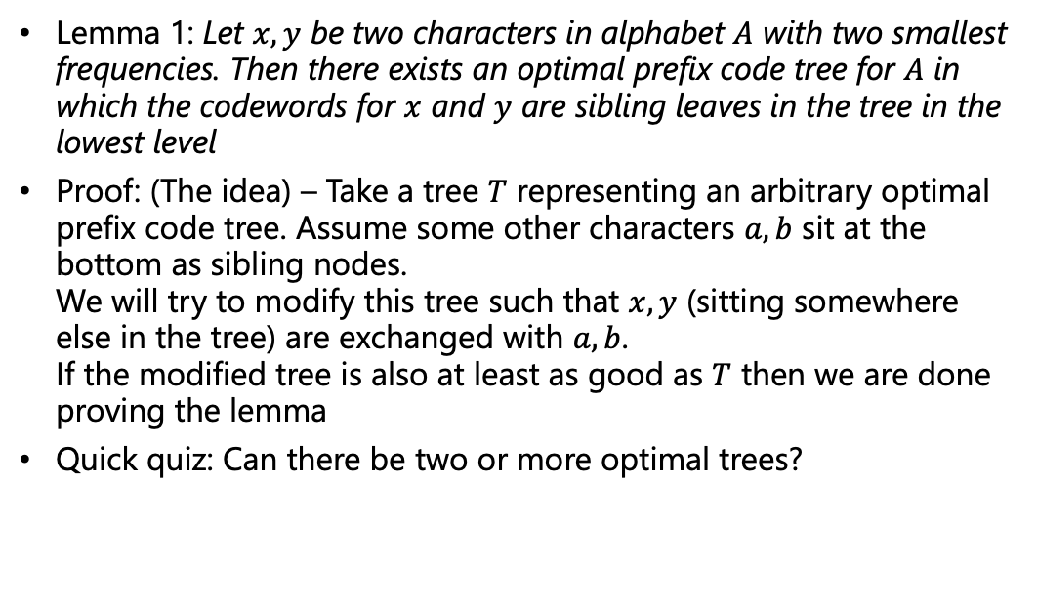
Optimality of Huffman Coding
Lemma 1: Let $x, y$ be two characters in alphabet $A$ with two smallest frequencies. Then there exists an optimal prefix code tree for $A$ in which the codewords for $x$ and $y$ are sibling leaves in the tree in the lowest level
Proof: (The idea) – Take a tree $T$ representing an arbitrary optimal prefix code tree. Assume some other characters $a,b$ sit at the bottom as sibling nodes.
We will try to modify this tree such that $x,y$ (sitting somewhere else in the tree) are exchanged with $a,b$.
If the modified tree is also at least as good as $T$ then we are done proving the lemma
Quick quiz: Can there be two or more optimal trees?
Notes:
Answer to quiz: Yes. Optimal value of the obj func is unique but the argument (i.e., tree here) optimizing the obj func can be more than one. Just think of an optimal tree and switch the two leaves of the same parent at the bottom.

Slide 53

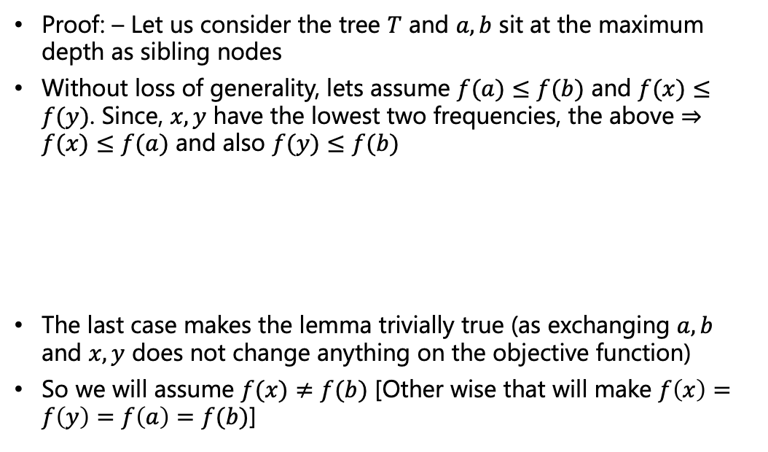



Optimality of Huffman Coding
Proof: – Let us consider the tree $T$ and $a,b$ sit at the maximum depth as sibling nodes
Without loss of generality, lets assume $f(a)≤f(b)$ and $f(x)≤f(y)$. Since, $x,y$ have the lowest two frequencies, the above $⇒$ $f(x)≤f(a)$ and also $f(y)≤f(b)$
The last case makes the lemma trivially true (as exchanging $a,b$ and $x,y$ does not change anything on the objective function)
So we will assume $f(x)≠f(b)$ [Other wise that will make $f\left(x\right)=f\left(y\right)=f\left(a\right)=f(b)$]
$$f$$
$$f$$
$$f$$
$$f$$
$$f$$
$$f$$
$$f$$
$$x$$
$$y$$
$$a$$
$$b$$
$$x$$
$$y$$
$$a$$
$$b$$
$$x$$
$$y$$
$$a$$
$$b$$
$$x$$
$$y$$
$$a$$
$$b$$
$$x$$
$$y$$
$$a$$
$$b$$
$$x$$
$$y$$
$$a$$
$$b$$
$$x$$
$$y$$
$$a$$
$$b$$
Notes:
f(d_x+d_y)+f(d_a+d_b) – f(d_a+d_b)-f(d_x+d_x) = 0

Slide 54
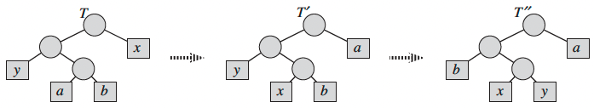
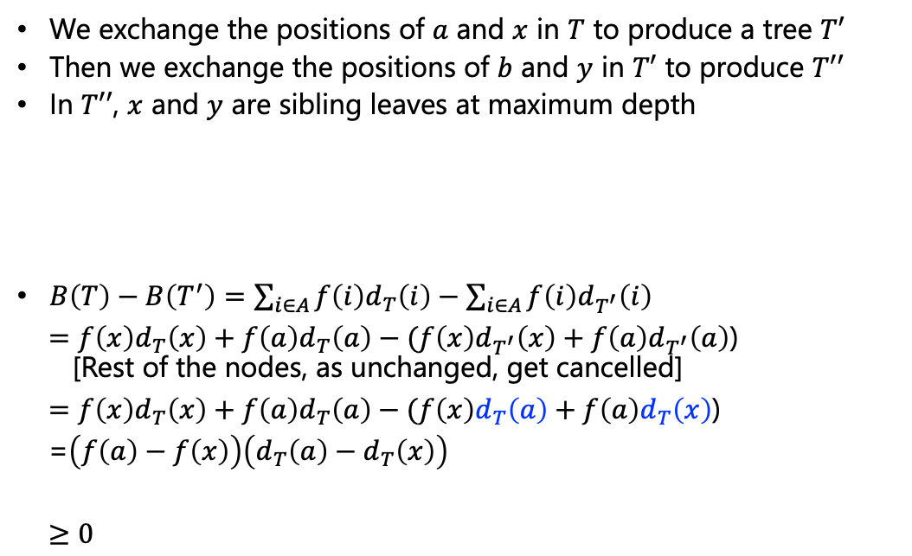


Optimality of Huffman Coding
We exchange the positions of $a$ and $x$ in $T$ to produce a tree $T′$
Then we exchange the positions of $b$ and $y$ in $T′$ to produce $T′′$
In $T′′$, $x$ and $y$ are sibling leaves at maximum depth
$B\left(T\right)−B\left(T^{′}\right)=\sum_{i∈A}{f\left(i\right)d_{T}\left(i\right)}−\sum_{i∈A}{f\left(i\right)d_{T^{′}}\left(i\right)}$
$=f\left(x\right)d_{T}\left(x\right)+f\left(a\right)d_{T}\left(a\right)−(f\left(x\right)d_{T^{′}}\left(x\right)+f\left(a\right)d_{T^{′}}\left(a\right)$)
[Rest of the nodes, as unchanged, get cancelled]
$=$ $f\left(x\right)d_{T}\left(x\right)+f\left(a\right)d_{T}\left(a\right)−(f\left(x\right)d_{T}\left(a\right)+f\left(a\right)d_{T}\left(x\right)$)
=$\left(f\left(a\right)−f\left(x\right)\right)\left(d_{T}\left(a\right)−d_{T}\left(x\right)\right)$
$≥0$
$$≥0$$
$$≥0$$

Slide 55
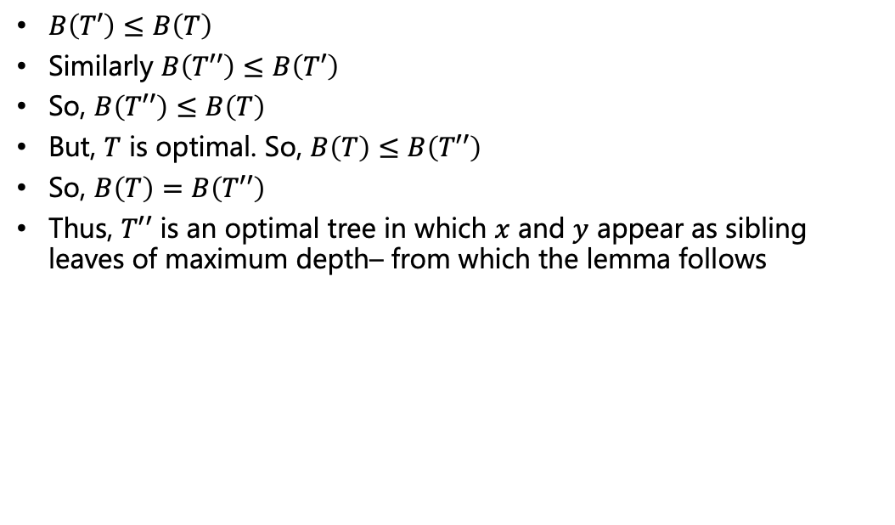
Optimality of Huffman Coding
$B\left(T′\right)≤B\left(T\right)$
Similarly $B\left(T′′\right)≤B\left(T′\right)$
So, $B\left(T′′\right)≤B\left(T\right)$
But, $T$ is optimal. So, $B\left(T\right)≤B\left(T′′\right)$
So, $B\left(T\right)=B\left(T′′\right)$
Thus, $T′′$ is an optimal tree in which $x$ and $y$ appear as sibling leaves of maximum depth– from which the lemma follows

Slide 56
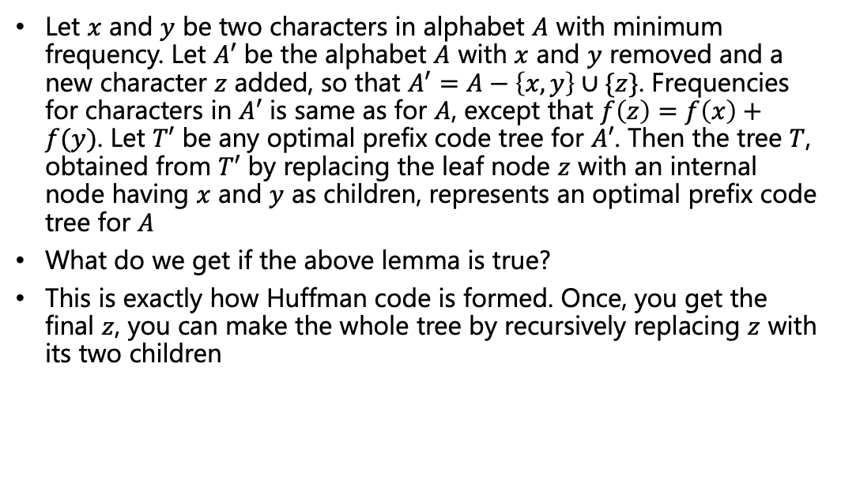
Optimality of Huffman Coding
Let $x$ and $y$ be two characters in alphabet $A$ with minimum frequency. Let $A′$ be the alphabet $A$ with $x$ and $y$ removed and a new character $z$ added, so that $A^{′}=A−\left\{x,y\right\}∪\{z\}$. Frequencies for characters in $A′$ is same as for $A$, except that $f\left(z\right)=f\left(x\right)+f(y)$. Let $T′$ be any optimal prefix code tree for $A′$. Then the tree $T$, obtained from $T′$ by replacing the leaf node $z$ with an internal node having $x$ and $y$ as children, represents an optimal prefix code tree for $A$
What do we get if the above lemma is true?
This is exactly how Huffman code is formed. Once, you get the final $z$, you can make the whole tree by recursively replacing $z$ with its two children

Slide 57
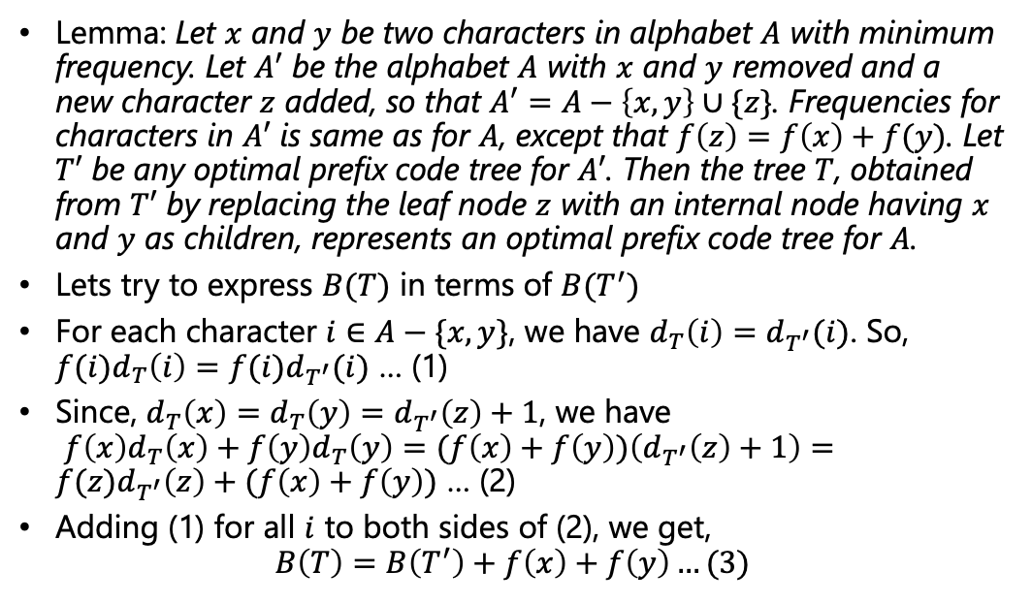
Optimality of Huffman Coding
Lemma: Let $x$ and $y$ be two characters in alphabet $A$ with minimum frequency. Let $A′$ be the alphabet $A$ with $x$ and $y$ removed and a new character $z$ added, so that $A^{′}=A−\left\{x,y\right\}∪\{z\}$. Frequencies for characters in $A′$ is same as for $A$, except that $f\left(z\right)=f\left(x\right)+f(y)$. Let $T′$ be any optimal prefix code tree for $A′$. Then the tree $T$, obtained from $T′$ by replacing the leaf node $z$ with an internal node having $x$ and $y$ as children, represents an optimal prefix code tree for $A$.
Lets try to express $B(T)$ in terms of $B(T^{′})$
For each character $i∈A−\{x,y\}$, we have $d_{T}\left(i\right)=d_{T^{′}}(i)$. So, ${f(i)d}_{T}\left(i\right)={f(i)d}_{T^{′}}(i)$ … (1)
Since, $d_{T}\left(x\right)=d_{T}\left(y\right)=d_{T^{′}}\left(z\right)+1$, we have
$f\left(x\right)d_{T}\left(x\right)+f\left(y\right)d_{T}\left(y\right)=(f\left(x\right)+f\left(y\right))\left(d_{T^{′}}\left(z\right)+1\right)=f(z)d_{T^{′}}\left(z\right)+(f\left(x\right)+f\left(y\right))$ … (2)
Adding (1) for all $i$ to both sides of (2), we get,
$B\left(T\right)=B\left(T^{′}\right)+f\left(x\right)+f\left(y\right)…(3)$

Slide 58
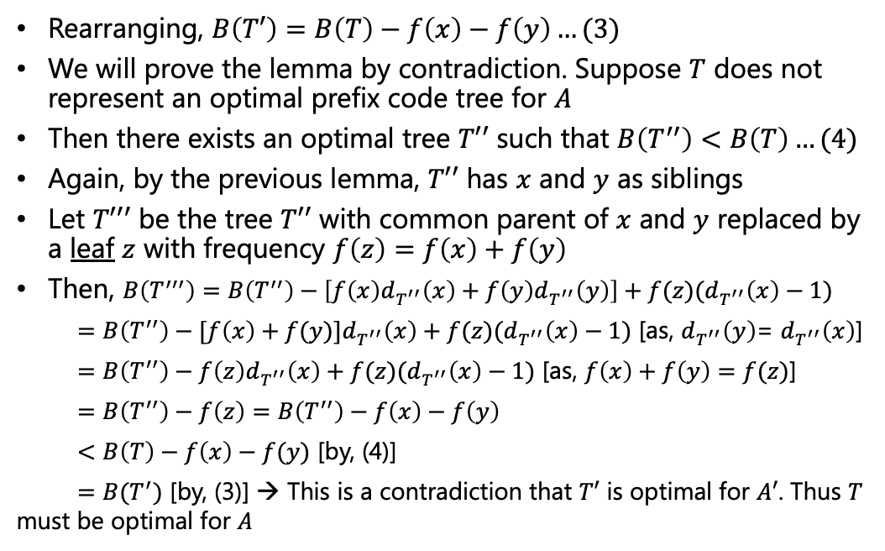
Optimality of Huffman Coding
Rearranging, $B\left(T′\right)=B\left(T\right)−f\left(x\right)−f\left(y\right)…(3)$
We will prove the lemma by contradiction. Suppose $T$ does not represent an optimal prefix code tree for $A$
Then there exists an optimal tree $T′′$ such that $B\left(T^{′′}\right)<B\left(T\right)…(4)$
Again, by the previous lemma, $T′′$ has $x$ and $y$ as siblings
Let $T′′′$ be the tree $T′′$ with common parent of $x$ and $y$ replaced by a leaf $z$ with frequency $f\left(z\right)=f\left(x\right)+f\left(y\right)$
Then, $B\left(T^{′′′}\right)=B\left(T^{′′}\right)−\left[f\left(x\right)d_{T^{′′}}\left(x\right)+f\left(y\right)d_{T^{′′}}\left(y\right)\right]+f(z)(d_{T^{′′}}\left(x\right)−1)$
$=B\left(T^{′′}\right)−[f\left(x\right)+f(y)]d_{T^{′′}}\left(x\right)+f(z)(d_{T^{′′}}\left(x\right)−1)$ [as, $d_{T^{′′}}\left(y\right)$= $d_{T^{′′}}\left(x\right)$]
$=B\left(T^{′′}\right)−f\left(z\right)d_{T^{′′}}\left(x\right)+f(z)(d_{T^{′′}}\left(x\right)−1)$ [as, $f\left(x\right)+f\left(y\right)=f(z)$]
$=B\left(T^{′′}\right)−f\left(z\right)=B\left(T^{′′}\right)−f\left(x\right)−f\left(y\right)$
$<B\left(T\right)−f\left(x\right)−f(y)$ [by, (4)]
$=B(T^{′})$ [by, (3)] → This is a contradiction that $T′$ is optimal for $A′$. Thus $T$ must be optimal for $A$

Slide 59

Tutorial Problems
Given an infinite array in which the first $n$ elements are integers in sorted order and the rest of the cells are filled with some special symbol (say $). Assume we do not know the $n$ value. Give an algorithm that takes an integer $k$ as input and finds a position in the array containing $k$, if the integer $k$ exists in the array in $O(\log{n})$ time

Slide 60

Tutorial Problems
Given a sorted array of non-repeated integers A[1..n], check whether there is an index $i$ for which $A\left[i\right]=i$. Give a divide-and-conquer algorithm that runs in time $O(\log{n})$

Slide 61

Tutorial Problems
We are given two sorted arrays of size n. Give an algorithm for finding the median element in the union of the two lists so that the complexity is $Θ(n)$

Slide 62
Thank You

