Slide 1

Algorithms – I
Assist. Prof. Dr. Abdul Hadi Mohammed
Divide and Conquer, Recursion

Slide 2
Divide and Conquer
General techniques
Merge sort
Recursion Tree Method
Master Theorem

Slide 3
Divide and Conquer
Divide and conquer involves three steps
Divide a problem into pieces (smaller instances of same problem)
  E.g., divide into halves
Conquer the subproblems by solving them recursively
  Can just call the same algorithm on the subproblems (recursively solving)
  Base case: when n=1 (or is small)
Combine solutions to pieces to get answer to original problem
  Combining results from recursive calls.
  Usually the hardest part in the algorithm design

Slide 4
Merge Sort
8
3
2
9
5
1
7
4
8
3
2
9
5
1
7
4
8
3
2
9
5
1
7
4
8
3
2
9
5
1
7
4
3
8
2
9
1
5
4
7
2
3
8
9
1
4
5
7
1
2
3
4
5
7
8
9

Slide 5
Merge Sort
Dividing is easy. The key operation, though, is merge.
How to do merging of two sorted arrays to produce a merged sorted array?
2
5
9
3
4
8

Slide 6
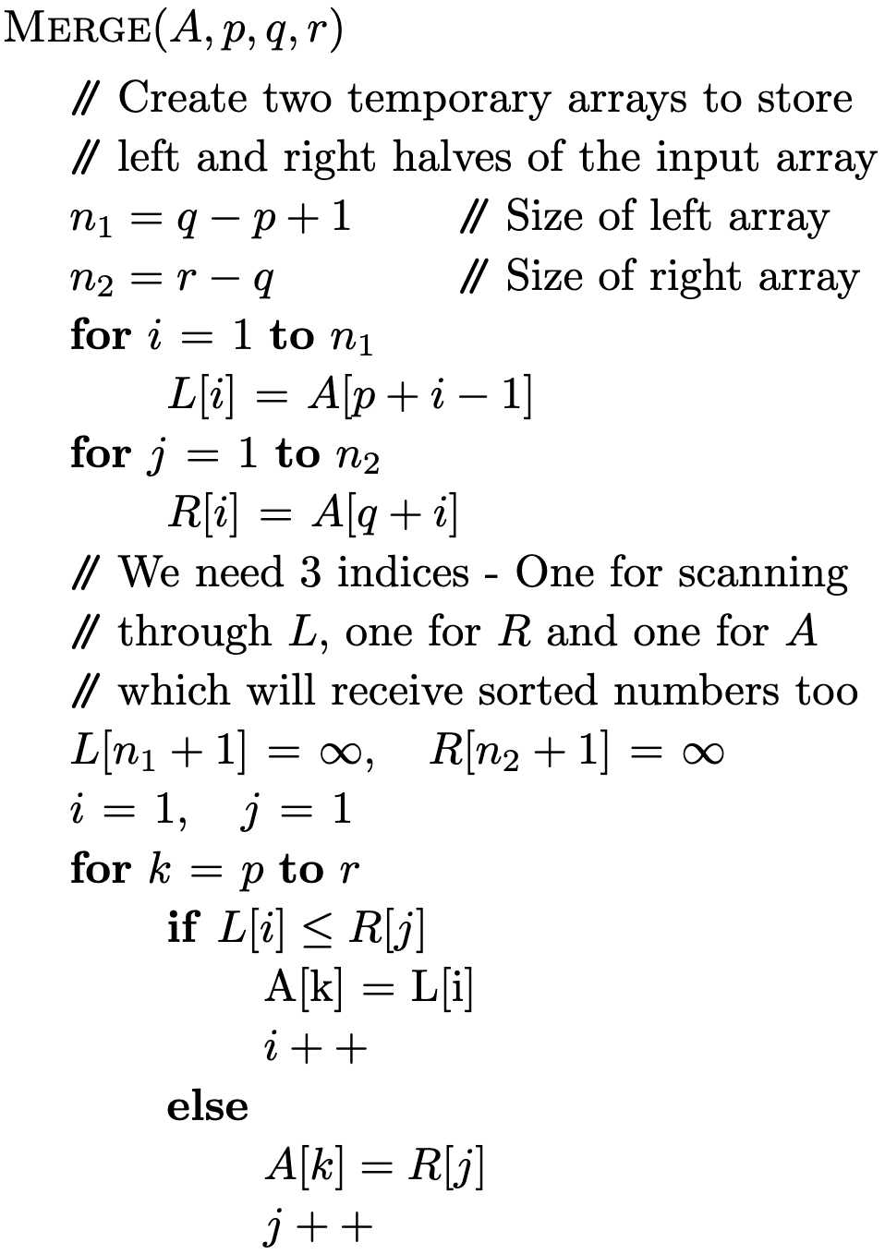
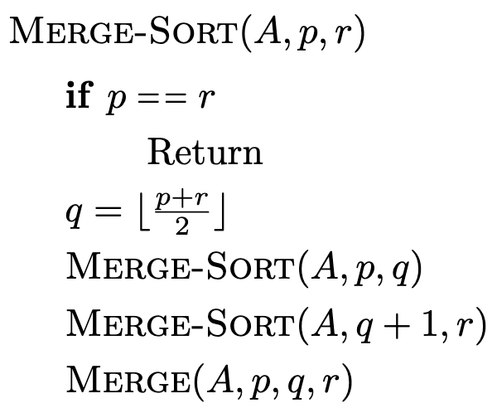
Merge Sort Pseudocode

Slide 7
Merge Sort – In What Order?
8
3
2
9
5
1
7
4
8
3
2
9
5
1
7
4
8
3
2
9
5
1
7
4
8
3
2
9
5
1
7
4
3
8
2
9
1
5
4
7
2
3
8
9
1
4
5
7
1
2
3
4
5
7
8
9

Slide 8




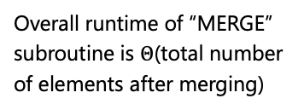


Merge Sort – Runtime Analysis
Total number of elements in two arrays is $n_{1}+n_{2}$
$Θ\left(1\right)$ [Constant time]
$$Θ\left(n_{1}\right)$$
$$Θ\left(n_{2}\right)$$
Overall runtime of “MERGE” subroutine is $Θ$(total number of elements after merging)
$$Θ\left(1\right)$$
$$Θ\left(n_{1}+n_{2}\right)$$

Slide 9
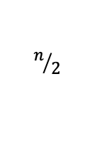





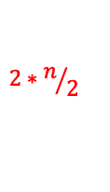

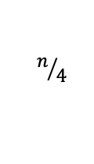















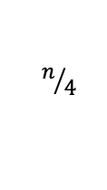




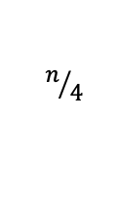



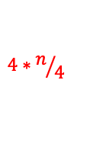



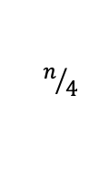


Merge Sort – Runtime Analysis
$$p$$
$$n$$
$$r$$
$$n$$
$$p$$
$$n/2$$
$$r$$
$$p$$
$$n/2$$
$$r$$
$$Θ\left(1\right)$$
$$2∗n/2$$
$$Θ\left(1\right)$$
$$p$$
$$r$$
$$p$$
$$r$$
$$p$$
$$r$$
$$n/4$$
$$p$$
$$r$$
$$n/4$$
$$n/4$$
$$n/4$$
$$4∗n/4$$
$$Θ\left(n\right)$$
$$p=r$$
$$p=r$$
$$p=r$$
$$p=r$$
$$p=r$$
$$p=r$$
$$p=r$$
$$p=r$$
$$n/8$$
$$n/8$$
$$n/8$$
$$n/8$$
$$n/8$$
$$n/8$$
$$n/8$$
$$n/8$$
How do we count the recursive calls?
Recursive calls belong to the next level
Notes:
If two subroutines each are \Theta(n/2), then why not the overall runtime \Theta(n/2). Because – these are separate ‘n/2’ numbers (inputs). – not the same inputs.
We are trying to count the number of levels and number of operations at each level. When we are at a certain level, we count const, const and \Theta(n), the two mergesort recursions will be counted in the next level.

Slide 10
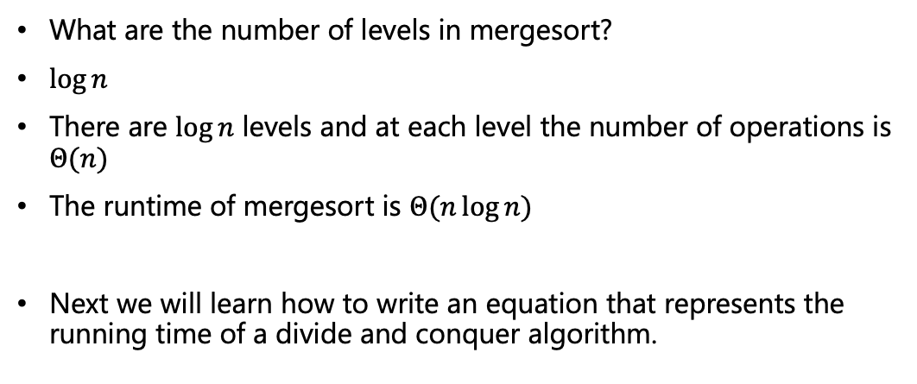
Merge Sort – Runtime Analysis
What are the number of levels in mergesort?
$\log{n}$
There are $\log{n}$ levels and at each level the number of operations is $Θ(n)$
The runtime of mergesort is $Θ(n\log{n})$
Next we will learn how to write an equation that represents the running time of a divide and conquer algorithm.
Notes:
Actually logn + 1, but we don’t care for the +1.

Slide 11


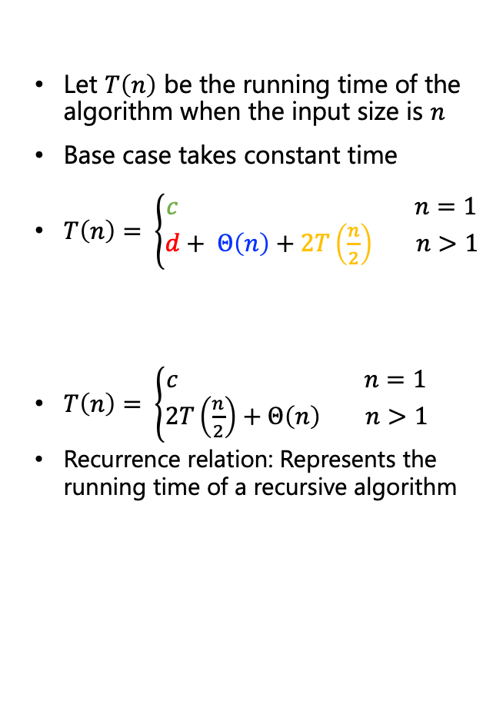
Recurrence Relation
Let $T\left(n\right)$ be the running time of the algorithm when the input size is $n$
Base case takes constant time
$T\left(n\right)= \left\{\begin{aligned}c n=1 \\ d+ Θ\left(n\right)+2T\left(\frac{n}{2}\right) n>1\end{aligned}\right.$
$T\left(n\right)= \left\{\begin{aligned}c n=1 \\ 2T\left(\frac{n}{2}\right)+Θ\left(n\right) n>1\end{aligned}\right.$
Recurrence relation: Represents the running time of a recursive algorithm
Base case
Divide time = const
Conquer time = $T(\frac{n}{2})$ each
Combine time = $Θ(n)$

Slide 12
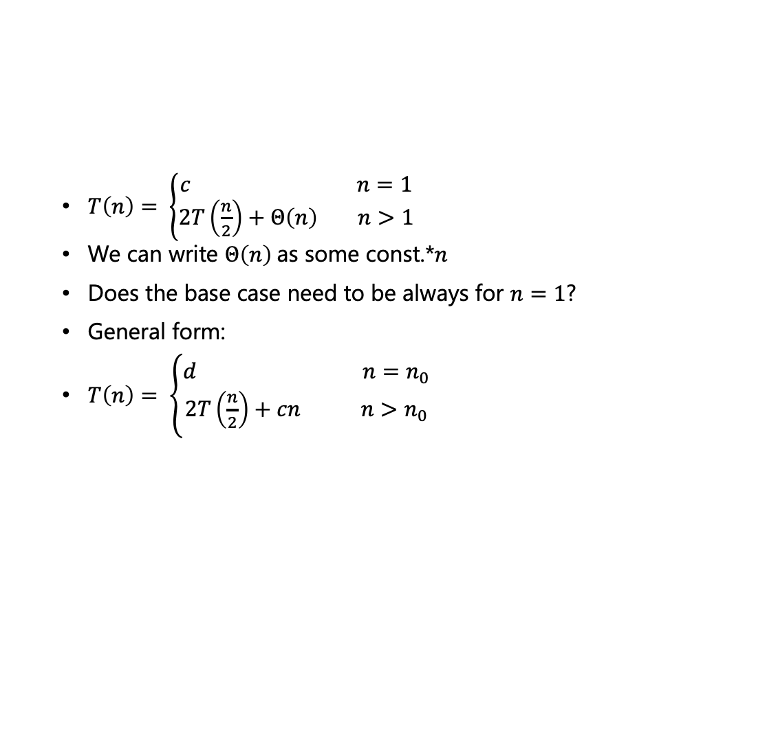
Solving Recurrences – Recursion Tree
$T\left(n\right)= \left\{\begin{aligned}c n=1 \\ 2T\left(\frac{n}{2}\right)+Θ\left(n\right) n>1\end{aligned}\right.$
We can write $Θ\left(n\right)$as some const.*$n$
Does the base case need to be always for $n=1$?
General form:
$T\left(n\right)= \left\{\begin{aligned}d n=n_{0} \\ 2T\left(\frac{n}{2}\right)+cn n>n_{0}\end{aligned}\right.$

Slide 13
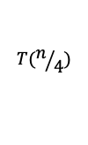




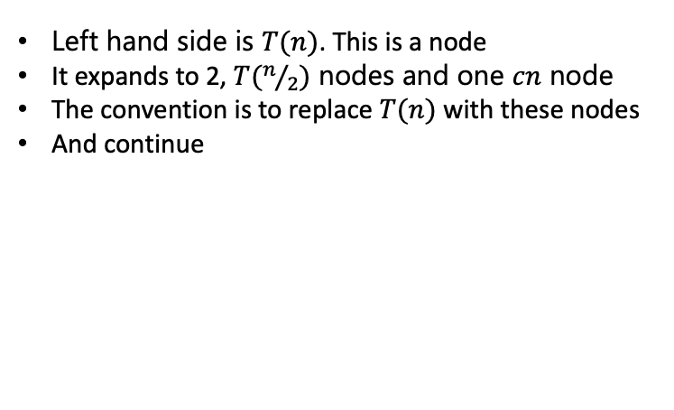
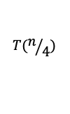
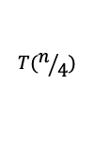
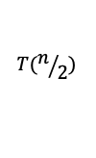


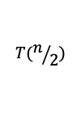

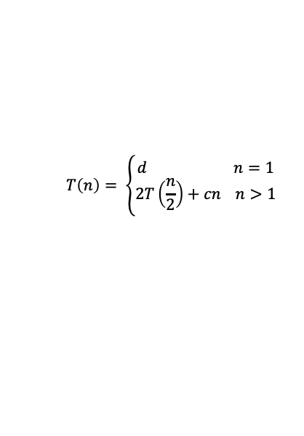
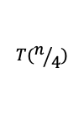

Solving Recurrences – Recursion Tree
$$T\left(n\right)= \left\{\begin{aligned}d n=1 \\ 2T\left(\frac{n}{2}\right)+cn n>1\end{aligned}\right.$$
Left hand side is $T(n)$. This is a node
It expands to 2, $T(n/2)$ nodes and one $cn$ node
The convention is to replace $T(n)$ with these nodes
And continue
$$cn$$
$$T(n)$$
$$T(n)$$
$$T(n/2)$$
$$T(n/2)$$
$$cn$$
$$T(n/2)$$
$$T(n/2)$$
$$T(n/4)$$
$$T(n/4)$$
$${cn}/2$$
$$T(n/4)$$
$$T(n/4)$$
$${cn}/2$$

Slide 14


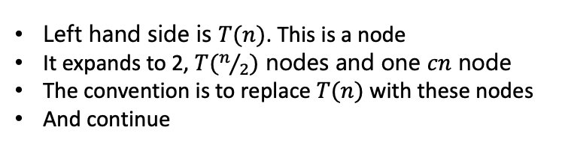
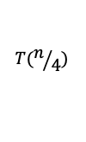


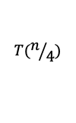



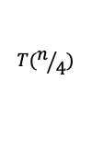

Solving Recurrences – Recursion Tree
$$T\left(n\right)= \left\{\begin{aligned}d n=1 \\ 2T\left(\frac{n}{2}\right)+cn n>1\end{aligned}\right.$$
Left hand side is $T(n)$. This is a node
It expands to 2, $T(n/2)$ nodes and one $cn$ node
The convention is to replace $T(n)$ with these nodes
And continue
$$cn$$
The tree ends when the base case is reached
$$T(n)$$
$${cn}/2$$
$${cn}/2$$
How many $d$ ?
$$T(n/4)$$
$$T(n/4)$$
$$T(n/4)$$
$$T(n/4)$$
Base
$$d$$
$$d$$
$$d$$
$$d$$

Slide 15
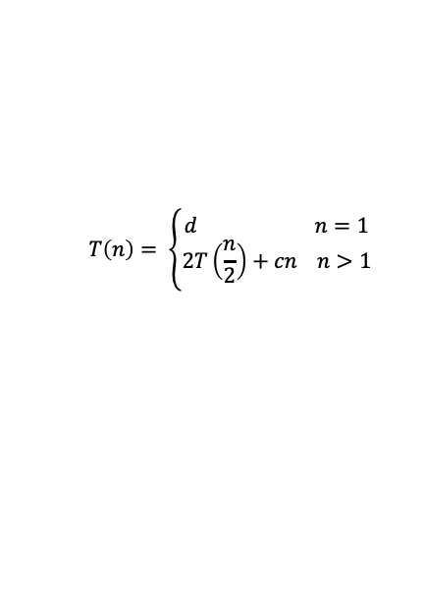




Solving Recurrences – Recursion Tree
$$cn$$
$${cn}/2$$
$${cn}/2$$
$$T\left(n\right)= \left\{\begin{aligned}d n=1 \\ 2T\left(\frac{n}{2}\right)+cn n>1\end{aligned}\right.$$
$${cn}/4$$
$${cn}/4$$
$${cn}/4$$
$${cn}/4$$
Base
$$d$$
$$d$$
$$d$$
$$d$$
Total runtime comes from counting number of operations from the internal nodes and counting them from base nodes
Lets get introduced to trees and some related terminologies as we need
More will come later

Slide 16
Solving Recurrences – Recursion Tree
Graphs are sets of nodes and edges
Trees are a form of a graph with some specialties
Trees have direction (parent/child relationships) and don't contain cycles
Some terminologies
In a Binary Tree, a node can have at most two children
Root
A
B
C
Internal
D
E
F
G
Leaf

Slide 17
Some Terminologies
A
Parent
Left child
Right child
B
Siblings
C
D
E
F
G
A
Root
Left subtree
Right subtree
B
C
D
E
F
G

Slide 18

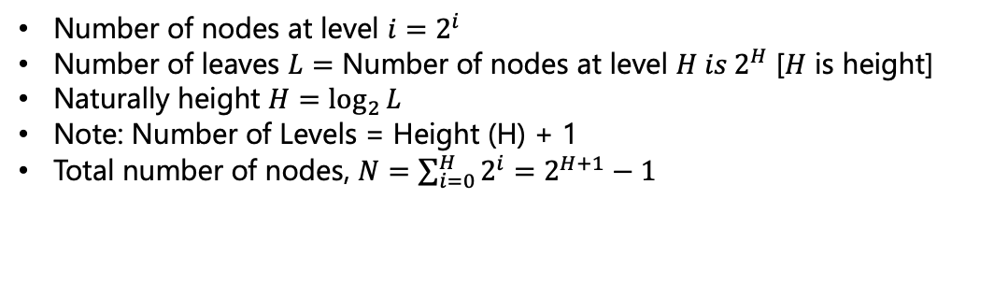



Some Terminologies
Max # of
Nodes
A
Level 0
$$1=2^{0}$$
B
C
Level 1
$$2=2^{1}$$
D
E
F
G
Level 2
$$4=2^{2}$$
I
J
K
L
M
N
O
P
Level 3
$$8=2^{3}$$
Number of nodes at level $i=2^{i}$
Number of leaves $L=$ Number of nodes at level $H is 2^{H}$ [$H$ is height]
Naturally height $H=\log_{2}{L}$
Note: Number of Levels = Height (H) + 1
Total number of nodes, $N=\sum_{i=0}^{H}{2^{i}=2^{H+1}−1}$

Slide 19
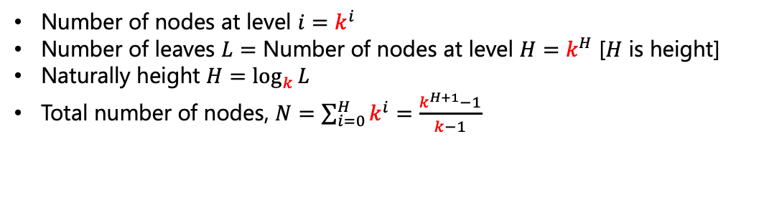
Some Terminologies
A
B
C
D
E
F
G
For general `k’-array Tree
I
J
K
L
M
N
O
P
Number of nodes at level $i=k^{i}$
Number of leaves $L=$ Number of nodes at level $H=k^{H}$ [$H$ is height]
Naturally height $H=\log_{k}{L}$
Total number of nodes, $N=\sum_{i=0}^{H}{k^{i}=\frac{k^{H+1}−1}{k−1}}$

Slide 20


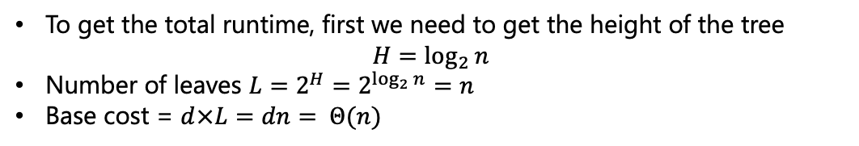
Solving Recurrences – Recursion Tree
Level 0
$$cn$$
$${cn}/2$$
$${cn}/2$$
Level 1
$$T\left(n\right)= \left\{\begin{aligned}d n=1 \\ 2T\left(\frac{n}{2}\right)+cn n>1\end{aligned}\right.$$
$${cn}/4$$
$${cn}/4$$
$${cn}/4$$
$${cn}/4$$
Level $H−1$
Base
$$d$$
$$d$$
$$d$$
$$d$$
Level $H$
To get the total runtime, first we need to get the height of the tree
$H=\log_{2}{n}$
Number of leaves $L=2^{H}=2^{\log_{2}{n}}=n$
Base cost = $d×L=dn= Θ(n)$

Slide 21
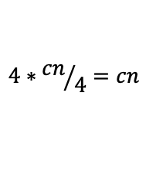
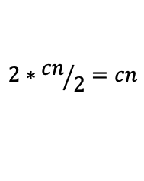

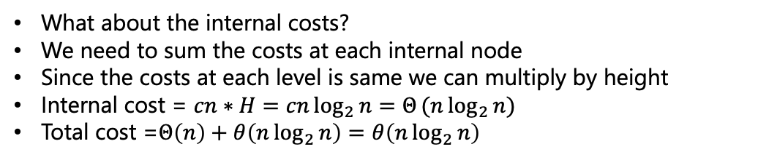
Solving Recurrences – Recursion Tree
Level 0
$$cn$$
$$cn$$
$$2∗{cn}/2=cn$$
$${cn}/2$$
$${cn}/2$$
Level 1
$$4∗{cn}/4=cn$$
$${cn}/4$$
$${cn}/4$$
$${cn}/4$$
$${cn}/4$$
Level $H−1$
Base
$$d$$
$$d$$
$$d$$
$$d$$
Level $H$
What about the internal costs?
We need to sum the costs at each internal node
Since the costs at each level is same we can multiply by height
Internal cost = $cn∗H=cn\log_{2}{n=Θ}(n\log_{2}{n})$
Total cost =$Θ\left(n\right)+θ\left(n\log_{2}{n}\right)=θ\left(n\log_{2}{n}\right)$

Slide 22
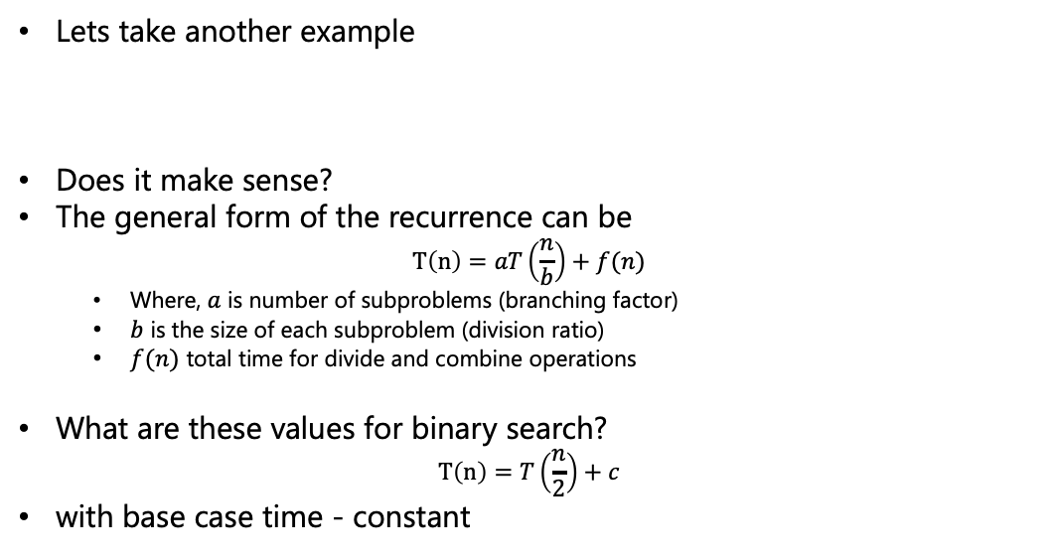
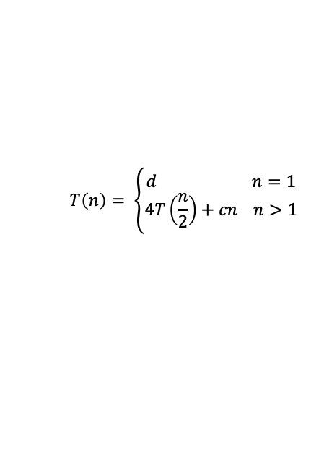
Solving Recurrences – Recursion Tree
Lets take another example
Does it make sense?
The general form of the recurrence can be
$T\left(n\right)=aT\left(\frac{n}{b}\right)+f(n)$
  Where, $a$ is number of subproblems (branching factor)
  $b$ is the size of each subproblem (division ratio)
  $f(n)$ total time for divide and combine operations
What are these values for binary search?
$$T\left(n\right)=T\left(\frac{n}{2}\right)+c$$
with base case time - constant
$$T\left(n\right)= \left\{\begin{aligned}d n=1 \\ 4T\left(\frac{n}{2}\right)+cn n>1\end{aligned}\right.$$

Slide 23
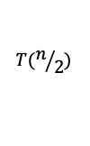

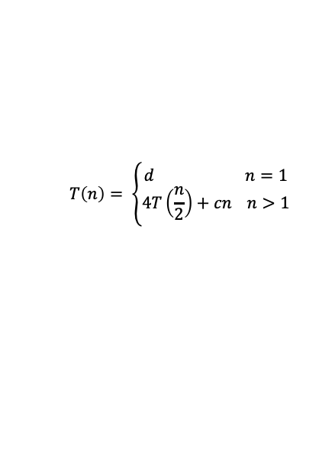
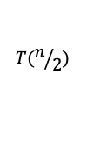



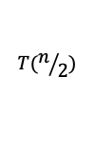

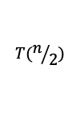





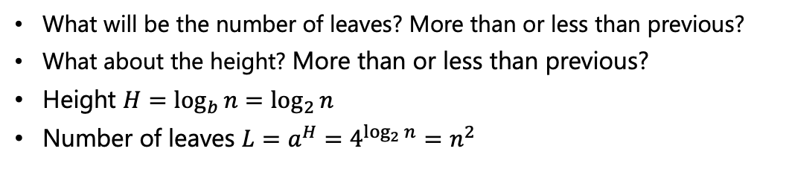
Solving Recurrences – Recursion Tree
$$T\left(n\right)= \left\{\begin{aligned}d n=1 \\ 4T\left(\frac{n}{2}\right)+cn n>1\end{aligned}\right.$$
c$n$
c$n$
$$T(n/2)$$
$$T(n/2)$$
$$T(n/2)$$
$$T(n/2)$$
$${cn}/2$$
$${cn}/2$$
$${cn}/2$$
$${cn}/2$$
$${cn}/4$$
$${cn}/4$$
$${cn}/4$$
$${cn}/4$$
Base
$$d$$
$$d$$
$$d$$
$$d$$
What will be the number of leaves? More than or less than previous?
What about the height? More than or less than previous?
Height $H=\log_{b}{n}=\log_{2}{n}$
Number of leaves $L=a^{H}=4^{\log_{2}{n}}=n^{2}$

Slide 24




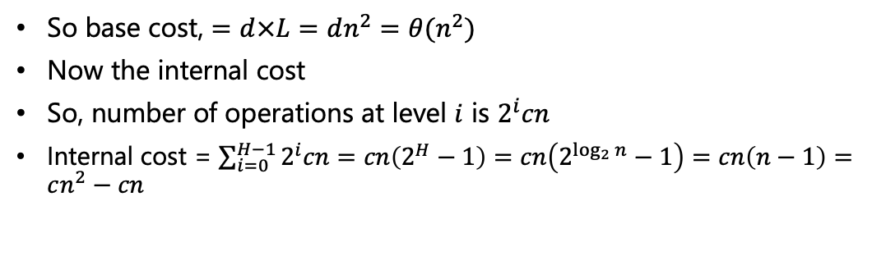

Solving Recurrences – Recursion Tree
$$T\left(n\right)= \left\{\begin{aligned}d n=1 \\ 4T\left(\frac{n}{2}\right)+cn n>1\end{aligned}\right.$$
c$n$
Level 0
$$cn$$
$${cn}/2$$
$${cn}/2$$
$${cn}/2$$
$${cn}/2$$
Level 1
$$4\frac{cn}{2}=2cn$$
$${cn}/4$$
$${cn}/4$$
$${cn}/4$$
$${cn}/4$$
Level 2
$$16\frac{cn}{4}=4cn$$
Level $H−1$
Base
$$d$$
$$d$$
$$d$$
$$d$$
Level $H$
So base cost, $=d×L=dn^{2}=θ(n^{2})$
Now the internal cost
So, number of operations at level $i$ is $2^{i}cn$
Internal cost = $\sum_{i=0}^{H−1}{2^{i}cn}=cn\left(2^{H}−1\right)=cn\left(2^{\log_{2}{n}}−1\right)=cn\left(n−1\right)=cn^{2}−cn$

Slide 25
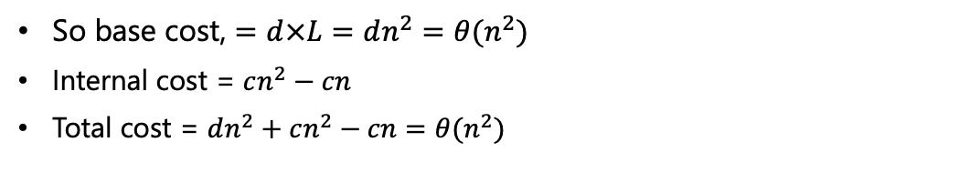
Solving Recurrences – Recursion Tree
$$T\left(n\right)= \left\{\begin{aligned}d n=1 \\ 4T\left(\frac{n}{2}\right)+cn n>1\end{aligned}\right.$$
c$n$
Level 0
$$cn$$
$${cn}/2$$
$${cn}/2$$
$${cn}/2$$
$${cn}/2$$
Level 1
$$4\frac{cn}{2}=2cn$$
$${cn}/4$$
$${cn}/4$$
$${cn}/4$$
$${cn}/4$$
Level 2
$$16\frac{cn}{4}=4cn$$
Level $H−1$
Base
$$d$$
$$d$$
$$d$$
$$d$$
Level $H$
So base cost, $=d×L=dn^{2}=θ(n^{2})$
Internal cost = $cn^{2}−cn$
Total cost = $dn^{2}+cn^{2}−cn=θ(n^{2})$

Slide 26

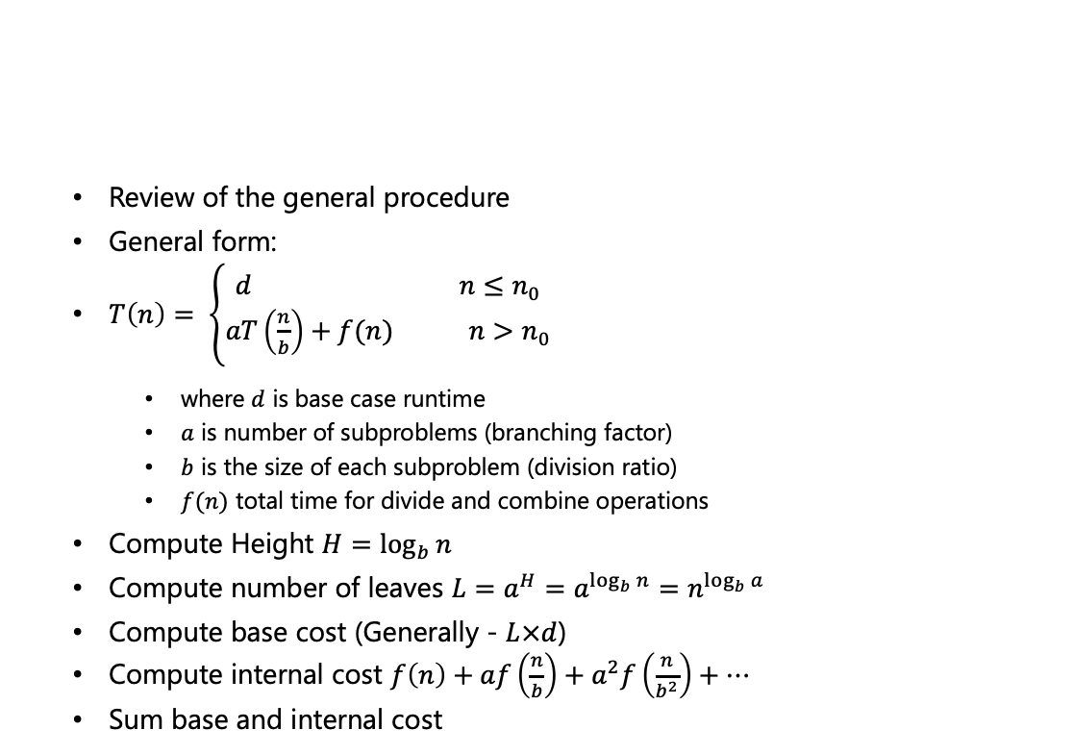







Solving Recurrences – Master Theorem
Review of the general procedure
General form:
$T\left(n\right)= \left\{\begin{aligned}d n≤n_{0} \\ aT\left(\frac{n}{b}\right)+f(n) n>n_{0}\end{aligned}\right.$
  where $d$ is base case runtime
  $a$ is number of subproblems (branching factor)
  $b$ is the size of each subproblem (division ratio)
  $f(n)$ total time for divide and combine operations
Compute Height $H=\log_{b}{n}$
Compute number of leaves $L=a^{H}=a^{\log_{b}{n}}=n^{\log_{b}{a}}$
Compute base cost (Generally - $L×d$)
Compute internal cost $f\left(n\right)+af\left(\frac{n}{b}\right)+a^{2}f\left(\frac{n}{b^{2}}\right)+…$
Sum base and internal cost
$$a$$
$$f(n)$$
$$f(\frac{n}{b})$$
$$f(\frac{n}{b})$$
$$f(\frac{n}{b})$$
$$f(\frac{n}{b})$$
Base
$$d$$
$$d$$
$$d$$

Slide 27
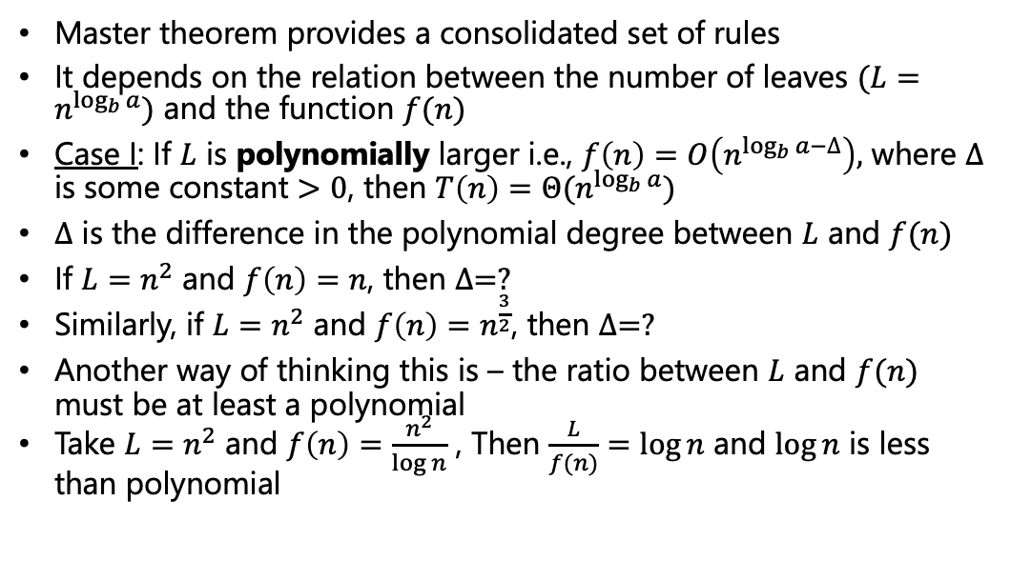
Solving Recurrences – Master Theorem
Master theorem provides a consolidated set of rules
It depends on the relation between the number of leaves $(L=n^{\log_{b}{a}})$ and the function $f(n)$
Case I: If $L$ is polynomially larger i.e., $f\left(n\right)=O\left(n^{\log_{b}{a}−∆}\right),$ where $∆$ is some constant $>0$, then $T\left(n\right)=Θ(n^{\log_{b}{a}})$
$∆$ is the difference in the polynomial degree between $L$ and $f(n)$
If $L=n^{2}$ and $f\left(n\right)=n$, then $∆=?$
Similarly, if $L=n^{2}$ and $f\left(n\right)=n^{\frac{3}{2}}$, then $∆=?$
Another way of thinking this is – the ratio between $L$ and $f(n)$ must be at least a polynomial
Take $L=n^{2}$ and $f\left(n\right)=\frac{n^{2}}{\log{n}}$ , Then $\frac{L}{f(n)}=\log{n}$ and $\log{n}$ is less than polynomial
→ 1
→ 0.5

Slide 28
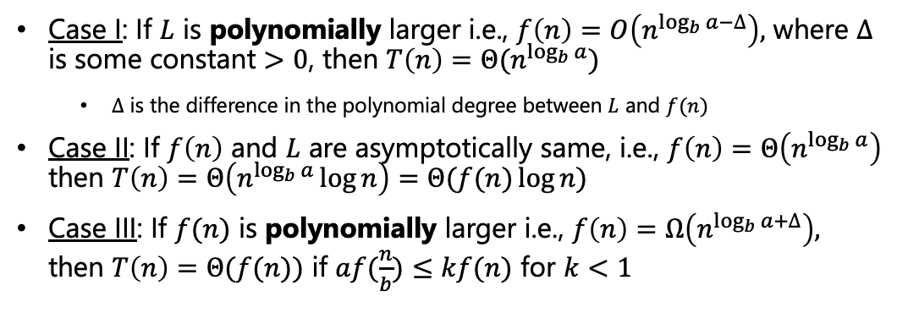
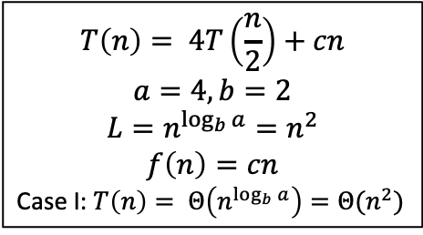
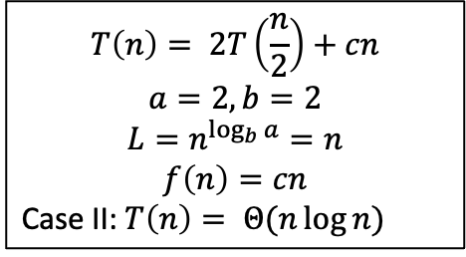
Solving Recurrences – Master Theorem
Case I: If $L$ is polynomially larger i.e., $f\left(n\right)=O\left(n^{\log_{b}{a}−∆}\right),$ where $∆$ is some constant $>0$, then $T\left(n\right)=Θ(n^{\log_{b}{a}})$
  $∆$ is the difference in the polynomial degree between $L$ and $f(n)$
Case II: If $f\left(n\right)$ and $L$ are asymptotically same, i.e., $f\left(n\right)=Θ\left(n^{\log_{b}{a}}\right)$ then $T\left(n\right)=Θ\left(n^{\log_{b}{a}}\log{n}\right)=Θ(f(n)\log{n})$
Case III: If $f(n)$ is polynomially larger i.e., $f\left(n\right)=Ω\left(n^{\log_{b}{a}+∆}\right),$ then $T\left(n\right)=Θ(f(n))$ if $af(\frac{n}{b})≤kf(n)$ for $k<1$
Regularity Condition
$$T\left(n\right)= 2T\left(\frac{n}{2}\right)+cn$$
$$a=2,b=2$$
$$L=n^{\log_{b}{a}}=n$$
$$f\left(n\right)=cn$$
Case II: $T\left(n\right)= Θ(n\log{n})$
$$T\left(n\right)= 4T\left(\frac{n}{2}\right)+cn$$
$$a=4,b=2$$
$$L=n^{\log_{b}{a}}=n^{2}$$
$$f\left(n\right)=cn$$
Case I: $T\left(n\right)= Θ\left(n^{\log_{b}{a}}\right)=Θ(n^{2})$

Slide 29
Quicksort
Quicksort is a sorting algorithm which puts elements in the right places one by one
What is a “right place”?
Is there any element which is at the right place?
3
7
9
5
15
11
4
4
7
9
5
15
11
17
4
7
5
9
15
11
12
Notes:
3 – everything to its right are greater.
17 - everything to its left are smaller.
9 - everything to its left are smaller and everything to its right are greater.
These are not necessarily sorted though

Slide 30
Quicksort
Lets walkthrough an example to understand how quicksort works
The crucial step in quicksort is partioning (divide into two parts such that left of pivot is less and right of pivot is more)
7
6
10
5
9
2
1
15
7

Slide 31
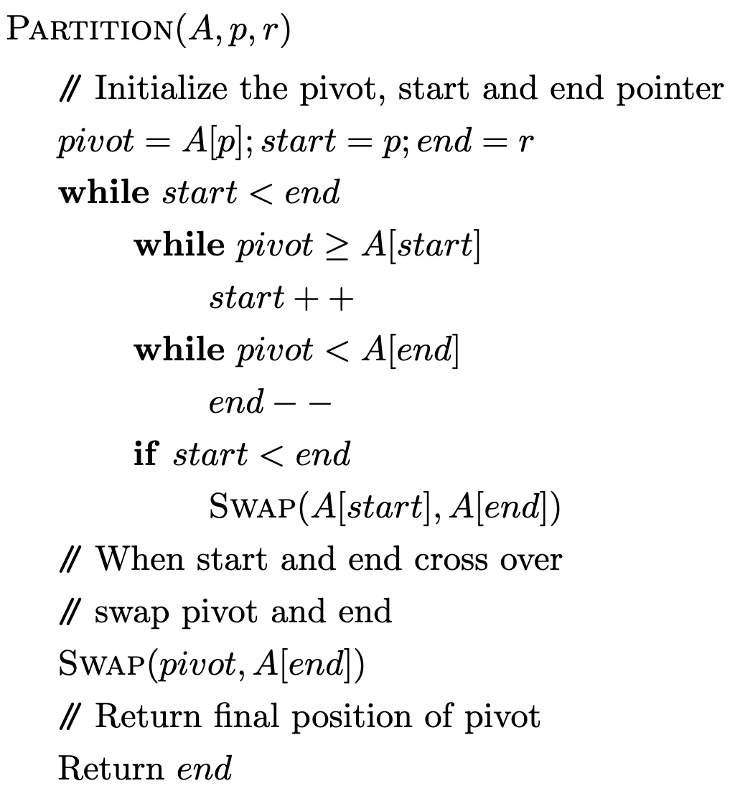
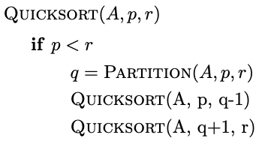
Quicksort

Slide 32




Quicksort – Runtime Analysis
$$Θ\left(1\right)$$
$$Θ\left(n\right)$$
Overall runtime of “PARTITION” subroutine is $Θ(n)$
$$Θ\left(1\right)$$
Notes:
The while loop is \Theta(n) as it comes out of the loop when start and end crosses over and that happens after a total scan of the whole array.

Slide 33

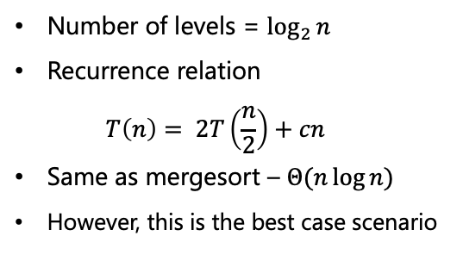
Quicksort – Runtime Analysis
$$Θ\left(n\right)$$
Hard to tell about these.
Lets take two extreme cases
Partitions are perfectly balanced everytime
Number of levels = $\log_{2}{n}$
Recurrence relation
$T\left(n\right)= 2T\left(\frac{n}{2}\right)+cn$
Same as mergesort – $Θ(n\log{n})$
However, this is the best case scenario

Slide 34


Quicksort – Runtime Analysis
$$Θ\left(n\right)$$
Hard to tell about these.
Lets take two extreme cases
Partitions are most unbalanced everytime
Number of levels = $Θ(n)$
Recurrence relation
$T\left(n\right)= T\left(n−1\right)+T(0)+cn$
Lets try to solve this recursive eqn.
$$Const.$$

Slide 35





Quicksort – Runtime Analysis
c$n$
Base case = $const.$
Internal cost at level $i$ is $c(n−i)$
Total internal cost
$c\left(2+3+…n\right)$
$=c\left[\frac{n(n+1)}{2}−1\right]$
$=Θ(n^{2})$
C$(n−1)$
C$(n−2)$
2c
Number of levels = $Θ(n)$
Recurrence relation
$T\left(n\right)= T\left(n−1\right)+T\left(0\right)+cn$
Same as insertion sort – $Θ\left(n^{2}\right)$
This is the worst case scenario
Base case
$$Const.$$

Slide 36

Quicksort – Runtime Analysis
What should the input look like for the best case?
  The medians are chosen as pivots always
What should the input look like for the worst case?
  The input array is already sorted
Probability of getting an already sorted array is $\frac{1}{n!}$
However, the problem can be tackled if instead of always taking the first element as pivot, we take any element as pivot in random
The average-case time complexity of the randomized version of quicksort is $Θ(n\log{n})$
The proof of this involves a more complicated recurrence than we have seen so far.
Notes:
Probability justification – Probability that lowest element is first is 1/n. Given the lowest element is in first position the probability that the second element is in the second position is 1/(n-1), and so on.

Slide 37




Quicksort – Runtime Analysis
We will follow “Introduction to Algorithms and Data Structures” by M. J. Dinneen, G. Gimelfarb, M. C. Wilson for the proof
Let $T(n)$ denote the average-case running time for size $n$ list
In the first step, the time taken to compare all the elements with the pivot is $cn$
Let $0≤i≤n−1$ is the final position of the pivot. So, the two sublists are of size $i$ and $n−i−1$ respectively
The recurrence relation for this $i$ is $T\left(n\right)=T\left(i\right)+T\left(n−1−i\right)+cn$
  Small detail: Last term should be $Θ\left(n\right),$ as it depends on the exact implementation (e.g., whether comparison starts from pivot or one element after, etc.)
$$i$$
$$i$$
$$n−i−1$$
Notes:
We are going by the convention by the book [0 index start]

Slide 38




Quicksort – Runtime Analysis
The recurrence relation for this $i$ is $T\left(n\right)=T\left(i\right)+T\left(n−1−i\right)+cn$
The final pivot position $i$ can be any of the $n$ positions with equal probability
So, the value of $T(n)$ to be $T\left(0\right)+T\left(n−1\right)+cn$ (i.e., $i=0$) has probability $\frac{1}{n}$
Similarly, the value of $T(n)$ to be $T\left(1\right)+T\left(n−2\right)+cn$ (i.e., $i=1$) has probability $\frac{1}{n}$ and so on
So the expected value of $T(n)$ is given by,
$$T\left(n\right)= \frac{1}{n}\sum_{i=0}^{n−1}{\left(T\left(i\right)+T\left(n−1−i\right)+cn\right)=}\frac{1}{n}\sum_{i=0}^{n−1}{\left(T\left(i\right)+T\left(n−1−i\right)\right)+cn}$$
$$i$$
$$i$$
$$n−i−1$$

Slide 39







Quicksort – Runtime Analysis
$T\left(n\right)= \frac{1}{n}\sum_{i=0}^{n−1}{(T\left(i\right)+T\left(n−1−i\right))+cn}$
$T\left(0\right)+T\left(n−1\right)=T\left(n−1\right)+T\left(0\right) for i=0 and i=n−1$
$T\left(1\right)+T\left(n−2\right)=T\left(n−2\right)+T\left(1\right) for i=1 and i=n−2$ and so on
$T\left(n\right)= \frac{1}{n}\sum_{i=0}^{n−1}{(T\left(i\right)+T\left(n−1−i\right))+cn}=\frac{2}{n}\sum_{i=0}^{n−1}{T\left(i\right)+cn}$
Let us rewrite this as $nT\left(n\right)=2\sum_{i=0}^{n−1}{T\left(i\right)+cn^{2}}$
$$i$$
$$i$$
$$i$$
$$n−i−1$$
$$n−i−1$$
$$i$$
Notes:
For n=4 (i.e., 4 elements to sort), L.H.S. is T(0) + T(3) + T(1) + T(2) + T(2) + T(1) + T(3) + T(0). So, naturally, R.H.S. can be, 2[T(0) + T(1) + T(2) + T(3)].

Slide 40

Quicksort – Runtime Analysis
$nT\left(n\right)=2\sum_{i=0}^{n−1}{T\left(i\right)+cn^{2}}$
Replace $n$ by $n−1$ and subtract from the above
$nT\left(n\right)=2\left(T\left(0\right)+T\left(1\right)+…T\left(n−2\right)+T\left(n−1\right)\right)+cn^{2}$
$\left(n−1\right)T\left(n−1\right)=2\left(T\left(0\right)+T\left(1\right)+…+T\left(n−3\right)+T(n−2)\right)+c{\left(n−1\right)}^{2}$
$nT\left(n\right)−\left(n−1\right)T\left(n−1\right)=2T\left(n−1\right)+c\left(n^{2}−{\left(n−1\right)}^{2}\right)$
$nT\left(n\right)=\left(n+1\right)T\left(n−1\right)+c(2n−1)$
Divide everything by $n(n+1)$
$\frac{T(n)}{n+1}=\frac{T(n−1)}{n}+c\frac{2n−1}{n(n+1)}=\frac{T(n−1)}{n}+c\left(\frac{3}{n+1}−\frac{1}{n}\right)$
Last term uses partial fraction decomposition

Slide 41

Quicksort – Runtime Analysis
$\frac{T(n)}{n+1}=\frac{T(n−1)}{n}+c\frac{2n−1}{n(n+1)}=\frac{T(n−1)}{n}+c\left(\frac{3}{n+1}−\frac{1}{n}\right)$
Lets put $n=1, 2,3,…n$
$\frac{T(1)}{2}=\frac{T(0)}{1}+\frac{3c}{2}− \frac{c}{1}$
$\frac{T(2)}{3}=\frac{T(1)}{2}+\frac{3c}{3}− \frac{c}{2}$
$\frac{T(3)}{4}=\frac{T(2)}{3}+\frac{3c}{4}− \frac{c}{3}$
$\frac{T(n)}{n+1}=\frac{T(n−1)}{n}+\frac{3c}{n+1}− \frac{c}{n}$
$\frac{T(n)}{n+1}=\frac{T(0)}{1}+3c\left(\frac{1}{2}+ \frac{1}{3}+\frac{1}{4}+…+\frac{1}{n+1}\right)−c\left(\frac{1}{1}+\frac{1}{2}+\frac{1}{3}+…+\frac{1}{n}\right)$

Slide 42

Quicksort – Runtime Analysis
$\frac{T(n)}{n+1}=\frac{T(0)}{1}+3c\left(\frac{1}{2}+ \frac{1}{3}+\frac{1}{4}+…+\frac{1}{n+1}\right)−c\left(\frac{1}{1}+\frac{1}{2}+\frac{1}{3}+…+\frac{1}{n}\right)$
$\frac{T(n)}{n+1}=\frac{T(0)}{1}−c+\frac{3c}{n+1}+2c\left(\frac{1}{2}+ \frac{1}{3}+\frac{1}{4}+…+\frac{1}{n}\right)=d−c+\frac{3c}{n+1}+2c(H_{n}−1)$
$H_{n}=1+\frac{1}{2}+\frac{1}{3}+…+\frac{1}{n}$ $;d=T(0)$
$T\left(n\right)=\left(d−c\right)\left(n+1\right)+3c+2c\left(n+1\right)\left(H_{n}−1\right)$
$=d+\left(d−3c\right)n+2cH_{n}+2cnH_{n}$
Using a result $H_{n}=Θ(\log{n})$, we can write
$T\left(n\right)=d+\left(d−3c\right)n+2cΘ\left(\log{n}\right)+2cΘ\left(n\log{n}\right)=Θ(n\log{n})$
$H_{n}=Θ\left(\log{n}\right)$ -> This will be shown to be true for a special case, next
Notes:
d is T(0) – a constant time operation

Slide 43




Quicksort – Runtime Analysis
In case, the number of terms in the Harmonic series is a perfect power of 2,i.e., $n=2^{k}$ or $k=\log_{2}{n}$,
$H_{n}=1+\frac{1}{2}+\frac{1}{3}+…+\frac{1}{2^{k}}≤1+\left(\frac{1}{2}+\frac{1}{2}\right)+\left(\frac{1}{4}+\frac{1}{4}+\frac{1}{4}+\frac{1}{4}\right)+(\frac{1}{8}+…$
All the bracketed sums are 1
So, $H_{n}≤k+\frac{1}{n}=\log_{2}{n}+\frac{1}{n}≤\log_{2}{n}+1$ as $1> \frac{1}{n}$
$$k=1$$
$$k=2$$
$$k=3$$

Slide 44

Quicksort – Runtime Analysis
So, $H_{n}≤\log_{2}{n}+1$ … (1)
Again, for $n=2^{k}$ or $k=\log_{2}{n}$,
$H_{n}=1+\frac{1}{2}+\frac{1}{3}+\frac{1}{4}+\frac{1}{5}…+\frac{1}{2^{k}}$
$≥1+\frac{1}{2}+\left(\frac{1}{4}+\frac{1}{4}\right)+\left(\frac{1}{8}+\frac{1}{8}+\frac{1}{8}+\frac{1}{8}\right)+\left(\frac{1}{2^{k}}+…+\frac{1}{2^{k}}\right)$
$=1+\left(\frac{1}{2}+\frac{1}{2}+k times\right)=1+\frac{1}{2}k≥\frac{1}{2}k= \frac{1}{2}\log_{2}{n}$
$H_{n}≥\frac{1}{2}\log_{2}{n}$ … (2)
Combining (1) and (2), $\frac{1}{2}\log_{2}{n}≤H_{n}≤\log_{2}{n}+$1
$H_{n}=Θ(\log_{2}{n})$

Slide 45

Quicksort
Quicksort was proposed by Sir Charles Antony Richard (Tony) Hoare in 1959/60 at age 26
He was trying to sort words for a machine translation project from Russian to English
In his own words – “I have been very lucky. What a wonderful way to start a career in Computing, by discovering a new sorting algorithm!”
Emeritus Professor, Oxford University
Turing award winner, 1980.
source: http://curation.cs.manchester.ac.uk/Turing100/www.turing100.manchester.ac.uk/speakers/invited-list/11-speakers/39-hoare.html

Slide 46

A Quick Animation
Click to play
https://tinyurl.com/3k8pt3a3

Slide 47

Median Finding
Given a set of numbers, a median is the “halfway point” of the set
More formally, given a set of $n$ numbers, medians occur at $i=⌊\frac{n+1}{2}⌋$ (lower median) and at $i=⌈\frac{n+1}{2}⌉$ (upper median)
Following the book, by “median”, we will mean the lower median
We would like to find the median.
If a list is sorted, the median can be easily found out. But that means at least $Θ(n\log{n})$ operation
We would like to do it faster than that
We would like to find $i^{th}$ rank element in a sorted list

Slide 48

Median Finding
The problem is called the selection problem
Input: Set $A$ of $n$ (distinct) numbers and an integer $i$, with $1≤i≤n$
Output: The element $x∈A$ that is larger than exactly $i−1$ other elements of $A$
The idea we will be using is that after the partition operation we know the “right” position of the pivot element. We will use it to discard some “obvious” elements
6
2
9
1
12
5
10
3
CS21003/Algorithms - I | Divide and Conquer

Slide 49
Median Finding - PseudoCode
Select(A, p, r, i)
if p==r
return A[p]
q = Partition(A, p, r)
if i == q
return A[q]
if q > i
return Select(A, p, q, i)
else
return Select(A, q+1, r, i)

Slide 50

Median Finding – Running Time Analysis
Best case is that the first pivot is $i$
What is the running time?
$Θ(n)$ [At least once you have to scan the array to get the partition]
What is the worst case?
(Similar to quicksort) To get the pivot always at one of the ends
The running time is $Θ(n^{2})$ – Same as quicksort
Another best case scenario is – perfectly balanced partitioning at all levels
Recurrence relation for such case is
$T\left(n\right)= T\left(\frac{n}{2}\right)+cn$
CS21003/Algorithms - I | Divide and Conquer

Slide 51


Median Finding – Running Time Analysis
$$T\left(n\right)= T\left(\frac{n}{2}\right)+cn$$
$$a=1,b=2$$
$$L=n^{\log_{b}{a}}=n^{0}=1$$
$$f\left(n\right)=cn$$
Case III: We need to check the regularity condition
$af\left(\frac{n}{b}\right)≤kf\left(n\right)⇒c\frac{n}{2}≤kcn$ – This is true for $\frac{1}{2}≤k<1$
$$T\left(n\right)= Θ(n)$$
Just like quicksort, it can be proven that the average case complexity is also of the same order as the best case complexity i.e., $Θ(n)$

Slide 52

Maximum Sum Subarray
Given an array, we need to find a subarray whose sum of elements among all possible subarray sums is the maximum
The problem will be trivial if the numbers are all positive
By inspection the solution is the subarray from 3 to 9
What can be a brute-force strategy to find this?
As we are looking for start and end positions of the subarray, we can try for all possible start indices and all possible end indices
This means n-choose-2 i.e., $Θ(n^{2})$ algorithm
Can we use divide-and-conquer paradigm to improve the runtime?
-1
3
4
-5
9
-2

Slide 53

Maximum Sum Subarray
The natural first step is to divide the array into half
Then recursively solve the same problem on the divided subarrays
Next we need to combine. While combining, the maximum sum can come from the two subarrays as well from an array that spans across the two subarrays
We need to find the maximum sum corresponding to the subarray crossing the centerline. And we need to find it efficiently.
If we can find the maximum crossing subarray in $Θ(n)$ time, then we have a chance to get $T\left(n\right)=2T\left(\frac{n}{2}\right)+Θ(n)$ recursion leading to $Θ\left(n\log{n}\right)$ overall runtime
-1
3
4
-5
9
-2

Slide 54
Maximum Sum Subarray
6
7
4
-5
4
2
-1
3
4
-5
9
-2
To do so, we will cleverly use the fact that we are trying to find a subarray whose one end lies on the right of the centerline and the other end lies on the left
The maximum subarray crossing the centerline will be a concatenation of 1) a subarray whose one end is the centerline and goes to the left 2) a subarray whose one end is the centerline and goes to the right
So, start at the centerline, keep going to the left, keep doing the sum and keep track of the maximum of the sum. Similarly, for the subarray going to the right from the centerline

Slide 55

Maximum Sum Subarray
6
7
4
-5
4
2
-1
3
4
-5
9
-2
Now we need to compare three sums – 1) one from entirely the left subarray 2) one from entirely the right subarray 3) one from the maximum crossing subarray
Maximum of these three we will return
Runtime of finding the maximum crossing subarray?
$Θ(n)$

Slide 56


Maximum Sum Subarray - Pseudocode

Slide 57



Maximum Sum Subarray Runtime Analysis
$$Θ\left(1\right)$$
$$Θ\left(n\right)$$
$$Θ\left(1\right)$$

Slide 58







Maximum Sum Subarray Runtime Analysis
$$T\left(n\right)=2T\left(\frac{n}{2}\right)+Θ\left(n\right)$$
$$⇒Θ(n\log{n})$$
$$Θ\left(1\right)$$
$$Θ\left(1\right)$$
$$T(\frac{n}{2})$$
$$T(\frac{n}{2})$$
$$Θ\left(n\right)$$
$$Θ\left(1\right)$$

Slide 59



Finding Convex Hull
We will now see two examples in computational geometry where divide and conquer is used effectively
The first problem is finding the convex hull of a set of points
Formally - The convex hull of a set $S$ of points is the smallest convex polygon containing all points in $S$
So, what is a convex polygon?
A convex polygon is a polygon with all its interior angles $<$ 180°
  A line drawn through a convex polygon will intersect the polygon exactly twice
  All the diagonals of a convex polygon lie entirely inside the polygon
Image source: Math Open Reference

Slide 60


Finding Convex Hull
Convex hull of a set of points in a plane is the smallest convex polygon that contains all of them either inside or on its boundary
Imagine that the points are represented by nails sticking out from a board. Convex hull is the shape formed by a tight rubber band that surrounds all the nails

Slide 61

Finding Convex Hull
We would like to have an algorithm that finds the segments/sides of the convex hull given the set of points (their $(x, y)$ co-ordinates)
The book has two efficient algorithms - Graham’s scan and Jarvis’s march
However, we would follow a divide-and-conquer algorithm, famously called as “two finger” algorithm by Prof. Srini Devadas, MIT in his “Design and Analysis of Algorithms” course
Much of the material is taken from his lecture [Link].
CS21003/Algorithms - I | Divide and Conquer

Slide 62










Finding Convex Hull – Problem Definition
Given $n$ points in plane i.e., set $𝕊=\left\{\left(x_{i},y_{i}\right)\right|i=1,2,…,n\}$ and assuming no two points having same $x$ coordinates, no two points having same $y$ coordinates and no three points in a line, we need to find the convex hull (CH($𝕊$)) containing all points in $𝕊$
The assumptions are not limiting, they are just convenient
$$p$$
$$q$$
We will use the following convention to represent the hull
Sequence of points on the boundary in clockwise manner
$$x$$
$$r$$
$$v$$
$$s$$
$$u$$
$$t$$
$$p−q−r−s−t−u−p$$

Slide 63

Finding Convex Hull – Brute Force
Can we think of a simple (can be brute force) algorithm to generate the segments comprising the convex hull?
Draw a line segment connecting a pair of points and check if all the other points are on one side of the segment
$$p$$
$$q$$
Assuming $n$ points, what is the complexity?
$Θ(n^{2})$ number of segments
We need to test roughly $n$ points against each segment
So, total runtime complexity of the brute-force approach is $Θ(n^{3})$
$$x$$
$$r$$
$$v$$
$$s$$
$$u$$
$$t$$

Slide 64

Finding Convex Hull – Divide and Conquer
Lets try to apply divide and conquer
‘Divide’ is pretty straight-forward - dividing them roughly into half
The points are sorted in terms of x-coordinates. Everything to the left of the median is one subproblem and everything to the right is another subproblem
Note that sorting is a single time operation. And it is $Θ(n\log{n})$
Solve for convex hulls for the subproblems
Base case is when the number of points are small – say 2 or 3
Now merging the solutions is where things start to happen

Slide 65









Finding Convex Hull – How to Merge?
Lets try to apply divide and conquer
The naming convention is – for the left subproblem, the first point is the closest to the dividing line (highest $x$). Similarly, for the right subproblem, the first point is the closest to the dividing line (least $x$)
We have got the sub-hulls. To generate the ‘combined’ hull, we need to generate additional segments that are not part of the sub-hulls but are part of the overall hull. Similarly we need to remove the ones that cease to be part of the overall hull
$$b_{1}$$
$$a_{3}$$
$$a_{4}$$
$$a_{0}$$
$$b_{0}$$
$$a_{2}$$
$$a_{1}$$
$$b_{2}$$

Slide 66





Finding Convex Hull – How to Merge?
One way can be picking one point from either side and check if all other points are on one side of the segment joining the two
$a_{3}b_{1}$ looks good. It has the highest $y$ intercept
The maximum $y$ intercept would make sure there is no point higher than the segment
Let us call it an ‘upper tangent’
Similarly $a_{1}b_{2}$ is the ‘lower tangent’
$$y_{31}$$
$$b_{1}$$
$$a_{3}$$
$$a_{4}$$
$$a_{0}$$
$$b_{0}$$
$$y_{41}$$
$$y_{00}$$
$$a_{2}$$
$$a_{1}$$
$$b_{2}$$

Slide 67

Finding Convex Hull – How to Merge?
This trivial strategy of choosing one point each from either side is $Θ(n^{2})$
Can we do better?
May be – for upper tangent, can I go for connecting highest $y$ coordinate points from either side?
This will be constant time but not correct always
$$b_{1}$$
$$a_{3}$$
$$a_{4}$$
$$a_{0}$$
$$b_{0}$$
$$a_{2}$$
$$a_{1}$$
$$b_{2}$$
Notes:
When telling \theta n^2, tell why not \theta n^3 like the brute-force algorithm. Here we don’t need to test rest n points to be on either side. We just have to pick the highest y-intercept.

Slide 68








Finding Convex Hull – Two Finger Algorithm
$$b_{1}$$
Connecting highest
y-coordinate points
$$b_{0}$$
$$b_{2}$$
$$y_{00}$$
$$a_{3}$$
$$a_{2}$$
$$b_{3}$$
$$a_{0}$$
Start with connecting two closest points to the midline on either side
$$a_{1}$$

Slide 69


Finding Convex Hull – Two Finger Algorithm
$$b_{1}$$
$$b_{0}$$
$$b_{2}$$
$$y_{00}$$
$$a_{3}$$
$$y_{01}$$
$$a_{2}$$
$$b_{3}$$
$$a_{0}$$
Move clockwise from $b_{0}$ to $b_{1}$
$$a_{1}$$

Slide 70


Finding Convex Hull – Two Finger Algorithm
$$b_{1}$$
$$b_{0}$$
$$b_{2}$$
$$y_{30}$$
$$y_{00}$$
$$a_{3}$$
$$y_{01}$$
$$a_{2}$$
$$b_{3}$$
$$a_{0}$$
As $y$ intercept decreased, we will go back to $b_{0}$on R.H.S. and move counterclockwise on L.H.S to $a_{3}$
$$a_{1}$$

Slide 71


Finding Convex Hull – Two Finger Algorithm
$$b_{1}$$
$$b_{0}$$
$$b_{2}$$
$$y_{30}$$
$$y_{31}$$
$$y_{00}$$
$$a_{3}$$
$$y_{01}$$
$$a_{2}$$
$$b_{3}$$
$$a_{0}$$
As $y$ intercept increased, we will move clockwise on R.H.S to $b_{1}$
$$a_{1}$$

Slide 72


Finding Convex Hull – Two Finger Algorithm
$$b_{1}$$
$$b_{0}$$
$$y_{20}$$
$$b_{2}$$
$$y_{30}$$
$$y_{31}$$
$$y_{00}$$
$$a_{3}$$
$$y_{01}$$
$$a_{2}$$
$$b_{3}$$
$$a_{0}$$
As $y$ intercept decreased, we will go back to $b_{0}$on R.H.S. and move counterclockwise on L.H.S to $a_{2}$
$$a_{1}$$

Slide 73

Finding Convex Hull – Two Finger Algorithm
$$b_{1}$$
$$b_{0}$$
$$y_{20}$$
$$b_{2}$$
$$y_{30}$$
$$y_{31}$$
$$y_{21}$$
$$y_{00}$$
$$a_{3}$$
$$y_{01}$$
$$a_{2}$$
$$b_{3}$$
$$a_{0}$$
As $y$ intercept increased, we will move clockwise on R.H.S to $b_{1}$
$$a_{1}$$

Slide 74



Finding Convex Hull – Two Finger Algorithm
Move from $b_{0}$to $b_{1}$ as well as $a_{2}$ to $a_{1}$, both resulted in decrease of $y$-intercept. So, the move will stop and $a_{2}b_{0}$ will be the segment with highest $y$-intercept.
$$b_{1}$$
$$b_{0}$$
$$y_{20}$$
$$b_{2}$$
$$y_{30}$$
$$y_{31}$$
$$y_{21}$$
$$y_{10}$$
$$y_{00}$$
$$a_{3}$$
$$y_{01}$$
$$a_{2}$$
$$b_{3}$$
$$a_{0}$$
As $y$ intercept decreased, we will go back to $b_{0}$on R.H.S. and move counterclockwise on L.H.S to $a_{1}$
$$a_{1}$$

Slide 75

PseudoCode
// Initialize counters
i=j=0;
$$while \left(y_{\left(i,j+1\right)}>y_{\left(i,j\right)} OR y_{\left(i−1,j\right)}>y_{\left(i,j\right)}\right)$$
$if \left(y_{\left(i,j+1\right)}\right)>y_{(i,j)} )$ // j+1 is actually (j+1)%p
$j=\left(j+1\right)\%p$
if ${(y}_{\left(i−1,j\right)}>y_{\left(i,j\right)})$// i-1 is actually (i-1)%q
$i=\left(i−1\right)\%q$
Return $(i,j)$
$p$ and $q$ are points on the left and right halves respectively
What about the runtime complexity of the two finger algorithm?

Slide 76









One Final Bit
How to remove the segments that are part of the sub-hulls but not of the overall hull?
Lets say we have found the upper and the lower tangents as $(a_{i},b_{j})$ and $(a_{k},b_{m})$ which for our example were $(a_{2},b_{0})$ and $(a_{1},b_{3})$
Our two sub-hulls are $a_{0},a_{1},a_{2},a_{3}$ and $b_{0},b_{1},b_{2},b_{3}$
$$b_{0}$$
$$b_{1}$$
$$b_{2}$$
$$a_{3}$$
$$b_{3}$$
$$a_{2}$$
$$a_{0}$$
$$a_{1}$$

Slide 77

One Final Bit
How to remove the segments that are part of the sub-hulls but not of the overall hull?
Lets say we have found the upper and the lower tangents as $(a_{i},b_{j})$ and $(a_{k},b_{m})$ which for our example were $(a_{2},b_{0})$ and $(a_{1},b_{3})$
Our two sub-hulls are $a_{0},a_{1},a_{2},a_{3}$ and $b_{0},b_{1},b_{2},b_{3}$
$$b_{0}$$
$$b_{1}$$
Link $a_{i}→b_{j}$ (here $a_{2}→b_{0}$)
Traverse the $b$ list till $b_{m}$ is met
Link $b_{m}$to $a_{k}$ (here $b_{3}$to $a_{1}$)
Traverse the $a$ list till $a_{i}$ is met
$$b_{2}$$
$$a_{3}$$
$$b_{3}$$
$$a_{2}$$
$$a_{0}$$
$$a_{1}$$
So the hull is $(a_{2}→b_{0}→b_{1}→b_{2}→b_{3}→a_{0}→a_{1}→a_{2})$

Slide 78

Closest Pair of Points
Problem definition: Given $n$ points $\left(x_{1},y_{1}\right),…,(x_{n},y_{n})$ in the plane, find the pair $\left(x_{i},y_{i}\right)$ and $\left(x_{j},y_{j}\right)$whose Euclidean distance is as small as possible
Naïve approach: Try every pair of points. $Θ(n^{2})$ runtime

Slide 79

Closest Pair of Points
Can we avoid comparing every pair of points?
How about single dimension case?
In one dimensional case, the structure of the problem setting helps. we only need the distances between adjacent points. So $Θ(n)$.
But we need to sort them first according to the $x$-coordinate values. So its $Θ(n\log{n})$

Slide 80

2 Dimensions – Divide and Conquer
Split the set of points into two halves
  For 2-D points, a good option to split is using a vertical line that divides the set into two of roughly the equal size
  For that we would need to sort the points according to $x$-coordinates
Recursively compute closest pairs in these halves until base case
While combining compute closest pair across two halves

Slide 81

2 Dimensions – Divide and Conquer
One way to compute closest pair across the midline, is to choose one point from either side and compute the distance
This will be $Θ(n^{2})$
But do we really need to consider every pair across the midline?
We only need to consider checking a narrow band across the midline where the band width is twice the minimum distance found on either halves

Slide 82



Closest Pair of Points
Let the closest pair distance on the left and right halves be $δ_{L}$ and $δ_{R}$ respectively and $δ=\min_{}{(δ_{L},δ_{R})}$
However, the same issue of all points to be residing inside the band can occur
Savior: Points on each side separated by at least $δ$. Not enough room for many of them to be packed nearby
This means we need to check only a few pairs crossing the line
$$δ$$
$$δ$$

Slide 83




Closest Pair of Points
Lets consider the point shown in the band
The candidate points can only lie in the two neighboring boxes of size $δ×δ$ shown to the right
Now, how many points can be in these two neighboring boxes?
$$δ$$
$$δ$$
$$δ$$
$$δ$$

Slide 84







Closest Pair of Points
Now, how many points can be in these two neighboring boxes?
Lets subdivide the boxes by half
Maximum one point can be there in these $\frac{δ}{2}×\frac{δ}{2}$ boxes
So at most 8 points to check on the right hand side
$$\frac{δ}{\sqrt{2}}$$
$$\frac{δ}{2}$$
$$\frac{δ}{2}$$
$$\frac{δ}{2}$$
$$\frac{δ}{2}$$
$$δ$$
$$δ$$

Slide 85



Closest Pair of Points
So, for every point in the $δ$ band on the left we have to scan points in the neighboring boxes
This requires the points to be sorted according to $y$-coordinates also
Time for comparison in this window is linear as it’s a fixed number (8 points).
$$δ$$
$$δ$$

Slide 86








Closest Pair of Points - Algorithm
Input: Set of 2-D points (denoted by set $𝒫$)
Assumption: No two points are same in its $x$ or $y$ coordinates. Not a limiting assumption, just convenient
Step 0: Sort all points on both $x$ and $y$ coordinates to get two different lists, say $𝒫_{x}$ and $𝒫_{y}$
When we divide $𝒫$, we need to get corresponding lists in each half
$$𝒫$$
$$𝒬$$
$$ℛ$$
$$𝒬_{y}$$
$$ℛ_{y}$$
$$𝒬_{x}$$
$$ℛ_{x}$$

Slide 87

Closest Pair of Points - Algorithm
Getting $𝒬_{x}$ and $ℛ_{x}$ are easy
To get $𝒬_{y}$ and $ℛ_{y}$, we have to scan $P_{y}$ and points for which $x$ coordinate is less than the midline will be pushed to the list $𝒬_{y}$ and points for which $x$ coordinate is more than the midline will be pushed to the list $ℛ_{y}$
So, in linear time we get $𝒬_{x}, 𝒬_{y}, ℛ_{x},ℛ_{y}$
$$𝒫$$
$$𝒬$$
$$ℛ$$
$$𝒬_{y}$$
$$ℛ_{y}$$
$$𝒬_{x}$$
$$ℛ_{x}$$

Slide 88

Closest Pair of Points - Algorithm
Step 0: Sort all points on both $x$ and $y$ coordinates to get two different lists, say $𝒫_{x}$ and $𝒫_{y}$
Step 1: Call ‘ClosestPair($𝒫_{x},$ $𝒫_{y}$)’
Step 2: If hits base case (2 Points) return the distance between two
Step 3: Recursively call ‘ClosestPair($𝒬_{x},$ $𝒬_{y}$)’ and ‘ClosestPair($ℛ_{x},$ $ℛ_{y}$)’
Step 4: Get closest ‘across-midline’ pair and return minimum of this, left closest and right closest pair
$$𝒬$$
$$ℛ$$
$$𝒬_{y}$$
$$ℛ_{y}$$
$$𝒬_{x}$$
$$ℛ_{x}$$

Slide 89

Closest Pair of Points - Analysis
Step 0: Sort all points on both $x$ and $y$ coordinates to get two different lists, say $𝒫_{x}$ and $𝒫_{y}$ -> $Θ(n\log{n})$
Step 1: Call ‘ClosestPair($𝒫_{x},$ $𝒫_{y}$)’ -> $T(n)$
Step 2: If hits base case (2 Points) return the distance between two
-> $Θ(1)$
Step 3: Recursively call ‘ClosestPair($𝒬_{x},$ $𝒬_{y}$)’ and ‘ClosestPair($ℛ_{x},$ $ℛ_{y}$)’
-> $T(\frac{n}{2})$
Step 4: Get closest ‘across-midline’ pair and return minimum of this, left closest and right closest pair -> $Θ(n)$
So the recurrence relation is
$T\left(n\right)=2T\left(\frac{n}{2}\right)+cn$
So, runtime
$T\left(n\right)= Θ(n\log{n})$

Slide 90
Thank You!!

Slide 91













Level 0
$$log n$$
$$log n$$
$$2∗logn^{1/2}=\log{n}$$
$$\log{n^{1/2}}$$
$$\log{n^{1/2}}$$
Level 1
$$4∗logn^{1/4}=\log{n}$$
$$\log{n^{1/4}}$$
$$\log{n^{1/4}}$$
$$\log{n^{1/4}}$$
$$\log{n^{1/4}}$$
Level $H−1$
Base
$$2$$
$$2$$
$$2$$
$$2$$
Level $H$

