Slide 1
Algorithms
Assist. Prof. Dr. Abdul Hadi Mohammed

Slide 2
Course Information
Books and References:
  Thomas H Cormen, Charles E Lieserson, Ronald L Rivest and Clifford Stein, Introduction to Algorithms. (3rd Edition)
  Jon Kleinberg and Éva Tardos, Algorithm Design, Pearson, 2005.
  Sanjoy Dasgupta, Christos H. Papadimitriou and Umesh V. Vazirani, Algorithms, Tata McGraw-Hill, 2008.
  Jeff Erickson, Algorithms, 2019.
  Mark Allen Weiss, Data Structures and Algorithm Analysis in C.

Slide 3
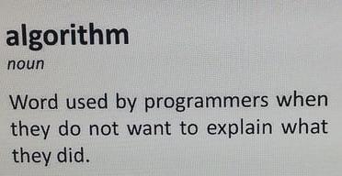

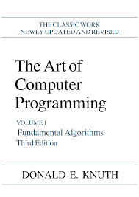

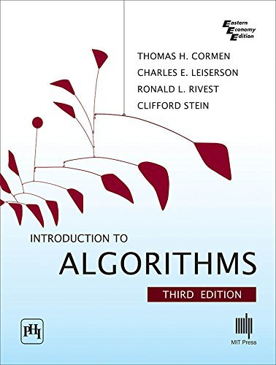
What are algorithms?
Source: http://redd.it/b5mtc7
Dictionary definition: A procedure for solving a mathematical problem (as of finding the greatest common divisor) in a finite number of steps that frequently involves repetition of an operation.
By Donald E Knuth: An algorithm is a finite, definite, effective procedure, with some input and some output.
By Cormen et al.: An algorithm is a sequence of computational steps that transform the input into the output.

Slide 4
Why is the study of algorithms worthwhile?
Especially, modern computers are pretty fast and memory cost is low
(If for no other reason) – show that your algorithm produces the right answer always
Different algorithms for the same problem often differ dramatically in terms of efficiency
Before showing an example, lets step into the practical world!

Slide 5
Why is the study of algorithms worthwhile?
typical job interview process, e.g., Google’s software developer [Source: Link]
Round 1: online assessment (~90 Minutes)
  Two data structures and algorithms questions you have to complete
  Write your own test cases and must pass all test cases that you cannot see
  You can use any IDE of your choice
  The recruiter will not review your resume if you do not pass the OA
Round 2: Technical phone interview
  Solve data structure and algorithm questions
  Write code (usually in txt/cloud doc) and explain the correctness/time complexity
  Additional behavioral questions that are usually not decisive

Slide 6
Why is the study of algorithms worthwhile?
typical job interview process, e.g., Google’s software developer [Source: Link]
Round 3: Onsite interviews
  Spend a full day at a Google office and do four to six interviews.
  Topics asked are usually data structure and algorithm and system design
  You are expected to do extremely well in coding interviews
Of course, algorithms are also important for doing research in all CS areas

Slide 7
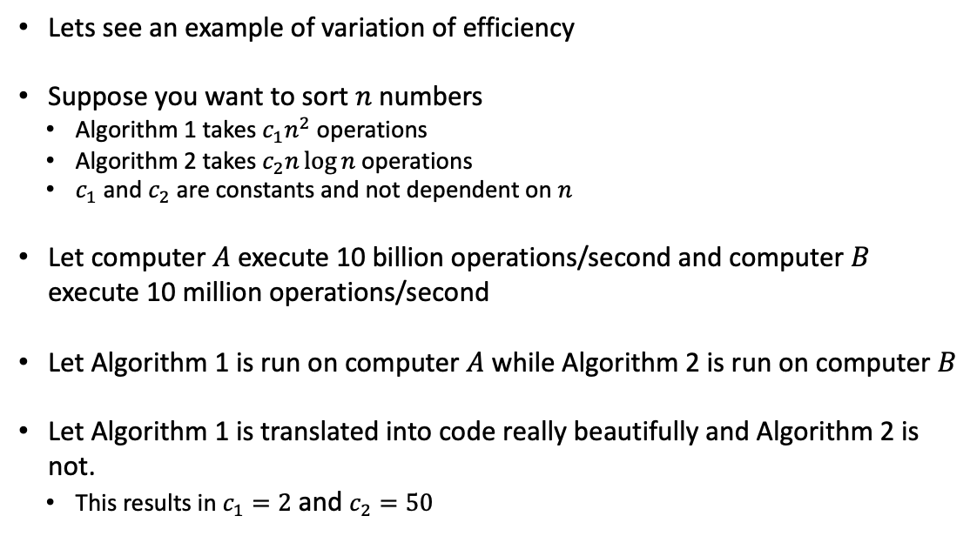
Why is the study of algorithms worthwhile?
Lets see an example of variation of efficiency
Suppose you want to sort $n$ numbers
  Algorithm 1 takes $c_{1}n^{2}$ operations
  Algorithm 2 takes $c_{2}n\log{n}$ operations
  $c_{1}$ and $c_{2}$ are constants and not dependent on $n$
Let computer $A$ execute 10 billion operations/second and computer $B$ execute 10 million operations/second
Let Algorithm 1 is run on computer $A$ while Algorithm 2 is run on computer $B$
Let Algorithm 1 is translated into code really beautifully and Algorithm 2 is not.
  This results in $c_{1}=2$ and $c_{2}=50$

Slide 8
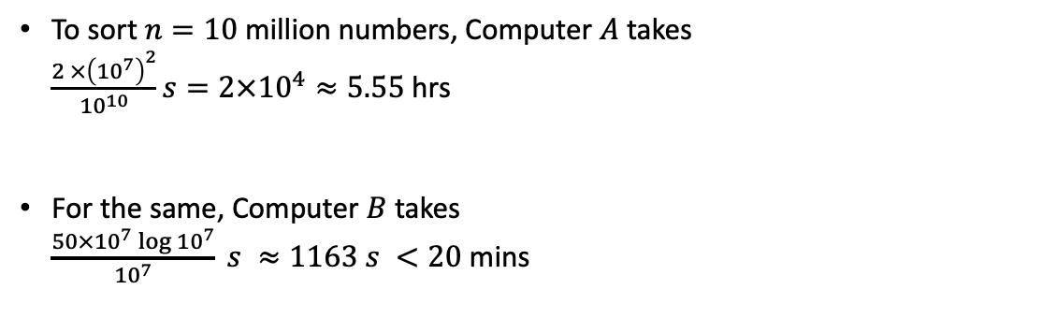
Why is the study of algorithms worthwhile?
To sort$n=10$ million numbers, Computer $A$ takes
$\frac{2 ×{\left({10}^{7}\right)}^{2}}{{10}^{10}}s=2×{10}^{4}≈5.55$hrs
For the same, Computer $B$ takes
$\frac{50×{10}^{7}\log{{10}^{7}}}{{10}^{7}} s ≈1163 s <20$ mins

Slide 9
First Algorithm: Insertion Sort
key
5
2
4
6
1
3
1
2
4
5
6
1
3
2
5
2
4
6
1
3
1
2
4
5
6
6
3
2
5
5
4
6
1
3
1
2
4
5
5
6
3
2
2
5
4
6
1
3
1
2
4
4
5
6
3
4
2
5
4
6
1
3
1
2
2
4
5
6
3
4
2
5
5
6
1
3
1
1
2
4
5
6
3
4
2
4
5
6
1
3
3
1
2
4
5
6
3
3
1
2
4
4
5
6
6
2
4
5
6
1
3
3
1
2
4
5
6
6
3
1
2
3
4
5
6
6
2
4
5
6
1
3
3
1
2
4
5
5
6

Slide 10
First Pseudocode: Insertion Sort
Let us write a pseudocode describing this process
But before that – what is a pseudocode and how is it different from a real code?
  Pseudocode does not bother much about language specific syntaxes
  Whatever helps to express the idea is used
  Is not concerned with issues of software engineering

Slide 11
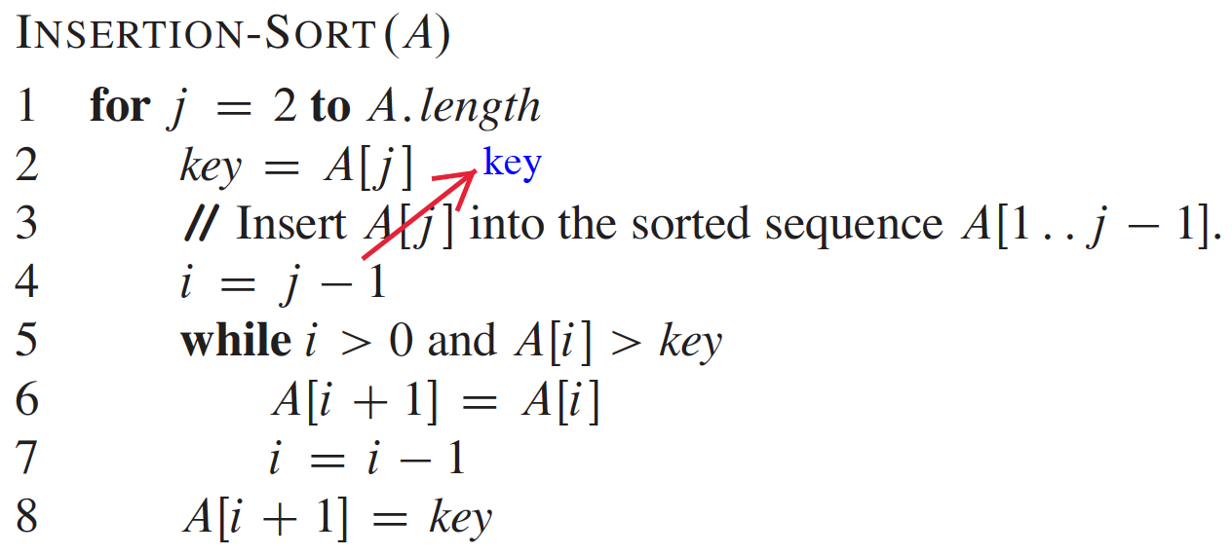
First Pseudocode: Insertion Sort

